Slide 1
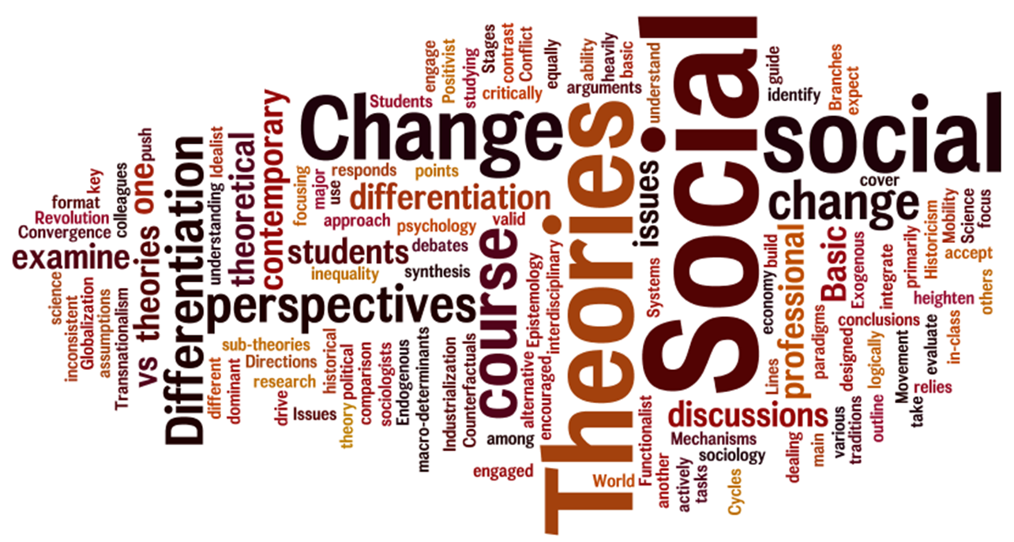
SOCIAL CHANGE

Slide 2
Objectives
Identify and describe the main sources of social change.
Describe the factors that lead people to resist social change.

Slide 3
SIX FACTORS THAT STIMULATE SOCIAL CHANGE
Values and Beliefs
Technology
Population
Diffusion
Physical environment
War and Conquest

Slide 4
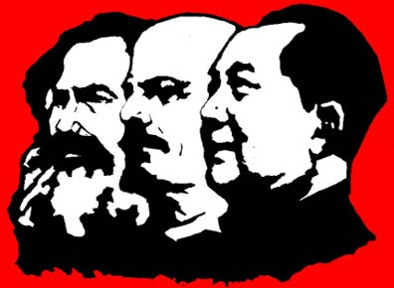
VALUES AND BELIEFS
Change in values/beliefs have the greatest effect on society when they are part of an ideology
Ideology: system of beliefs that justify social, moral, religious, political, or economic interest held by a group
Ideologies are often spread through social movements
Examples throughout history?

Slide 5
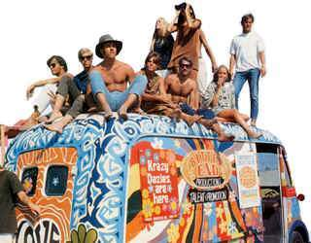
VALUES AND BELIEFS
Examples throughout history?
Temperance
Feminism
Civil Rights
Environmentalism
Gay / Lesbian Rights
Pro Choice / Pro Life

Slide 6
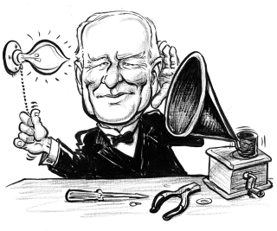
TECHNOLOGY
Social change occurs when people find new ways to manipulate the environment (knowledge + tools = tech)
Example: Fire = Language
Two ways that new technology can arise:
Discovery
Invention

Slide 7
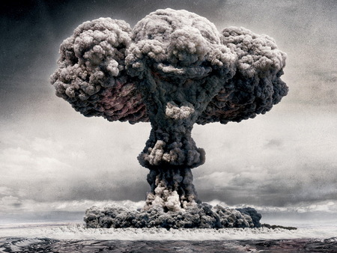
TECHNOLOGY
Two ways that new technology can arise:
Discovery: new use for existing element
Invention: use of existing knowledge to create something that previously did not exist… can be material or non-material… examples?

Slide 8
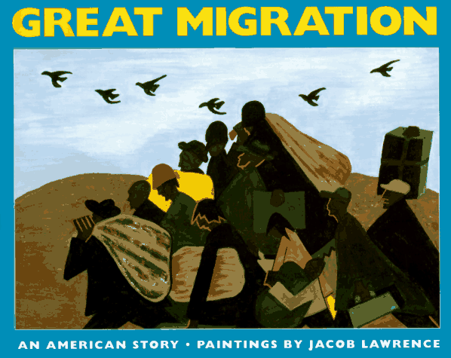
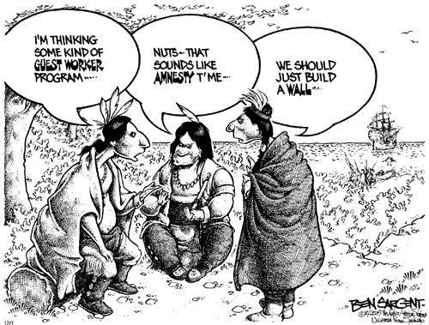
POPULATION
Change in population will most often bring about cultural change
How does this occur?
Immigrants arrive with unique cultural traits that influence American culture… examples?
Migration of people from one part of a country to another can also bring about change… how?

Slide 9
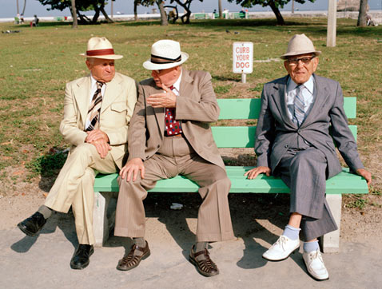

Slide 10
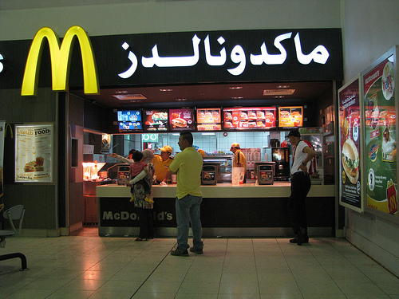
DIFFUSION
The process of spreading cultural traits from one society to another… examples?

Slide 11
DIFFUSION
The process of spreading cultural traits from one society to another… examples?
Societies that have the most contact with each other will have higher levels of diffusion

Slide 12
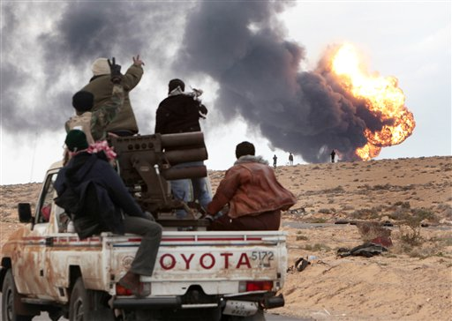
DIFFUSION
The process of spreading cultural traits from one society to another… examples?
Today diffusion takes place much more rapidly that in the past… why?
Generally societies are more willing to adopt material culture than non-material culture

Slide 13
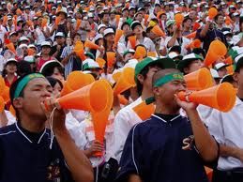
DIFFUSION
The process of spreading cultural traits from one society to another… examples?
Reformulation: adapting a borrowed cultural trait to better fit your society… examples?

Slide 14
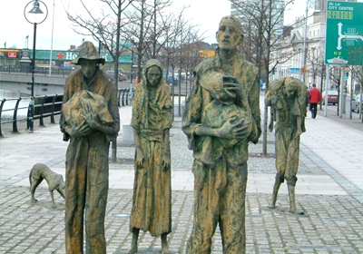
PHYSICAL ENVIRONMENT
Provides conditions that may encourage or discourage change
Food:
Can be produced locally or imported
Introduction of a new food or scarcity of a familiar food can bring about change… examples?

Slide 15
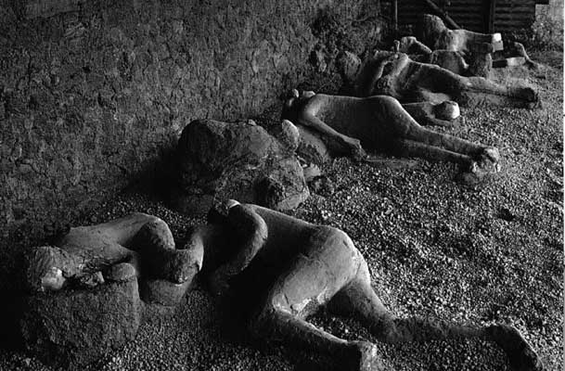
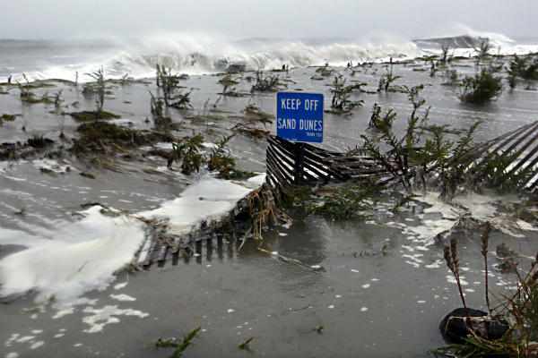
PHYSICAL ENVIRONMENT
Provides conditions that may encourage or discourage change
Natural Disasters:
Can promote change or destroy an entire society

Slide 16
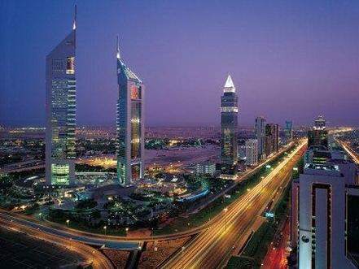
PHYSICAL ENVIRONMENT
Provides conditions that may encourage or discourage change
Natural Resources:
Abundance or shortage can lead to cultural change… how?

Slide 17
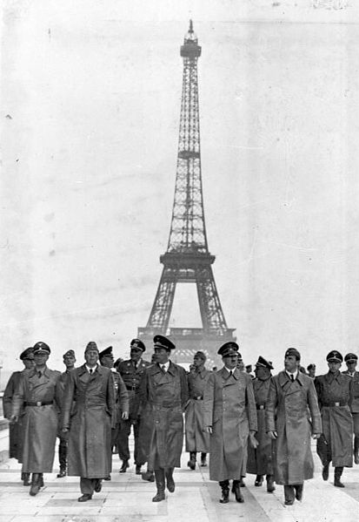
WAR AND CONQUEST
Not as common as
other sources of
societal change.
Brings about the
greatest amount
of change in the
least amount of
time.

Slide 18
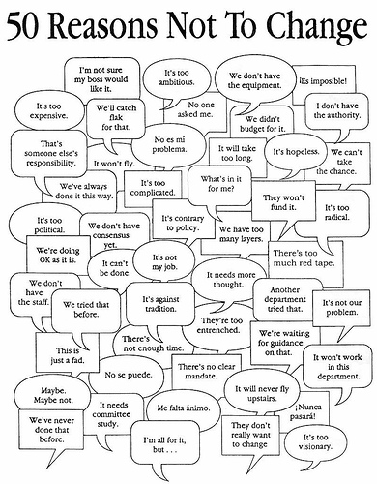
RESISTANCE TO CHANGE
Cultural change rarely occurs without resistance
Social change often results from compromise

Slide 19
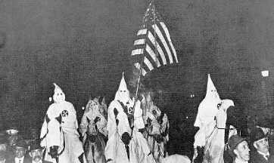
RESISTANCE TO CHANGE
Three forms of / reasons for resistance:
Ethnocentrism

Slide 20
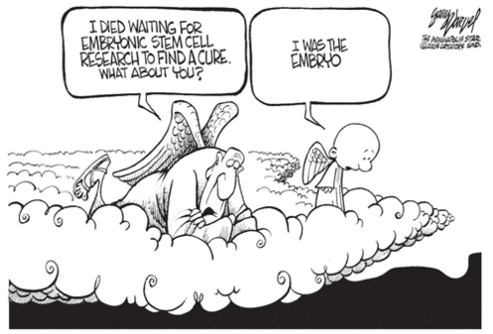
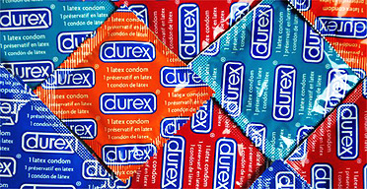
RESISTANCE TO CHANGE
Three forms of / reasons for resistance:
Cultural lag
Common phenomenon due to the tendency of material culture to evolve and change rapidly while, non-material culture tends to resist change and remain fixed for a far longer period of time.

Slide 21
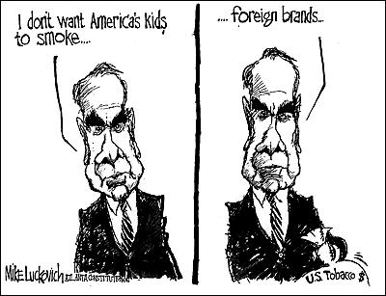
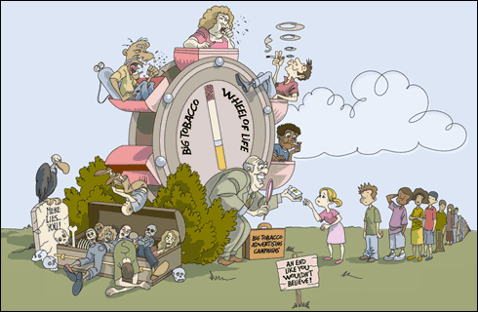
RESISTANCE TO CHANGE
Three forms of / reasons for resistance:
Vested interests
Notion that highly vested attitudes concerning issues are related to an individual’s situational point of view.

