Slide 1
COLONIES REVIEW NOTES

Slide 2
English

Slide 3
Roanoke
The English Wanted To Provide New Markets and Raw Materials for English Industry
Sir Walter Raleigh settled in Roanoke (NC)
It disappeared and became known as the Lost Colony.
Then the English settled in Jamestown.
The VIRGINIA COMPANY was issued a CHARTER which granted them specific rights to create a Colony.

Slide 4
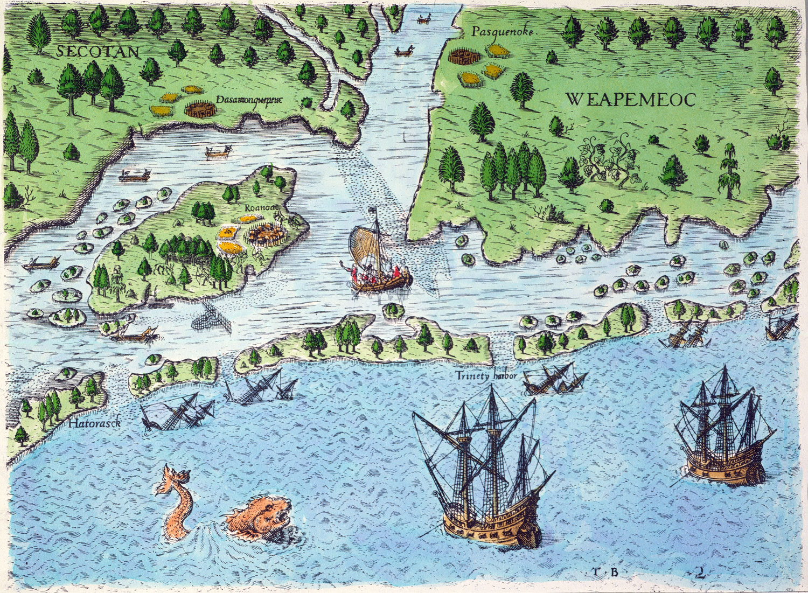
© 2007 McGraw-Hill Higher Education
Notes:
Virginia Map
In the 1580s, especially following the defeat of the Spanish Armada in 1588, England began its first tentative exploration and settlement of the New World. John White, the painter of the map on which this engraving was based, was part of an expedition organized by Sir Walter Raleigh in 1585. He became governor of Roanoke the following year. In 1590, however, he returned to this same harbor from England to find the Roanoke colonists gone without a trace and, unexpectedly, a scene very much the same as his original view of the colony despite five years of effort and privations. The engraving attempts to capture vital information about the hazards and the opportunities that awaited English settlers in Virginia, simultaneously tempting and cautioning its European audience.
CITATION: de Bry, Theodore. "ROANOKE: ARRIVAL, 1590. The arrival of the Englishemen in Virginia (at Roanoke): engraving, 1590, by Theodore de Bry." Courtesy of the Granger Collection, New York, ID: 0009889.

Slide 5
Jamestown
Virginia
1607
First successful English colony
First settlers came looking for gold but did not find any
Used indentured servants and African slaves as laborers
Main crop = tobacco
John Smith was sent from London in 1608 to lead Jamestown
Captain John Smith, Pocahontas, and John Rolfe are all famous people associated with Jamestown
1619, an early start on democracy with the Virginia House of Burgesses, which allowed property holding which males to vote.
Notes:
In return for free passage, indentured servants promised 7 years labor after which they received their freedom. Throughout much of the 17th century, indentured servants received small pieces of land with their freedom enabling them to survive and to vote. Indenture was extremely difficult, nearly half did not survive their period of servitude. This was still a popular idea as it allowed people to leave famine, crowded, disease and poverty ridden England. More than 75% of the 130000 Englishmen who migrated to the Chesapeake area were indentured servants.

Slide 6
Jamestown (continued)
THE STARVING TIME
Smith returned to England
Powhatan turned against the Jamestown Settlers because they were raiding Native American Villages for Food.

Slide 7
Plymouth
Massachusetts
1620
Settled by the separatists who left England for religious freedom – they wanted to separate from England’s official church (the Church of England)
We call these settlers pilgrims
Came aboard the Mayflower
Many died (about half) during the first winter
Were aided by the local Native Americans including SQUANTO who taught them how to plant crops and other skills to survive.
They celebrated their first year of survival with a feast that we now honor as Thanksgiving

Slide 8
Massachusetts Bay
Created by Puritans who wanted to change to church.
John Winthrop was the leader.

Slide 9
Massachusetts Bay Colony
Massachusetts
1630
John Winthrop was the leader.
Settled by the Puritans
Established Boston
Were very religious strict people
They valued educations
Their unwillingness to grant religious freedom drove out such settlers as Roger Williams and Anne Hutchinson who left Massachusetts Bay Colony to establish a colony in Rhode Island

Slide 10
New Jersey and New York
Were originally owned by the DUTCH (Netherlands/Holland) and were called New Netherlands before the English took over
1664 – the English took over and renamed it
As 2 PROPRIETARY COLONIES
The Delaware and Hudson Rivers were vital to these colonies’ trade
Colonies famous for its trade…shipping the grain that the middle colonies were famous for.

Slide 11
Pennsylvania
WILLIAM PENN- a QUAKER
Quakers did not believe in slavery and were among the first to speak out against it.
Women played an important role among the Quaker religion
German Settlers were mistaken to be speaking Dutch and were called Pennsylvania Dutch.

Slide 12
Colonies
A territory settled and controlled by a foreign power.
Royal- owned by the crown (King or Queen)
Proprietary- issued a Charter and run by another person or group.
NY and NJ were originally Proprietary Colonies.

Slide 13
GEOGRAPHICAL CONDITIONS OF THE COLONIES

Slide 14
New England Colonies
Rocky soil
Mountainous terrain
Long, cold, snowy, harsh winters making for a short growing season
People farmed for their own consumption, not for profit
New Englanders made their living from fishing, lumbering and Ship Building

Slide 15
SOUTHERN COLONIES
Wide flat plains
Fertile soil
Warm humid climate all year long making for a long growing season
Made money from farming.

Slide 16
SOUTHERN COLONIES… Continued
profitable crops were tobacco, indigo and rice
Farmers and plantation owners use indentured servants as workers (people who paid off the cost of their voyage to America with roughly seven years of service; then they were set free).

Slide 17
MIDDLE COLONIES
land and soil - better than in New England, but not as good as Southern Colonies.
The climate was moderate
Crops included wheat, corn, oats, barley and other grains; the Middle Colonies were therefore known as the Breadbasket of the colonies

Slide 18
Philadelphia
Pennsylvania
1682
Founded by William Penn
He led the religious group known as the Quakers.
(Quakers are a religious group who are also called “Friends”. They believe – and still do today – in equality for all people, including Native Americans from whom they bought land rather than taking it, and Africans since the Quakers strongly opposed slavery. In addition, they opposed war. Finally, they loved a very simple lifestyle, not a materialistic one.

Slide 19
THE END!

Slide 20
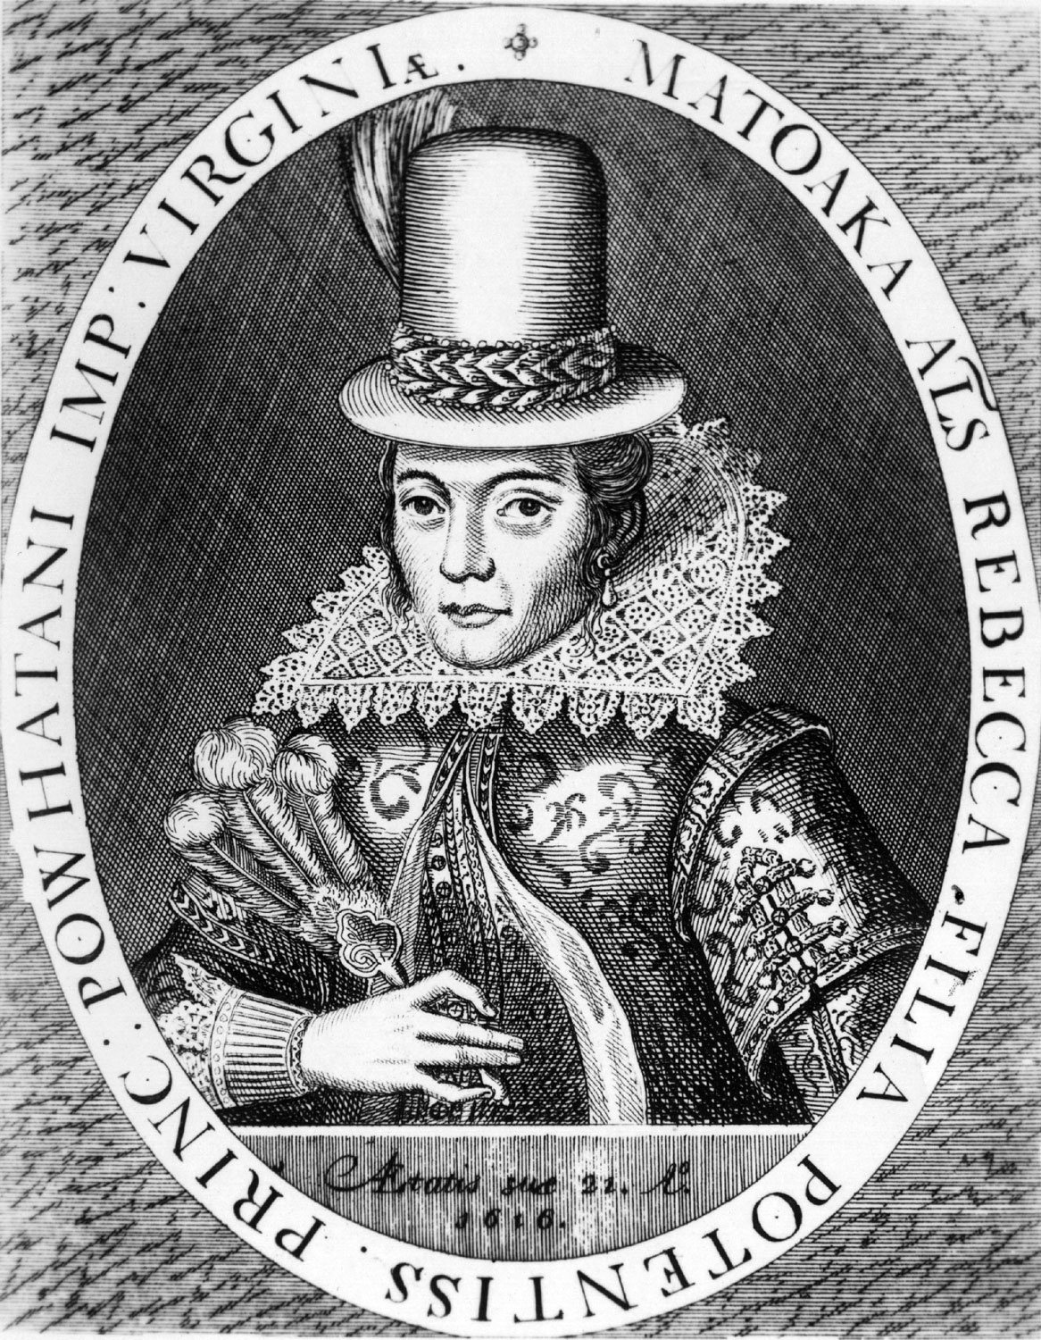
© 2007 McGraw-Hill Higher Education
Notes:
Pocahontas Portraits
Matoaka (Pocahontas) was the daughter of Powhatan, chief of about thirty Algonquin tribes in the area surrounding Jamestown, Virginia. While exact dates are uncertain, she was born around 1595. In her early teens, Pocahontas was a frequent visitor to the successors to the Roanoke colony, the struggling English colonists of Jamestown. The nickname Pocahontas means "frolicsome," yet she performed many of the serious -- sometimes deadly -- roles often played by women in cultural borderlands: arbitrator, translator, trade liaison, and diplomatic hostage. In 1611, the English took her hostage. While imprisoned, she fell in love with and married John Rolfe. In 1616, they sailed with their son for England, where Pocahontas was a sensation at the English court as Lady Rebecca (her Christian name). This portrait was engraved and printed for an enthralled public. (The second portrait, based on the first, was made in 1793 with subtle and interesting changes.) In 1617, Pocahontas fell ill and succumbed to smallpox, as did so many Native-Americans, who lacked resistance to many virulent European diseases. Centuries later, we are still fascinated by her example of individual agency in the collision of ancient cultures. Portraits such as these provide, as the historian Thomas Carlyle once wrote, "a small lighted candle by which the Biographies could for the first time be read, and some human interpretation be made of them."
CITATION: "Pocahontas." Circa 1617, Native American princess Pocahontas (1595 - 1617) in European dress. Daughter of American Indian Chief Powhatan, went to Jamestown, Virginia in 1612, was baptised [sic] as Rebecca into Christianity, and in 1613 married Englishman John Rolfe. 2 Jan 1754. Photo by Hulton Archive/Getty Images. Getty Images, Image #51242178."Rebecca Rolfe." 1616, Matoaka or Pocahontas (c.1595 - 1617), the daughter of Native American chief Powhatan, after her conversion to Christianity and marriage to settler John Rolfe under the new name of Rebecca. 2 Jan 1754. Photo by MPI/Getty Images. Getty Images, Image #51246278.

Slide 21
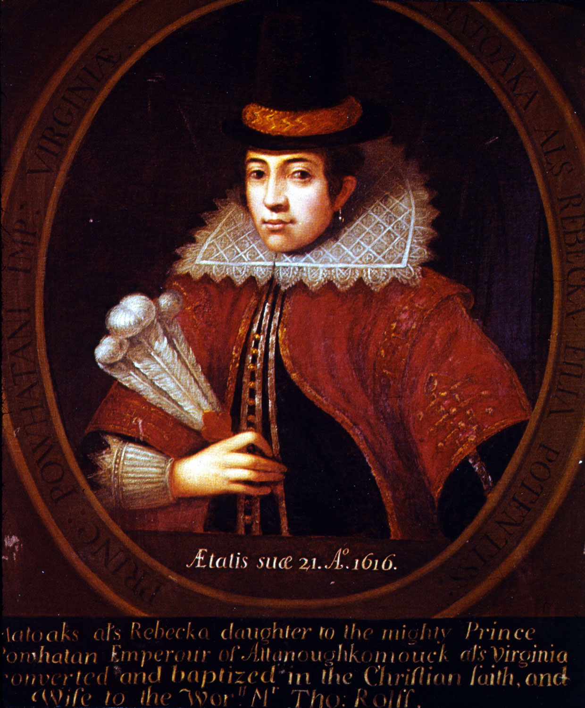
© 2007 McGraw-Hill Higher Education
Notes:
Pocahontas Portraits
Matoaka (Pocahontas) was the daughter of Powhatan, chief of about thirty Algonquin tribes in the area surrounding Jamestown, Virginia. While exact dates are uncertain, she was born around 1595. In her early teens, Pocahontas was a frequent visitor to the successors to the Roanoke colony, the struggling English colonists of Jamestown. The nickname Pocahontas means "frolicsome," yet she performed many of the serious -- sometimes deadly -- roles often played by women in cultural borderlands: arbitrator, translator, trade liaison, and diplomatic hostage. In 1611, the English took her hostage. While imprisoned, she fell in love with and married John Rolfe. In 1616, they sailed with their son for England, where Pocahontas was a sensation at the English court as Lady Rebecca (her Christian name). This portrait was engraved and printed for an enthralled public. (The second portrait, based on the first, was made in 1793 with subtle and interesting changes.) In 1617, Pocahontas fell ill and succumbed to smallpox, as did so many Native-Americans, who lacked resistance to many virulent European diseases. Centuries later, we are still fascinated by her example of individual agency in the collision of ancient cultures. Portraits such as these provide, as the historian Thomas Carlyle once wrote, "a small lighted candle by which the Biographies could for the first time be read, and some human interpretation be made of them."
CITATION: "Pocahontas." Circa 1617, Native American princess Pocahontas (1595 - 1617) in European dress. Daughter of American Indian Chief Powhatan, went to Jamestown, Virginia in 1612, was baptised [sic] as Rebecca into Christianity, and in 1613 married Englishman John Rolfe. 2 Jan 1754. Photo by Hulton Archive/Getty Images. Getty Images, Image #51242178."Rebecca Rolfe." 1616, Matoaka or Pocahontas (c.1595 - 1617), the daughter of Native American chief Powhatan, after her conversion to Christianity and marriage to settler John Rolfe under the new name of Rebecca. 2 Jan 1754. Photo by MPI/Getty Images. Getty Images, Image #51246278.

Slide 22
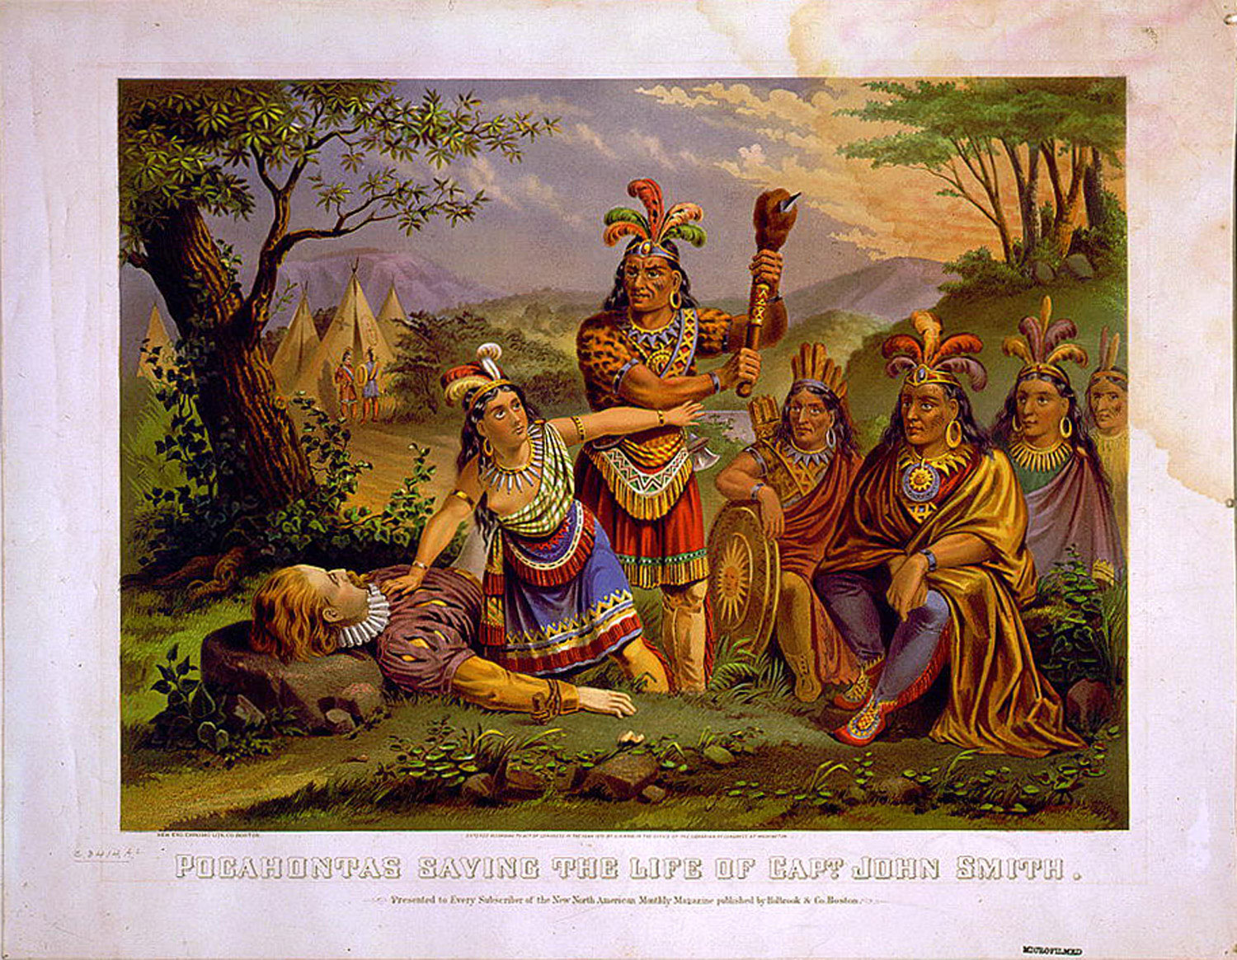
© 2007 McGraw-Hill Higher Education
Notes:
Captain Smith Saved
Captain John Smith was captured by Native Americans while exploring Virginia in December 1607. His captors brought him before Powhatan, the leader of the Algonquian confederacy. Powhatan condemned Smith to death. But, as this picture shows, just before Smith was to be beaten to death, Powhatan's daughter, Pocahontas, threw herself in front of Smith and pleaded with her father to spare his life. In this image, ornately dressed Algonquian warriors sit calmly by, watching the scene play out. An Algonquian village can be seen in the background. Compare and contrast this painting of Pocahontas with other images or paintings depicting Native-American interaction with Europeans.
CITATION: "Pocahontas saving the life of Capt. John Smith." New England Chromo. Lith. Co., 1870. 1 print : chromolithograph, color. Library of Congress Prints and Photographs Division, ID: LC-USZC4-3368. Original image number: 3g03368.

