Slide 1
APUSH Review: Period 4 (1800 - 1848) In 10 Minutes!
Everything You Need To Know About Period 4 In 10 Minutes!

Slide 2
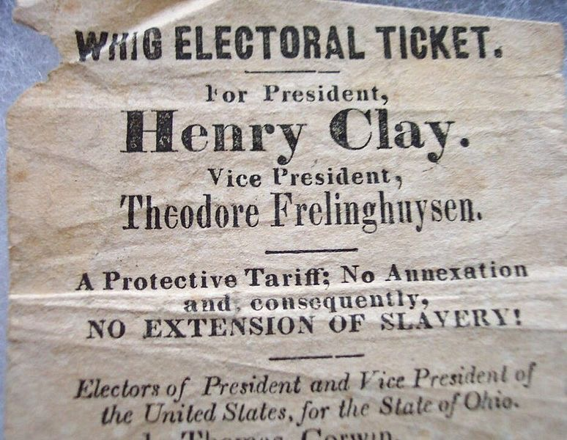
Increased Democracy And Government Relationships
Emergence of Political Parties
Federalists vs. Democratic-Republicans (1790s)
Hamilton v. Jefferson
Democrats vs. Whigs (1830s-1850s)
Jackson vs. Clay
The Supreme Court increased the power of the federal government over states
McCulloch v. Maryland, Worcester v. Georgia
Growth of market economy increased debates over role of government
Often, people were loyal to their region, NOT the nation
Embargo Act of 1807, Nullification Crisis of 1832-33
The South identified with, and took pride in slavery - “Positive good”

Slide 3
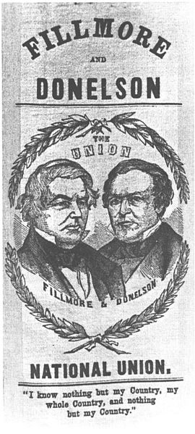
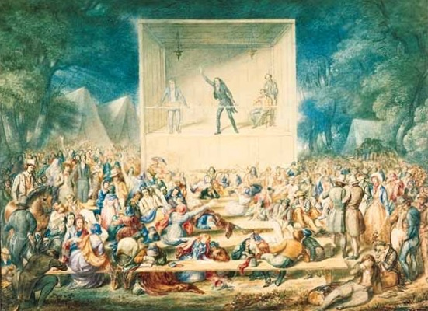
Increased Democracy And New Institutions
2nd Great Awakening:
Stressed the importance of achieving perfection
Inspired MANY reform movements:
Abolitionism, Women’s Rights (Seneca Falls Convention, 1848) Temperance, etc.
Restriction of African Americans’ (both free and slave) citizenship and rights
Various emancipation plans: American Colonization Society
Resistance to democracy included:
Proslavery arguments - “Slavery as a positive Good”
Xenophobia - Intense hatred of foreigners, Know-Nothing Party, discrimination against Irish
Antiblack sentiments in culture - Minstrel shows
Restrictive anti-Indian policies - Indian Removal Act, Trail of Tears

Slide 4
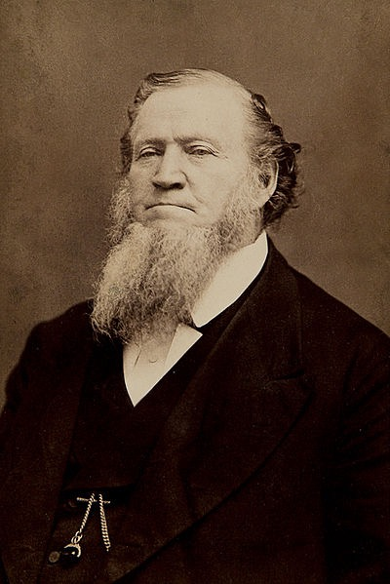
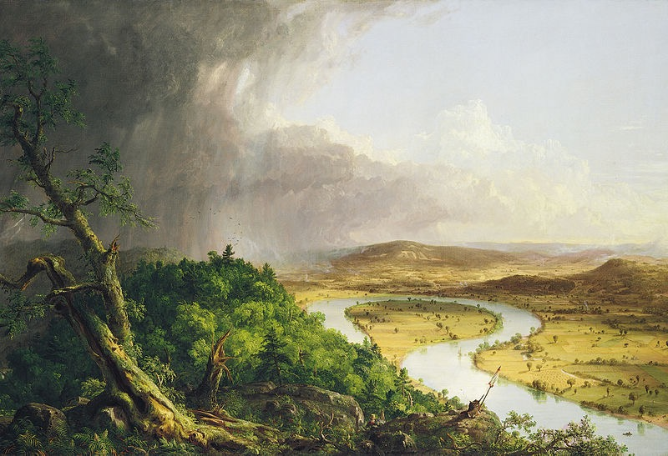
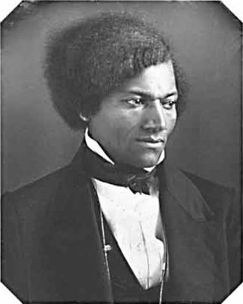
Emergence Of New Cultures
New art, architecture, and literature emerged in America
Hudson River School - landscape paintings
John James Audubon - Environment and birds
Religious groups and Women:
Shakers - believed in sexual equality, celibacy
Mormons - moved to Utah to seek religious refuge
Seneca Falls Convention - 1848
Declaration of Sentiments
Free and enslaved blacks respond to their conditions:
New family structures - surrogate families
Some became involved in abolitionism
David Walker - An Appeal to Colored Citizens of the World
Advocated African Americans to resist oppression
Nat Turner’s Rebellion (1831)

Slide 5
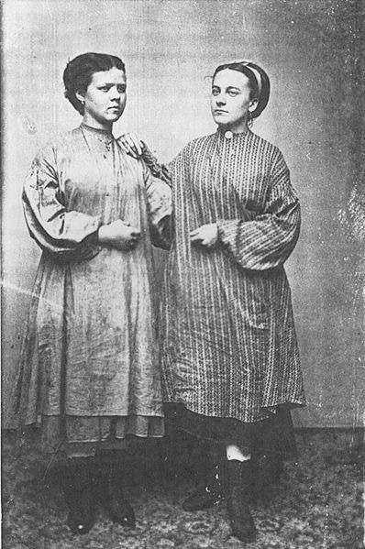
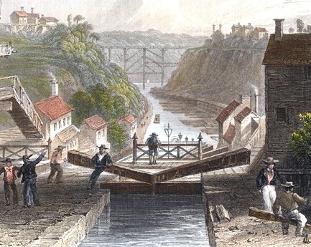
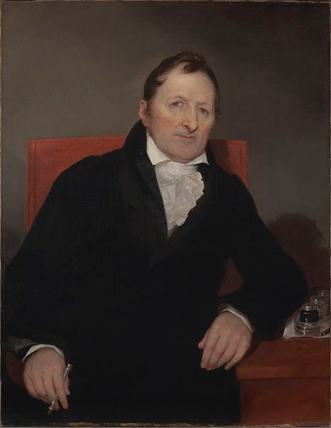
Changes in Agriculture and Manufacturing
New technological innovations increased efficiency and extended markets
Textile machines - Spinning Jenny, increased production
Steam engines - boats could travel against the current
Interchangeable parts - Eli Whitney, mass production of goods
Canals - Erie Canal, goods could be shipped further
Railroads - Expanded rapidly in the 1840s, hurt canals
Telegraph - spread of information (1844 Democratic Convention)
Agricultural inventions - mechanical reaper, steal plow
Production of goods began to replace semi subsistence farming
Lowell System - farmers’ daughters worked in factories in 8 hour shifts, lived in boarding houses, worked OUTSIDE the home

Slide 6
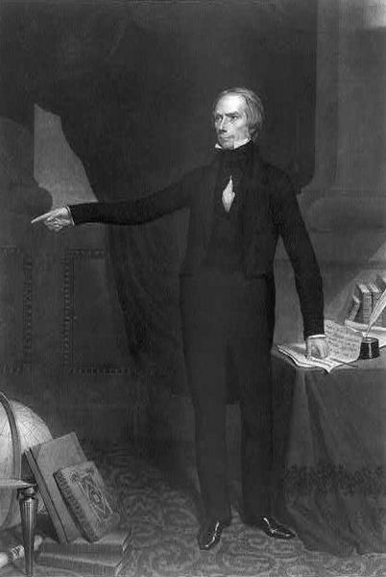
Regional Specialization
Impacts of cotton:
Used in textile production in the Northeast
Depleted land, need for expansion
Government tried to create a unified national economy…
American System
However, the North and Midwest were more linked than the South
Free and forced (Slaves and Native Americans) migration of people across the nation:
In part to gain natural resources - cotton depleted land
New labor systems emerged
Unions - Commonwealth v. Hunt (1837) MA Supreme Court Ruling
3 Parts:
Bank of the US (BUS)
Tariffs
Internal Improvements

Slide 7
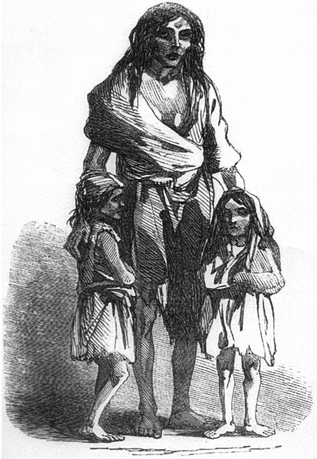
Impacts of Market Revolution
Canals and roads helped encourage westward expansion
European immigrants settled in the:
East - Irish (cities)
Midwest (Germans, as farmers)
Why did immigrants leave Europe?
Economic hardships (Potato famine), not enough land, and economic opportunities in the US
This helped increase interdependence between the Northeast and Old Northwest

Slide 8
Impacts of Market Revolution
The South remained distinctly different from the other regions
Relied on cotton exportation to make $
The Market Revolution changed life in the following ways:
Increased gap between rich and poor
Emergence of middle and working classes
Separation between home and workplace - more goods were produced OUTSIDE the home
Helped change gender and family roles
For many Americans, regional interests were more important than national concerns, as seen through:
Slavery - tensions increased as time went on
National bank (BUS) - disliked in the South
Tariffs - favored in the north (manufacturing), disliked in the South
Internal Improvements - tariffs would pay the cost; favored out West (Henry Clay!)

Slide 9
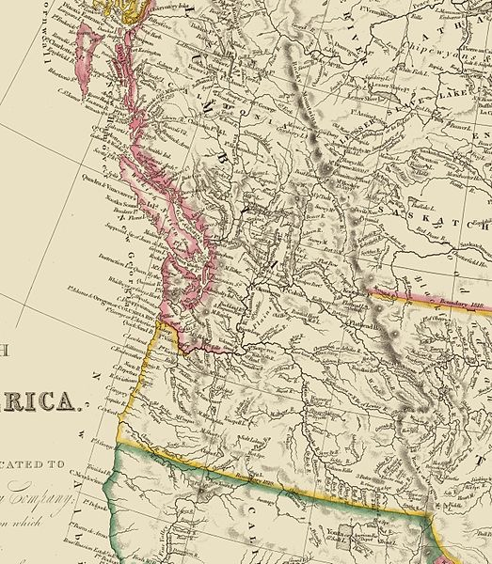
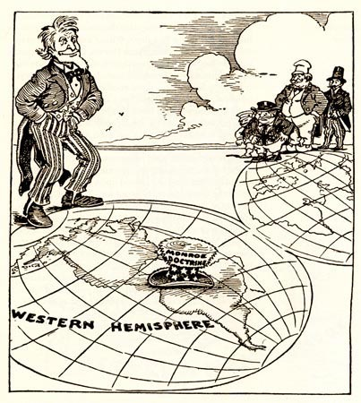
US Increases Its Presence In The Western Hemisphere
Post-LA Purchase, the US participated in several initiatives in the Western Hemisphere and Asia:
Negotiating the Oregon border - “54º40’ or Fight” turns into the 49th parallel
Annexation of Texas - 1845 - helps lead to the Mexican-American War, tensions over slavery
Monroe Doctrine - 1823 - Message to Europe to stay out of the Western Hemisphere, US will stay out of European affairs

Slide 10
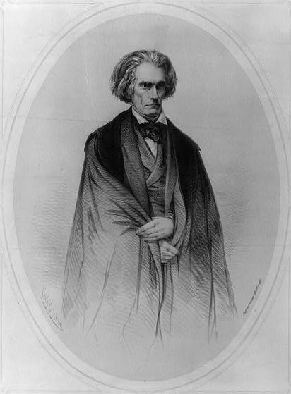
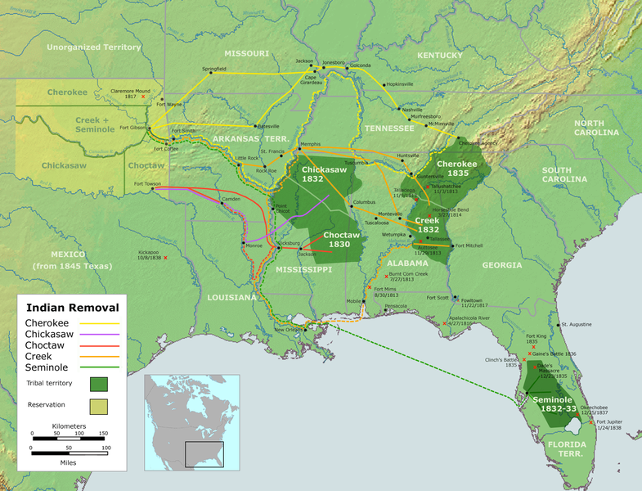
Expansion and Its Effects
Debates about new territories:
Slave/non-slave areas - usually in alternating fashion
Resistance to increasing power of the federal government
Hartford Convention - Federalist grievances to the War of 1812, some urged secession
Nullification Crisis - issue over tariffs, South Carolina nullified the Tariffs of 1828 and 1832
Those living on the frontier advocated expansion - War Hawks!
Impacts?
Conflicts with Natives
Indian Removal Act -> Trail of Tears

Slide 11
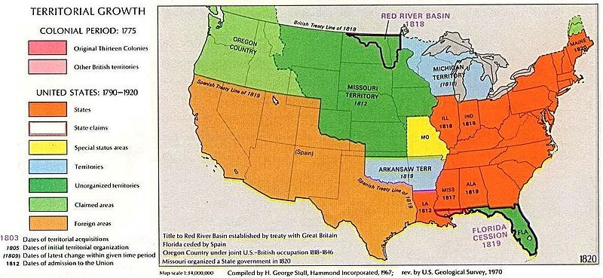
Expansion and Slavery
Missouri Compromise (Compromise of 1820)
3 parts:
Above 36º30’ - free, below 36º30’ - slave
MO - Free
ME - Slave
Balance preserved at 12 states each
Eventually, the compromise broke down (Overturned by the KS-NB Act and Dred Scott - Period 5)
Overcultivation of land in the Southeast led to expansion ->
Tensions over slavery

Slide 12
Quick Recap
Federalists and Democratic-Republicans
Whigs and Democrats
2nd Great Awakening = inspired REFORMS
Ways slaves resisted their situations
New technological inventions
Market Revolution and its impact
“Old” Immigration
Missouri Compromise

Slide 13
Short Answer Practice
Answer All 3 Parts:
Briefly explain one government proposal to slavery between 1800 and 1850
Briefly explain one short-term effect of the proposal
Briefly explain one long-term effect of the proposal

