Slide 1
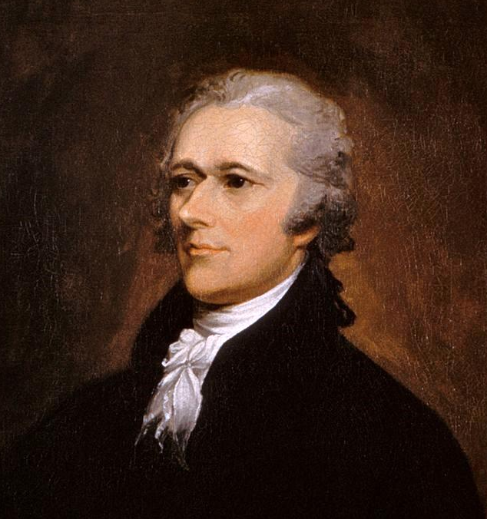
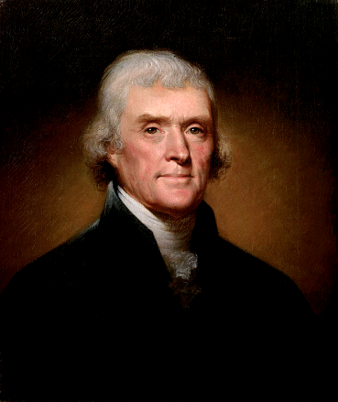
The First Two Party System
Jefferson vs. Hamilton

Slide 2
1791-1816

Slide 3
Federalist Party
Hamilton

Slide 4
Republican Party
Jeffersonian*
* Jefferson’s Republican Party is not the same party as today’s Republican Party, which was founded in the 1850s. For clarification, this party is referred to as the Jeffersonian Republican Party or the Democratic-Republican Party.
Jefferson

Slide 5
The First Two Party System
 | Leaders
 | Federalism
 | Fears
 | Constitution
 | Support Base
 | Gov. Involvement in Economy
 | National Bank
 | Protective Tariff
 | Federal Assumption of State War Debts
 | Foreign Policy
HAMILTON
John Adams
JEFFERSON
James Madison
Republicans
Federalists
Strong Central Gov.
States’ Rights
Anarchy / Mob Rule
Tyranny
LOOSE Construction
STRICT Construction
Urban (Commerce)
Rural (Agrarian)
YES
NO (Laissez Faire)
VERY YES
%$&* NO
YES
NO
YES
NO
Anglophiles
Francophiles

Slide 6
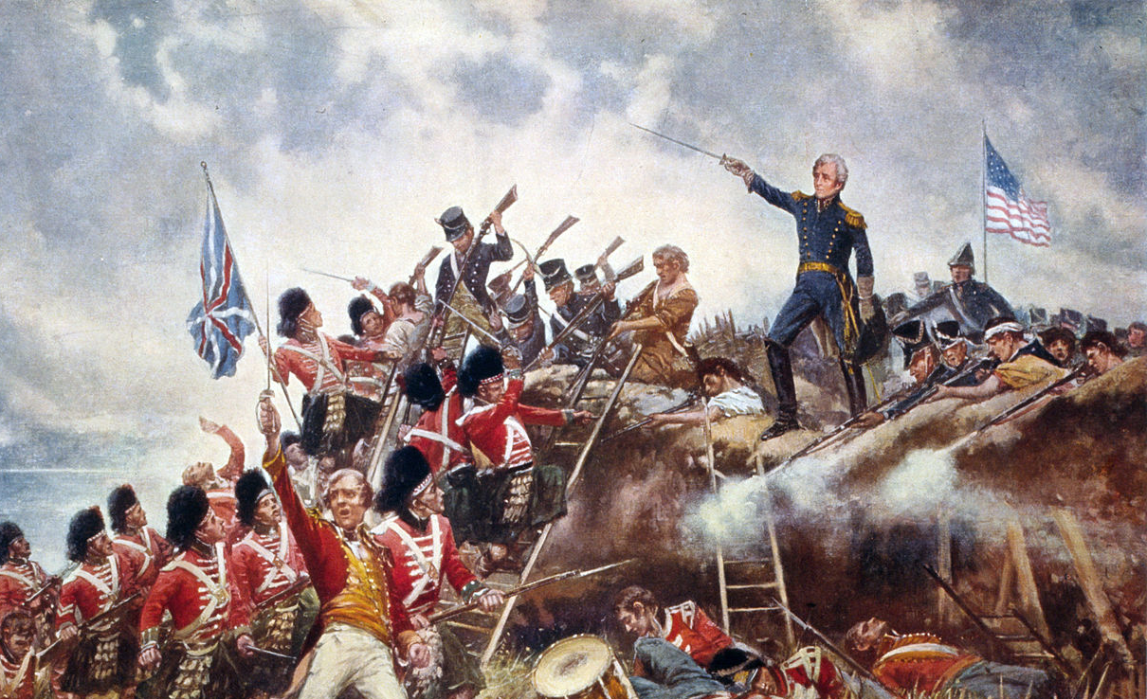
RIP
The first two party system ended after the War of 1812.

