Slide 1
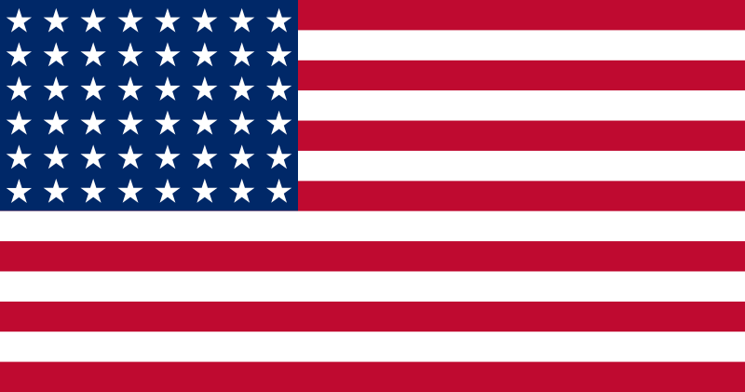
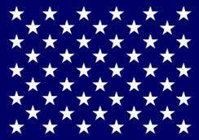
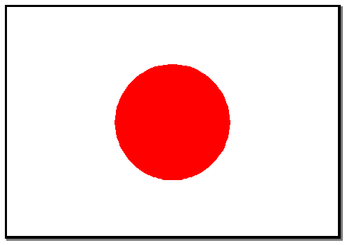
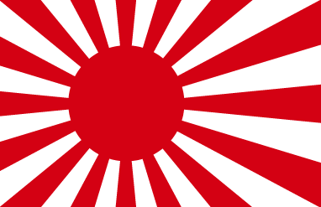
WAR IN THE PACIFIC

Slide 2
On DECEMBER 7, 1941
Japanese Planes Attacked US ships at Pearl Harbor, Hawaii.
Many people in the US had no idea where
Pearl Harbor was on the map.

Slide 3
The Next Day, FDR Asked Congress to declare War
ROOSEVELT called the Attack on Pearl Harbor a DASTARDLY ATTACK
He told Congress that the Japanese had also attacked Six other places in the Pacific Ocean.

Slide 4
THE United States did not have enough forces to Fight TWO Wars
They decided to put the MOST effort into fighting Hitler in North Africa and Europe.
For six months, the Japanese advance against the US in the Pacific, taking island after island.

Slide 5
THE US GOT A LUCKY BREAK
The US won a Sea Battle against the Japanese in the CORAL SEA
AND…
The American Navy cracked the Japanese code just before the Japanese attacked MIDWAY ISLAND

Slide 6
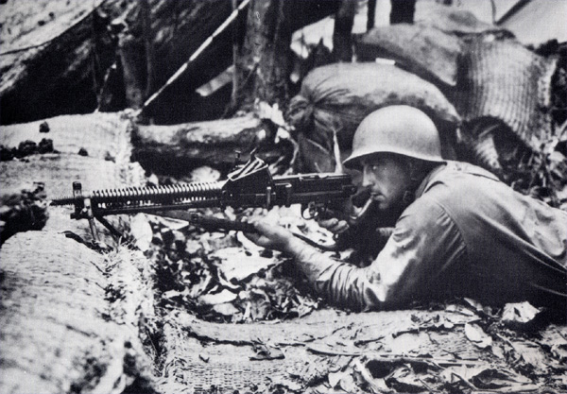
The Two Sides Fought for six months without a clear winner.
The Battle of Guadalcanal was a long fought campaign by US Marines who were fighting with rifles made in 1903.

Slide 7
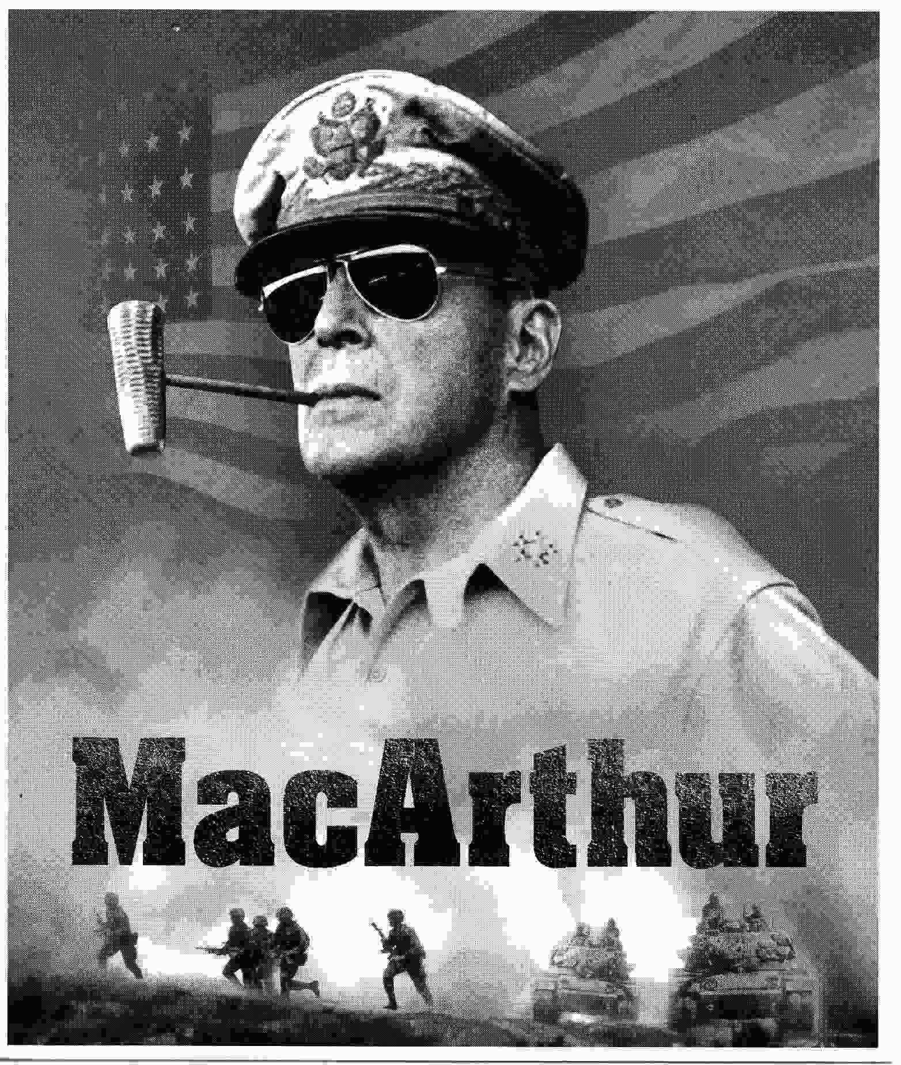
BY 1943, The US gained the Advantage
The UNITED STATES Began
“ ISLAND HOPPING” Toward Japan…
They split US Forces into TWO groups.
Gen. MacArthur Attacked from the south and Liberated the Philippines.
Admiral Nimitz pursued the Enemy Navy closer to Japan

Slide 8
By 1945, The President Had An Important Decision to Make
Franklin Roosevelt died, leaving his Vice President, Harry Truman as President.
Truman was told it would take 1 million US soldiers to invade Japan and end the war.
But he also was given another option from his scientists.

