Slide 1
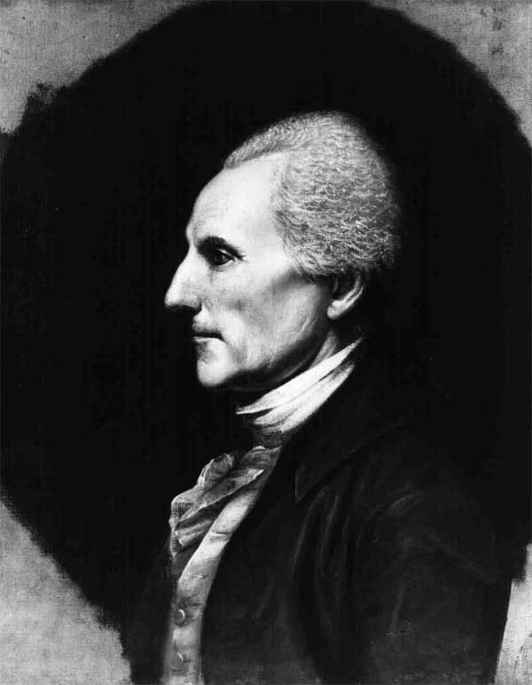
Richard Henry Lee’s Resolution
On June 7, 1776, Virginia delegate Richard Henry Lee introduced a resolution to the Congress stating:
“these United Colonies are, and of right ought to be, free and independent States”
While Congress considered Lee’s resolution, it also appointed a committee to draft a formal declaration of the separation from Great Britain.
Notes:
While Lee introduced the resolution for independence, he was not part of the committee to actually draft the Declaration of Independence. Because his wife was in poor health, he declined the opportunity, and a committee of five delegates were appointed to draft the Declaration.
On July 2, 1776, the Continental Congress voted to approve Lee’s resolution. During the next two days, the Congress then debated the Declaration, which was approved and announced on July 4, 1776.

Slide 2
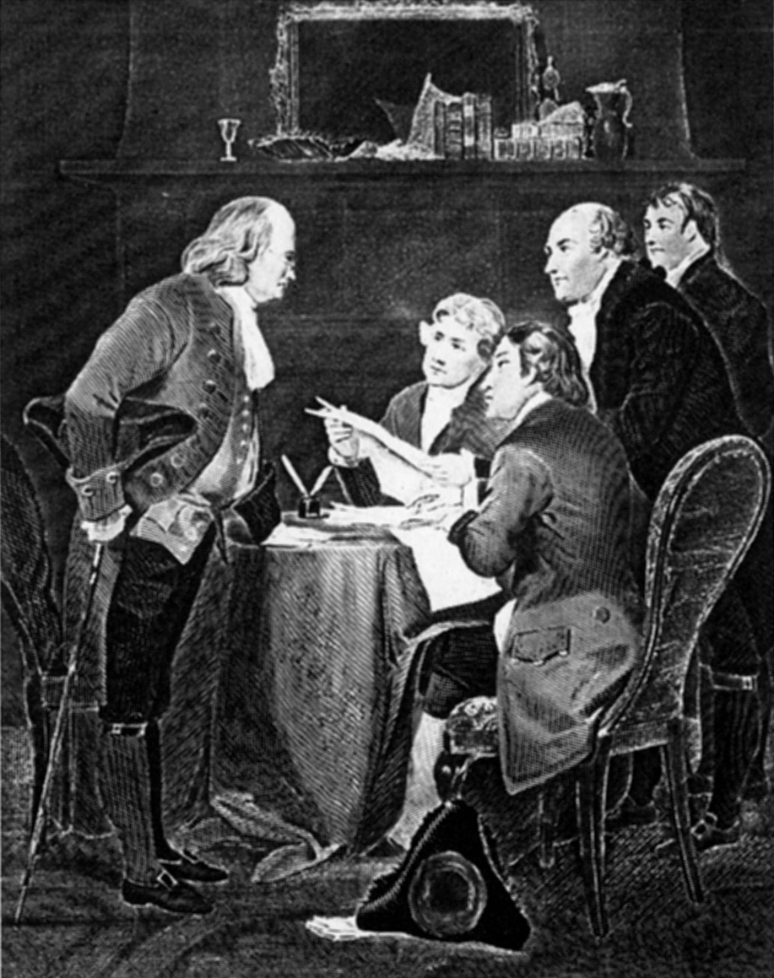
The Committee of Five
Congress appointed a committee of five delegates to write a suitable declaration of independence.
Serving on the committee were Benjamin Franklin, Thomas Jefferson, John Adams, Robert Livingston, and Roger Sherman.
The entire committee was instructed to write the Declaration, however, most of the actual drafting was created by Jefferson.
Livingston
Jefferson
Adams
Sherman
Franklin

Slide 3
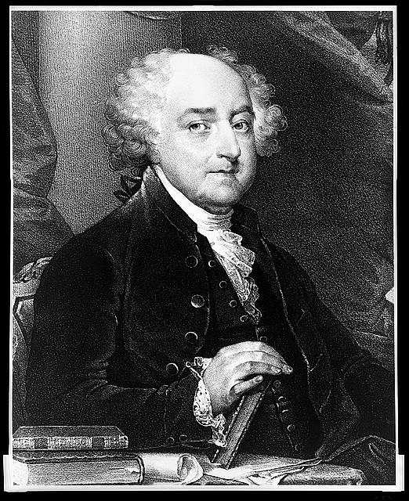
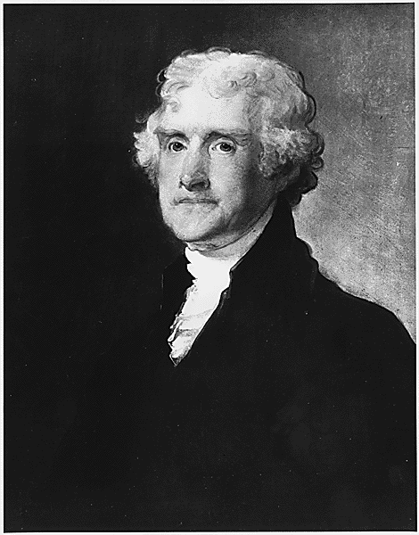
Adams & Jefferson
John Adams came from a poor background, Thomas Jefferson from a wealthy family
Many thought Adams would write the Declaration because he had made many speeches in favor of separation, but he deferred to Jefferson because he believed Jefferson was more popular, a better writer, and from Virginia (an important state to independence)
Once good friends, Adams and Jefferson later became bitter political rivals as they developed different political philosophies and both sought the presidency
Both died on July 4, 1826 (50th anniversary of the signing of the Declaration of Independence)
John Adams
Thomas Jefferson
Notes:
John Adams and Thomas Jefferson came from two completely different backgrounds. While Adams came from a poor background in Massachusetts and had been educated at Harvard, Jefferson had come from a wealthy family, and had been educated at the College of William and Mary.
Both became members of the Continental Congress. While Adams was one of the most vocal proponents of American independence, Jefferson had not given a single speech in Congress when both were selected for the “Committee of Five” to draft the Declaration of Independence. While many believed Adams would be the one to write the Declaration, Adams insisted that Jefferson write the Declaration. According to the story, Adams gave three reasons for selecting Jefferson, including, “"Reason first, you are a Virginian and a Virginian ought to be at the head of this business. Reason second, I am obnoxious, suspected and unpopular -- . Reason third, you can write ten times better than I can."
Jefferson wrote the Declaration. After the end of the Revolutionary War, the two became bitter political and personal rivals, with both aspiring to the Presidency. Adams served two terms as vice president under Washington and then was elected himself in 1796. Because of the way the Constitution selected the vice president, Jefferson, with the second highest total of electoral votes, became vice president under Adams, although they were from different political parties. In 1800, Jefferson defeated Adams, as well as other candidates, and served two terms as president.
While Adams believed in a strong central government and believed the merchants and wealthy should rule, Jefferson believed in states’ rights, and that the common man, the shopkeepers and farmers, could rule effectively.
As they both grew older, however, they became close personal friends, visiting one another as well as exchanging various letters. Both died on July 4, 1826, the 50th anniversary of the signing of the Declaration of Independence. According to reports, Adams last words were, “Thomas Jefferson still survives…”. However, Jefferson had died a few hours before Adams. His last words were “Is it the Fourth?”

Slide 4
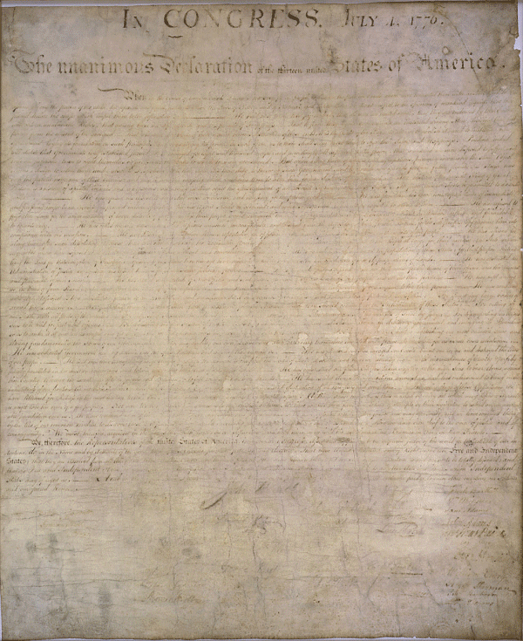
The Declaration of Independence contains three sections:
Preamble: purpose of the document
Grievances: reasons for separation
Formal declaration to the world of their independence from Britain

Slide 5
Ratifying the Declaration
July 2, 1776: Continental Congress unanimously approved Lee’s resolution of independence.
July 2-4, 1776: The Congress debated and edited Jefferson’s Declaration.
South Carolina and Georgia objected to a condemnation of the African slave trade added to the Declaration by Jefferson. Jefferson removed the condemnation, and the two colonies vote to accept the Declaration.
On July 4, the Declaration unanimously approved and announced.

