Slide 1
Unit One: The Rise of Democratic Ideals
Which influences contributed to our modern world beliefs with regard to the rule of government, a “good life” and the meaning of it all? We start with some of the philosophers and cultures from an earlier time…

Slide 2
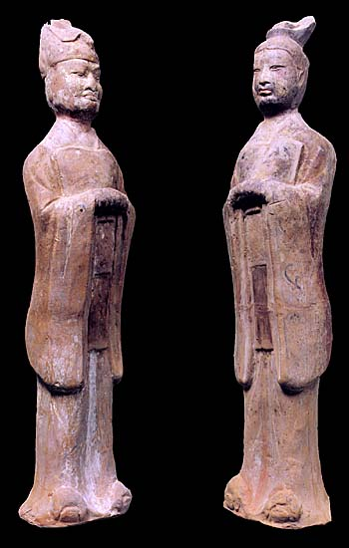
1. Aristocracy
Name 3 people that you consider
to be ARISTOCRATS in our society,
and give a reason why.
Government headed by a privileged minority from the “upper classes”.

Slide 3
2. Citizens
Who have rights as CITIZENS today
in the United States?
Citizenship is membership in a political community (originally a city or town but now usually a country) and carries with it rights to political participation; a person having such membership is a citizen.

Slide 4
3. The Reforms of Solon
An Athenian leader, chosen because he was wise and educated, in order to ease disruptions in the city.
Abolished Debt Slavery
Limited Land Ownership
Stopped Sale of Grain Abroad
Ordinary Citizens Gained New Political Power
What sort of condition would society
have to be in for YOU to allow
Someone to gain such powers?

Slide 5
4. The Reforms of Cleisthenes
Athenian leader who built on the reforms of Solon.
Athenian Assembly to make all laws
All citizens, landed or not, voted in Assembly
Ostracism (to be Ostracized). Banished from city with vote of 6000 citizens for ten years.
Are there ways that
people are
OSTRACIZED in our
World today? Mention
At least one way!

Slide 6
5. Direct Democracy
A system of government where citizens participate directly rather than through representatives.
At what point would
DIRECT DEMOCRACY
become impossible
to conduct?

Slide 7
6. Monarchy
Government headed by a King or Queen, usually based on “Divine Right”. Their rule is ultimate, unlimited and unquestioned.
Some people became, or made themselves Royalty without the use of Divine Right.
Are there any countries that still have
DIVINE RIGHT monarchs? Where?

Slide 8
7. Natural Laws
Natural law or the law of nature (Latin: lex naturalis) is an ethical theory that posits the existence of a law whose content is set by nature and that therefore has validity everywhere.
Describe a NATURAL LAW or NATURAL RIGHT that you think
All people should enjoy, and why?

Slide 9
8. Republic
A system of government in which citizens who have the right to vote choose their leaders.
Some countries are referred to as republics despite the level of how fair or how representative that government might be.
Describe a
country today
that is called
a REPUBLIC
but is probably
not.

Slide 10
9. Roman Senate
Patricians- Wealthy landowners. 300 patricians served as the Senate for life. They chose two…
Consuls, every year, to administer laws. Consuls had to right to Veto (“I forbid”) the actions of the other.
Dictator- Appointed in times of crisis, with absolute power for six months.
What is the organization of the U.S. Senate today?
How does someone become a U.S. Senator?

Slide 11
Plebeians- Farmers, Artisans and minor Merchants who made up an assembly to approve the appointments of the consuls. They had no real power.
Slaves- A large part of Roman society, with no political power.
Who is considered to have no political power in our society today?

Slide 14
10. Legal Code
A legal code is a body of law written and enforced by a state. In addition to a body of substantive law, a legal code also specifies certain court procedures and rules of evidence.
Usually, the legal code serves the dual purpose of broadcasting a certain idea of public morality, and disclosing the retribution that the society, via the state, will visit on those who offend that morality.
Describe a law that is based on PUBLIC MORALITY

Slide 15
Hammurabi
Hammurabi is known for the set of laws called Hammurabi’s Code, one of the first written codes of law in recorded history.
Describe the first
LAW or RULE that
you were made
aware of in your
life!

Slide 16
11. Jewish Law
Based on moral standards, primarily from the 10 Commandments as expressed in the Torah. While the notion of “an eye for an eye” was seen as an important element of Jewish Law, it was not as harsh as Hammurabi’s Code, which often sentenced people to death for minor offenses.
Does anyone know all 10 Commandments?
Which of the
Commandments is
your favorite?
Explain why.

Slide 17
12. Teachings of Christianity
Based on Hebrew teachings. However, some other ideas that contributed to law and government…
Love your neighbor as you love yourself
Turn the other cheek
What, exactly does TURN THE OTHER CHEEK mean?

Slide 18
13. Teachings of Islam
Consistent with many of the ideas found in Jewish and Christian Teachings.
Some basic ideas…
Based on the Koran (religious teachings of Muhammad) and Sharia (system of divine law).
Where is SHARIA LAW practiced today? Where are there
Movements to install SHARIA LAW pursued today?

Slide 19
14. Individualism
Individualism is a term used to describe a moral, political, or social outlook that stresses human independence and the importance of individual self-reliance and liberty.
Describe a way in which you are treated as an INDIVIDUAL.

Slide 20
15. Pardon
A pardon is the forgiveness of a crime and the penalty associated with it. It is granted by a sovereign power, such as a monarch or chief of state or a competent church authority.
When does a PRESIDENT or GOVERNOR usually give a pardon? Why?

Slide 21
16. Common Law
In common law legal systems, the law is created and/or refined by judges: a decision in the case currently pending depends on decisions in previous cases and affects the law to be applied in future cases. When there is no authoritative statement of the law, common law judges have the authority and duty to "make" law by creating precedent.
Which is the ultimate COURT OF LAST RESORT in the U.S. today?

Slide 22
17. Juries
The concept of a modern jury trial stems back at least to Magna Carta, which gave English nobles and freemen the right to be tried by a panel of their peers, rather than by summary judgment of the king or other official who often had the utter power to impose his own arbitrary judgment.
Who are entitled
to become
Jurors in the U.S.
today?

Slide 23
18. Magna Carta
Magna Carta (Latin for "Great Charter", literally "Great Paper"), also called Magna Carta Libertatum ("Great Charter of Freedoms"), is an English charter originally issued in 1215. Magna Carta was the most significant early influence on the extensive historical process that led to the rule of constitutional law today.
Did the Magna Carta
apply to all people
in England, or just
some? Who did it
cover?

Slide 24
19. Due Process
In United States Law, adopted from English Law, due process of law is the principle that the government must respect all of a person's legal rights instead of just some or most of those legal rights when the government deprives a person of life, liberty, or property.
What is the first step in DUE PROCESS when a person
is arrested in the United States?

Slide 25
20. Contract
A contract is a legally binding exchange of promises or agreement between parties that the law will enforce. It is believed that the law is a contract between individuals and the government.
In the United States who
IS NOT allowed to make
CONTRACTS?

Slide 26
21. Tax
A tax is a financial charge paid by citizens for the maintenance of the government. How fairly that tax is charged, and where the taxes go to is a constant issue in modern society.
In our society, which
TAXES do minors pay
directly?

Slide 27
22. Divine Right
The Divine Right of Kings is a political and religious doctrine of political absolutism. It teaches that a monarch owes his rule to the will of God, and is not responsible to anyone else in society.
Chosen by God and Backed by God
How is DIVINE RIGHT
proven by a monarch?

Slide 28
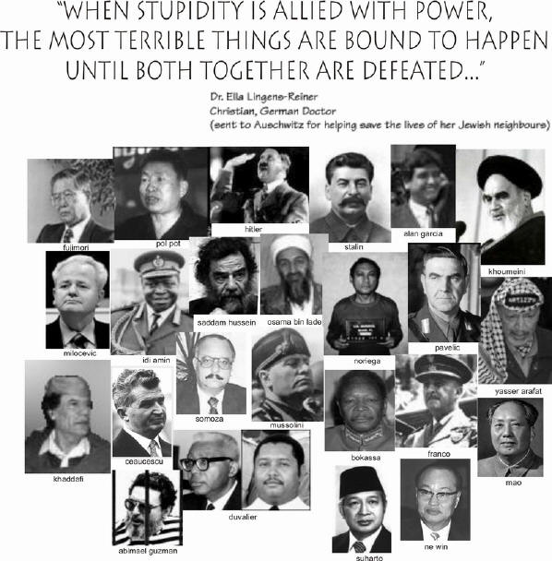
23. Tyranny
A tyrant is a single ruler holding vast, if not absolute power through a state or in an organization. Their interest comes before those of society. Modern law often hopes to prevent tyranny.

Slide 29
24. Constitutional Monarchy
A constitutional monarchy is a form of government established under a constitutional system which acknowledges an elected or hereditary monarch as head of state, as opposed to an absolute monarchy.

Slide 30
Quick Write…
“If you could enter a time machine and travel back to be present at important moments in history, which events would you choose? Make a list of at least five events from some time in either distant or recent history that you believe would have been interesting to witness first-hand.” Be specific and describe a specific reason for each event you choose.

Slide 31
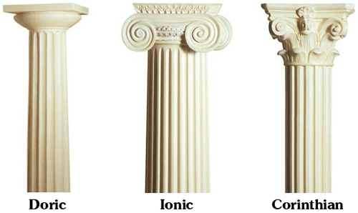
Greek Columns

Slide 32
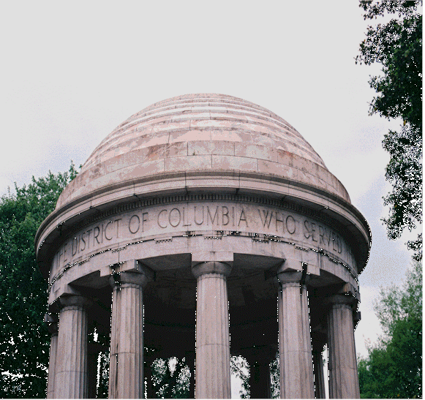

Slide 33
