Slide 1
Chapter 9: Manifest Destiny
US History I
Mr. Tuttle
michael.tuttle@lodi.k12.nj.us

Slide 2
Schedule
Due Friday: Current Events & Read pp. 294-297
Be ready to answer these questions: How Did Congress protect squatters?
What invention made it easier to settle the frontier. Who invented them and why were they significant.
(Do Now Quiz).

Slide 3
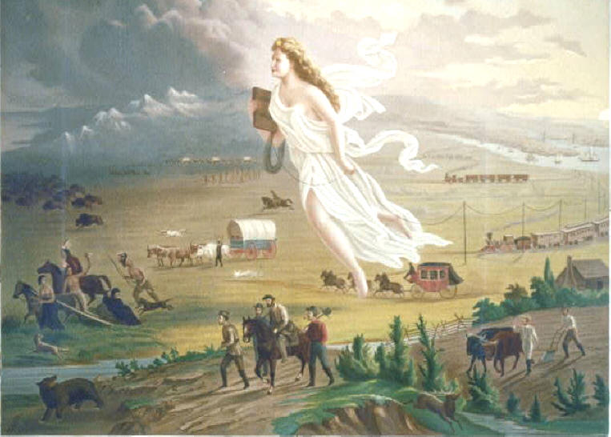
Heading Westward
Two reasons many Americans began to move westward:
Religious reasons
Missionaries
Mormons
Economic reasons
opportunity to begin own farm
Squatters
Preemptive Act of 1830
Invention of iron and steel bladed plows and mechanical reaper
Jethro Wood, John Deere, and Cyrus McCormick
Followed John O’Sullivan’s concept of Manifest Destiny
Notes:
In 1845 a New York newspaper editor named John L. O’Sullivan gave the spirit of expansion a name, calling it Manifest Destiny. He said, “Our manifest destiny is to overspread the continent allotted by Providence for the free development of our yearly multiplying millions.” The concept of Manifest Destiny was soon used by others and became a familiar idea throughout the United States.

Slide 4
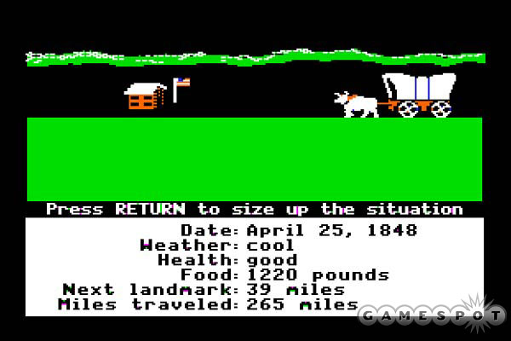
West Coast!
Missionaries began to settle in Oregon
John Sutter established Sutter’s Fort in California to attract more settlers
Trade routes made by mountain men helped settler travel through the wilderness
Oregon Trail (Kit Carson)

Slide 5
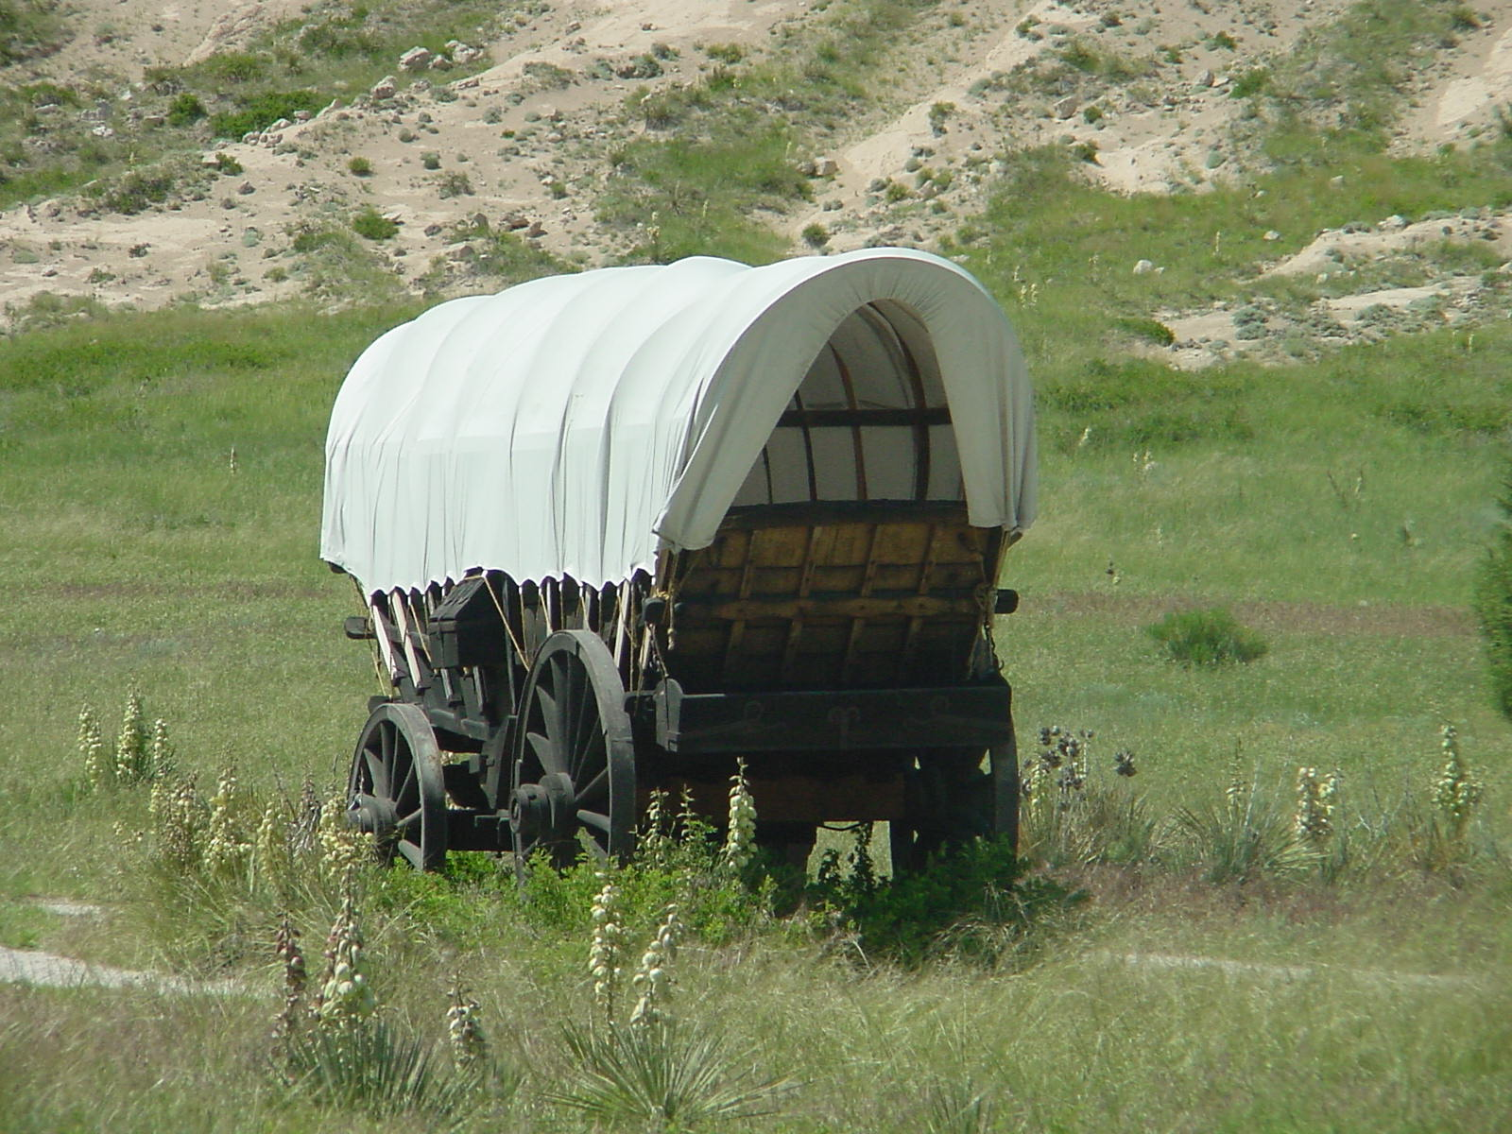
Settler Life
Emigrants made journey in covered wagons
assembled trains in staging areas in towns, where they also exchanged information about routes and supplies
hired mountain men to guide them, but once familiar with land, over-landers continued the journey with the help of guidebooks
Sometimes, the guidebooks were wrong (Donner Party)
Emigrant had little attacks from Native Americans
Natives became angry over continued immigration
Treat of Fort Laramie (1851)
Agreed to specific geographical boundaries

Slide 6
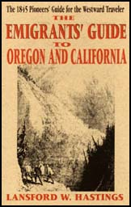
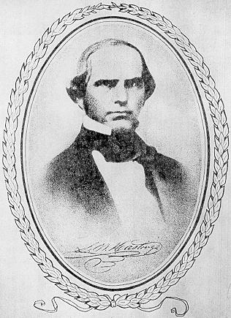
Donner: Party of 87…uh 48 ?
LESSON: KNOW YOUR SOURCES!
The Donner Party (87 people) took a shortcut found in
this Book by Lansford Hastings.
But Hasting Never Took the Shortcut Himself!

Slide 7
Having a Friend for Dinner?
When Faced with Starvation, some in the Donner Party resorted to eating those who had died (cannibalism). A little more than half of the group made it to Sutter’s Fort in California.

Slide 8
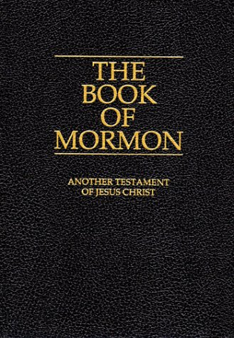
Mormon Migration
After the murder of their leader, Joseph Smith, Brigham Young took the Mormons west to escape persecution
Mormon Trail
Ended up near the Great Salt Lake in Utah (called it Deseret)

