Slide 1
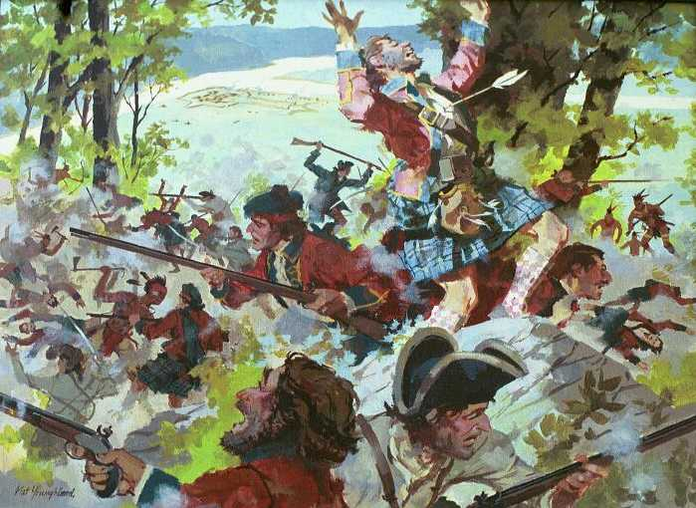
FRENCH AND INDIAN WAR REVIEW (also called the SEVEN YEARS WAR)
Competition in North America led to a war (1754-1763) between old rivals France and England
The French in North America were tradesmen (furs) not long-term inhabitants
Ohio River valley was the site of the conflict
The Colonists supported the British while most of the Native Americans supported the French
The British trained Colonists to fight in MILITIAS along with British REGULARS
FRENCH INDIAN WAR BY NAT YOUNGBLOOD

Slide 2
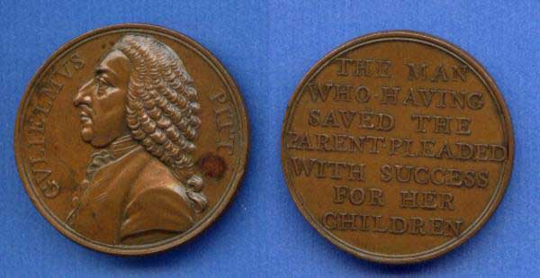
BRITAIN DEFEATS AN OLD ENEMY
While the French had early victories, the British led by William Pitt and George Washington eventually defeated the French
Treaty of Paris ends the war in 1763
Brits claim most of North America including Florida (from French ally Spain) & Canada
Native Americans also realized a French loss was a Native American loss
WILLIAM PITT ON A COIN

Slide 3
Peace Treaties Lead to War
Question: Who is especially unhappy about the French loss?
The Native Americans.
British Trappers and Settlers refuse to pay Native Americans for the use of the land.
Chief Pontiac puts together a Native American Alliance and strikes back at the British.
Pontiac fails to capture key terrain.
Pontiac’s War ends in 1765.

Slide 4
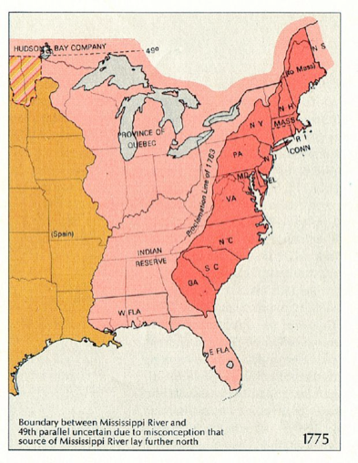
AFTER PONTIAC’S WAR
The Colonists wanted to move west to take advantage of new arable land.
George III knew that keeping the Native Americans pacified would be expensive.
IF YOU WERE KING GEORGE, HOW WOULD YOU STOP THE COLONISTS FROM FIGHTING WITH THE NATIVE AMERICANS?

Slide 5
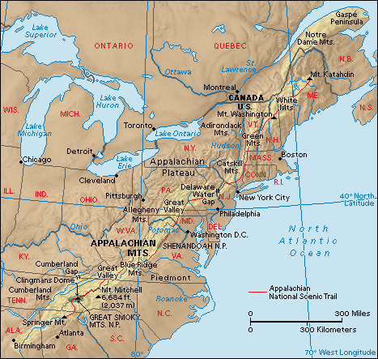
PROCLAMATION LINE OF 1763
To avoid further costly conflicts with Native Americans, the British government prohibited colonists from settling west of the Appalachian Mountains
The Proclamation established a line along the Appalachian that colonists could not cross (They did anyway)
THINK ABOUT: How did the establishment of the Proclamation Line ( and the Colonist’s response to it) help lead America down the road toward INDEPENDENCE ?

Slide 6
One Cause of the American Revolution
The Proclamation of 1763
Proclaimed that land west of the Appalachian Mountains temporarily off limits to settlements.
British Halt Westward Expansion to minimize costs in maintaining a military force to secure the Frontier.
Colonists upset. Especially those who had bought shares in companies or bought land in the newly captured territories.
However, this does create a fragile peace between the British and the Native Americans.

