Slide 1
MISC | MISC | MISC | MISC
200 | 200 | 200 | 200
400 | 400 | 400 | 400
600 | 600 | 600 | 600
800 | 800 | 800 | 800

Slide 2
200
TRUE OR FALSE:
Ideas and language are examples of material culture.

Slide 3
200
culture includes both material and nonmaterial elements. Ask them what comes to mind when they think of the word material.
FALSE- culture includes both material and nonmaterial elements. Ask them what comes to mind when they think of the word material.

Slide 4
400
TRUE OR FALSE:
The words society and culture are interchangeable.

Slide 5
400
FALSE

Slide 6
600
TRUE OR FALSE:
The most serious mores are formalized as laws.

Slide 7
600
TRUE-
norms can be classified as folkways, mores, or laws.

Slide 8
800
TRUE OR FALSE:
A only a subculture can have a counterculture, the ruling majority cannot have a counterculture

Slide 9
800
TRUE TRUE TRUE

Slide 10
200
Ethnocentrism is the tendency to view one’s own culture and group as superior.

Slide 11
200
TRUE- AMERICANS ARE THE BEST

Slide 12
400
What is nature vs. nurture?

Slide 13
400
½ of personal traits are determined by genetics and ½ from environment

Slide 14
DAILY DOUBLE!!!!
There are 8 components of universal culture. For each component named you get $100.

Slide 15
600
ECONOMY
INSTITUTIONS
ARTS
LANGUAGE
ENVIRONMENT
RECREATION
BELIEFS

Slide 16
800
What are norms?

Slide 17
800
Norms are rules that define appropriate and inappropriate behavior

Slide 18
200
Which of the following is an example of nonmaterial culture?
a. computer
b. rule
c. book
d. car

Slide 19
200
B. Rule

Slide 20
400
How would you classify individual freedom and material comfort?
a. European norms
b. American values
c. universal laws
d. counterculture attitudes

Slide 21
400
American Values

Slide 22
600
Which statement best describes the purpose of the family?
a. protect territory
b. stabilize population
c. expose members to new cultures
d. care for children

Slide 23
600
D. Care for children

Slide 24
800
List 6 American Values.

Slide 25
800
Along with education, religion
Achievement and success
activity and work favored above leisure and laziness,
moral orientation i.e. absolute judgments of good/bad, right/wrong
humanitarian motives as shown in charity and crisis aid
efficiency and practicality
progress and technology
material comfort
equality as an abstract ideal OR equal opportunity, (not equality of condition)
freedom as a person’s right against the state
science and rationality, as the means of masterminding the environment and securing more material comforts
nationalism, a belief that US values and institutions represent the best on earth
democracy
individualism emphasizing personal rights and responsibilities
racism and group superiority

Slide 26
200
What is a norm of American society?
a. financial responsibility
b. not paying bills
c. dancing
d. stealing from one’s neighbor

Slide 27
200
A. Financial Responsibility

Slide 28
400
A friend says, “My country is the best of all.” What does this statement reflect?
a. subculture
b. relativism
c. ethnocentrism
d. cultural universal

Slide 29
400
c. ethnocentrism

Slide 30
600
Some groups in society share values, norms, and behaviors that are not shared by the entire population. The unique cultural characteristics of these groups form what?
a. more
b. cultural lag
c. subculture
d. cultural trait

Slide 31
600
c. Subculture

Slide 32
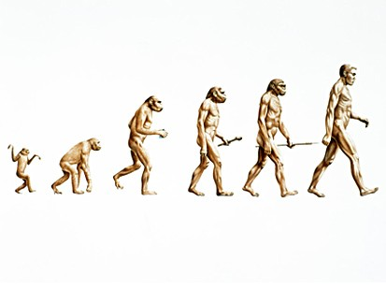
800
Which statement best describes cultural universals?
a. They ensure fulfillment of needs and are unique to certain cultures.
b. They ensure fulfillment of some needs and are common to all cultures.
c. They describe interactions between countercultures.
d. They are common only in North American countries.

Slide 33
800
b. They ensure fulfillment of some needs and are common to all cultures.

Slide 34
Final Jeopardy
See jeopardy I

Slide 35
Final Jeopardy
Name the 3 reasons why cultural universal exist?

Slide 36
Final Jeopardy
1) Biology shared by all humans
If a society is to survive children must be born, the sick must be cared for, and the dead honored
2) Physical environment
Humans cannot survive without protection from the environment
3) The same social problems

