Slide 1
Ford – G.W. Bush

Slide 2
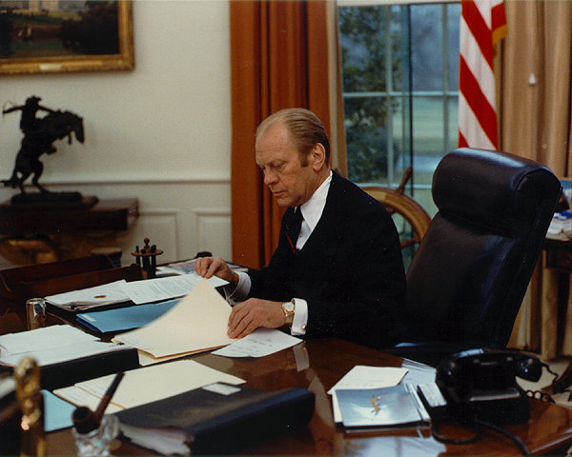
Gerald Ford - President
Gerald Ford became the 38th President of the U.S. after Nixon resigned – served 1974-1977
“Our long national nightmare is over” – Ford to nation after Nixon resignation

Slide 3
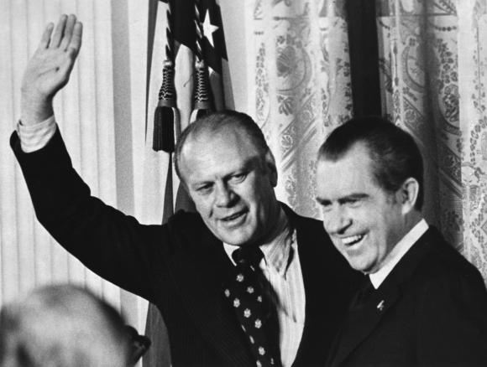
Off to a bad start…
Sept. 9, 1974 – grants Nixon a “full, free, and absolute” pardon for Watergate
Many people angry – letting Nixon off too easy
Some thought it was good – it put an end to a bad time
Ford testified before Congress in investigation of pardon – “There was no deal, period.”

Slide 4
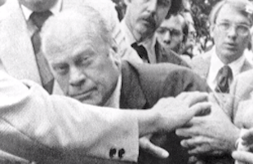
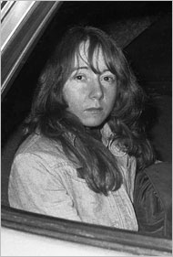
Press highly critical of Ford
Ridiculed him for his clumsiness
2 failed assassination attempts even failed to win him popular support

Slide 5
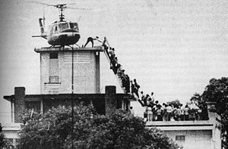
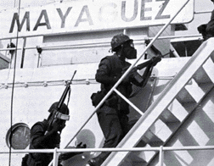
Ford’s presidency… Many bad events
Fall of Saigon (April 1975)
Mayaguez Incident (May 1975)
Cambodians seized U.S. merchant ship Mayaguez
Rescue mission frees 39 hostages but results in 41 dead soldiers
Bad recession (prolonged decline in economy)
High unemployment (up to 9% of work force)

Slide 6
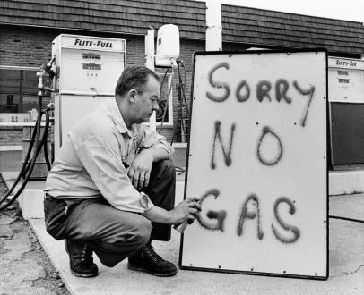
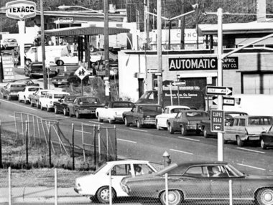
Many bad events…
Arab oil embargo (1974)
Arab countries angry at U.S. support of Israel
Refused to ship oil to U.S. & other Western countries
Resulted in long lines at gas stations & shortage of heating fuel
Riots broke out in some places over gas
OPEC (Org. of Petroleum Exporting Countries) price hikes
Drove up price of oil – gas prices began to rise sharply

Slide 7
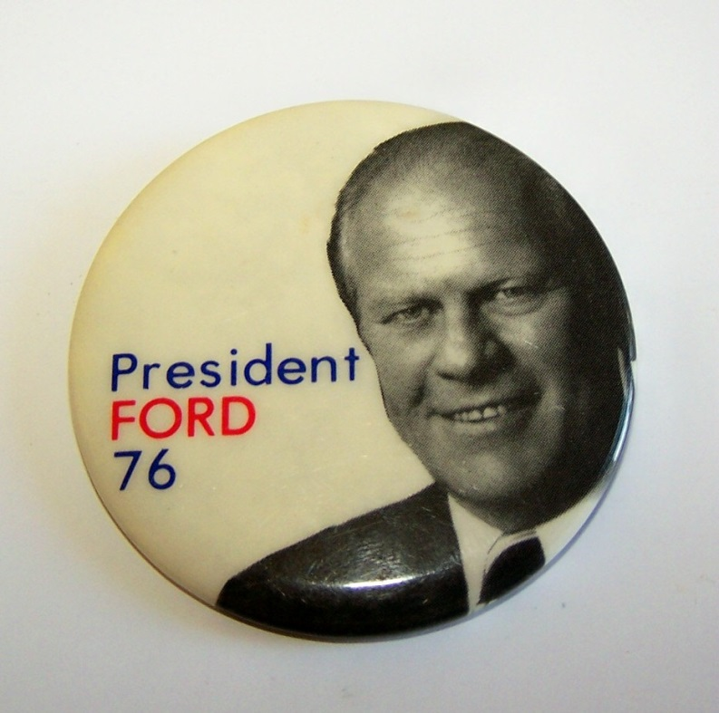
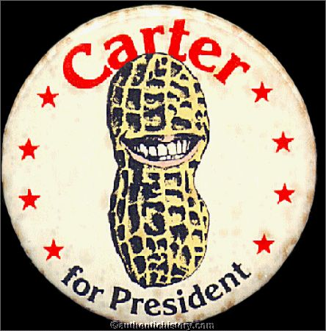
1976 Election
Ford loses to Jimmy Carter (D-GA)
297 – 240 Carter victory in Electoral College
Record low voter turnout

Slide 8
The Carter Years
1977 - 1981

Slide 9
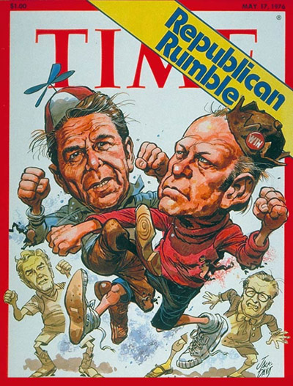
1976 Election
By the middle of the seventies – Americans looking for a change
Still stinging from failure in Vietnam
Distrusted the government after Watergate
Ford ran for reelection in 1976
Faced Ronald Reagan for Republican nomination – Ford won

Slide 10
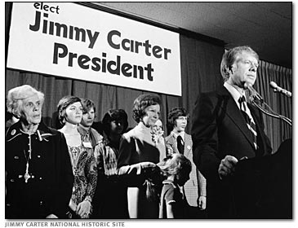
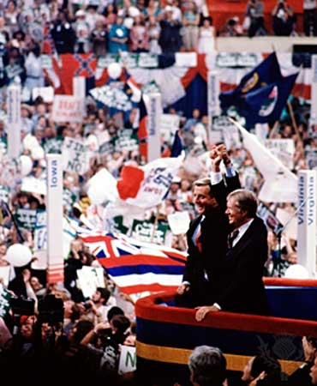
1976 Election
Democrats ran a little-known former governor from Georgia
James “Jimmy” Carter
Seen as an “outsider” – not corrupted by D.C. politics
Fundamentalist Christian – seen as very moral
Good record on Civil Rights as Georgia’s Governor
A warm, friendly personality
Carter’s running mate – Walter Mondale of Minnesota

Slide 11
1976 Election
1976 Election issues = economy, energy, and unemployment
Carter won
Little practical experience w/ D.C. politics
Tough to get support for programs
Appointed many women and minorities to govt. positions

Slide 12
Energy Crisis
An energy crisis developed during the 70’s
Shortages due to OPEC control of world oil supply
Carter sought to regulate “gas guzzler” cars w/ taxes
Proposed gas rationing program
Congress refuses to act – Carter does instead
Creates cabinet-level Department of Energy (1977)
Responsible for energy policy in U.S.

Slide 13
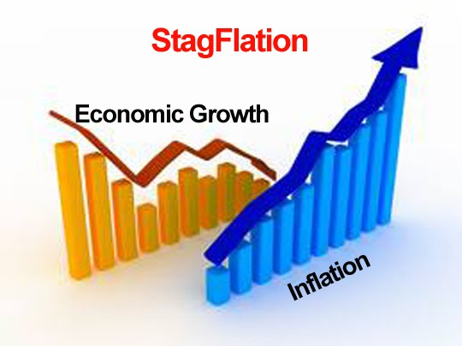
Economic Problems
Carter also faced economic problems - Stagflation
Inflation = increase in prices & wages coupled with decline in purchasing power of money
High unemployment
Low productivity & a trade deficit (more imports than exports)

Slide 14
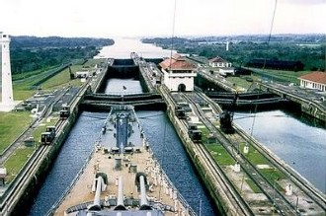
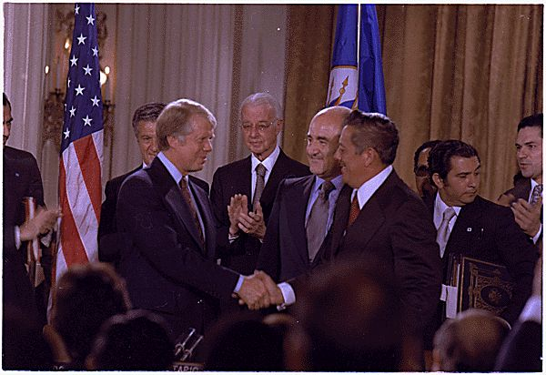
Foreign Policy
Carter better known for foreign policy matters
Stressed importance of human rights in U.S. foreign relations
Signed treaty returning Panama Canal to Panamanian control
Ratified in 1978 - Effective 12/31/1999

Slide 15
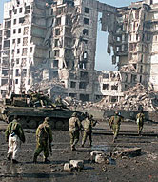
Foreign Policy : - SALT II Negotiations
Continued SALT negotiations w/ USSR
US & USSR began making medium range nukes
Placed them in W & E Europe, endangering SALT I treaty
Agreed to new limitations on missiles & launchers (SALT II)
Many in Congress against SALT II – thought US was already behind - limiting new nukes would keep US from catching up
Soviet invasion of Afghanistan killed the deal (12/1979)
USSR tried to stop the takeover of pro-Soviet govt.
Turned into their “Vietnam”
US placed embargo on grain sales to USSR
Boycotted 1980 Summer Olympics in Moscow

Slide 16
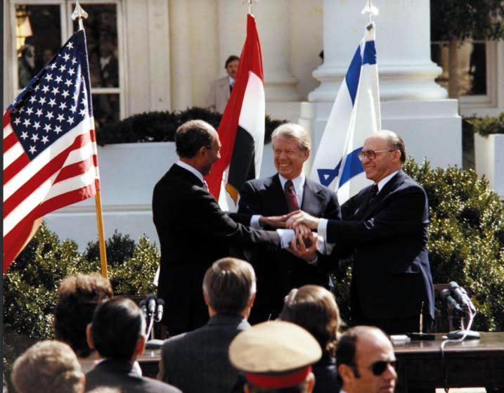
Camp David Accords
1979 - Brokered peace between Egypt & Israel (Camp David Accords)
Ended war between Egypt & Israel and returned Sinai Peninsula to Egypt
Start of other efforts to settle Arab/Israeli fighting
Terrorism continued – sponsored by Palestinian Liberation Organization (PLO)

Slide 17
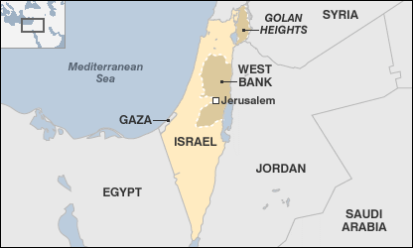
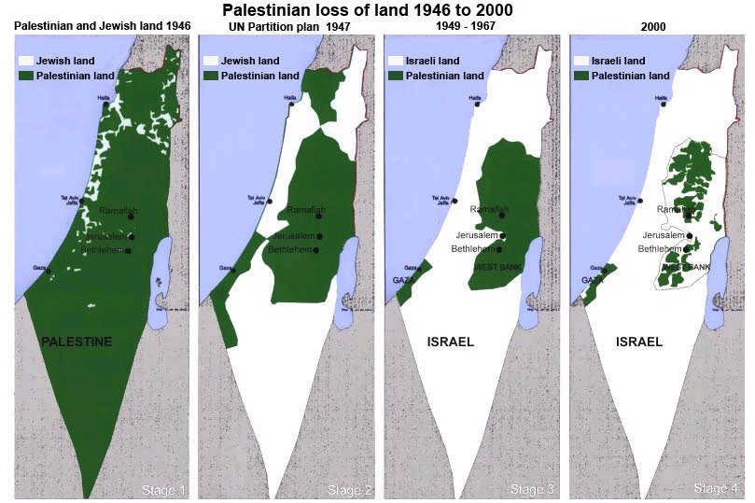

Slide 18
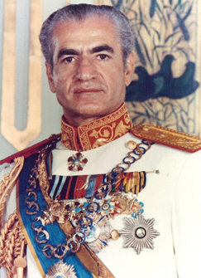
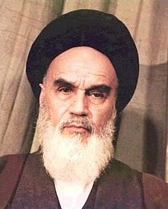
Issues with Iran
Supported westernized Shah of Iran (Mohammed Reza Pahlavi) with $ and military hardware
A dictator & abuser of human rights (counter to Carter policy)
A revolution led by the Islamic fundamentalist Ayatollah Ruhollah Kohomeini overthrew the Shah
Iran became an Islamic theocracy (run by clergy)
Replaced by

Slide 19
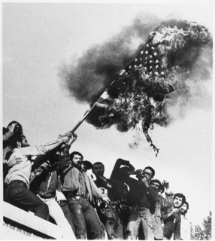
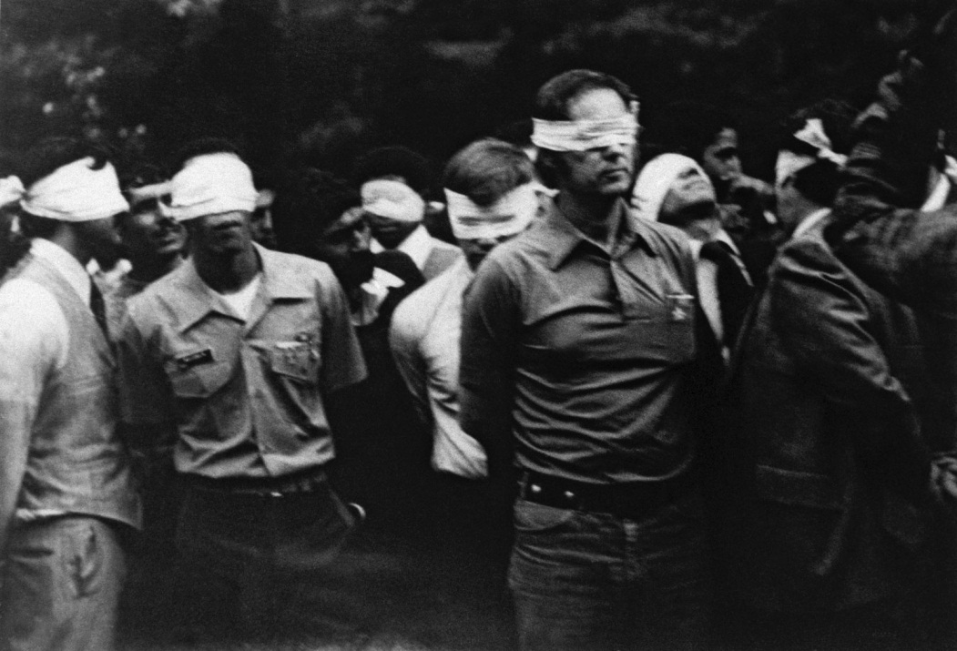
Issues with Iran
When Carter allowed the Shah to come to U.S. – revolutionaries in Iran seized the U.S. embassy in Teheran (Fall 1979)
52 American hostages held – to be exchanged for the Shah
Carter refused to turn him over – would mean death
Froze Iranian assets, banned trade w/ Iran, cut off dip. relations
Mounted a failed rescue mission – 8 U.S. soldiers died
Shah died in 1980

Slide 20
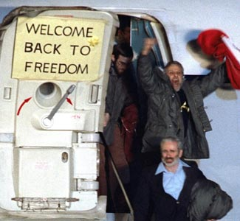
Issues with Iran
U.N. condemned Iran
None of these solved the problem
Crisis dragged on – daily press coverage
Became a campaign issue in 1980 - cost Carter the election
Negotiations continued, even after Carter lost the election
Delays and stalling by Iranians prevented hostages’ release until inauguration day – Jan 20, 1981
1st day of Reagan’s presidency
Hostages were held for 444 days

Slide 21
Ronald W. Reagan
1981 - 1989

Slide 22
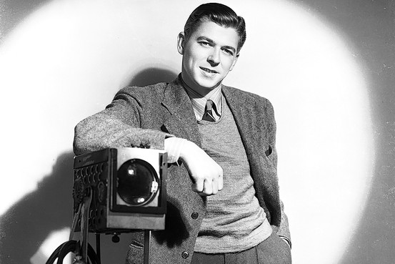
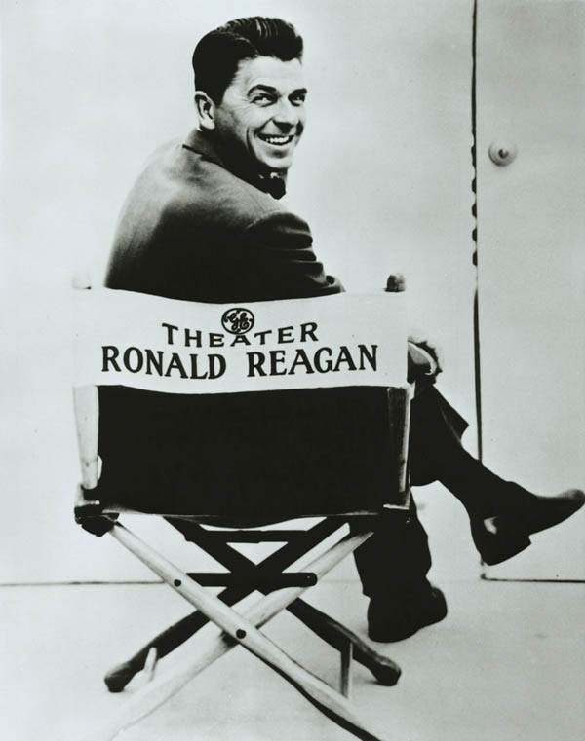
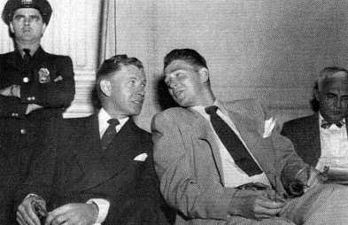
Early Life
Made more than 50 Hollywood films and 400 army training films
Was never “blacklisted” - hated communism & actively sought to remove “reds” from movie industry
Spoke before HUAC in 1947

Slide 23
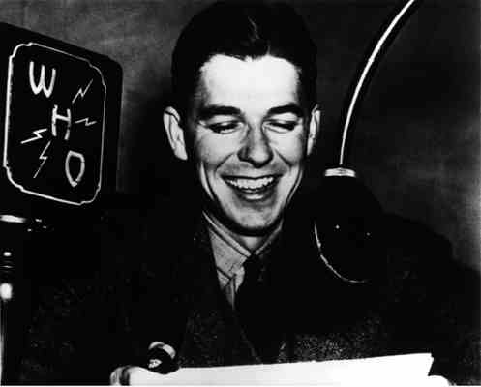
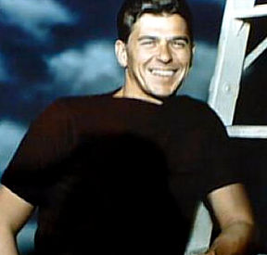
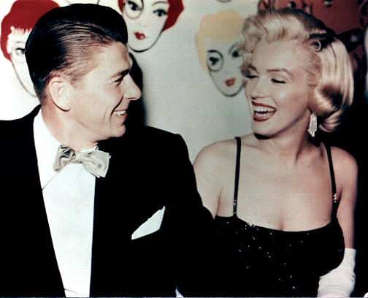
Transition to Politician
Early radio & screen exposure helped him enter politics
Job as corporate spokesman (G.E.) brought him natl. attention.
Gave TV speech for Goldwater in ‘64
Businessmen encouraged him to run for governor of CA - he did and won 2 terms (1966-1975)

Slide 24
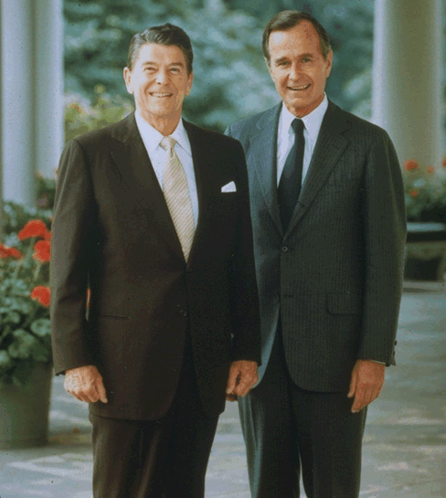
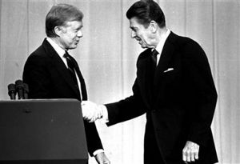
1980 Election
Reagan /George H.W. Bush (V.P.)
Ran against Carter/Mondale
People unhappy w/ Carter domestic & foreign policy woes
Stagflation, Energy Crisis, Hostages
Reagan promised smaller govt., less taxes, less social spending

Slide 25
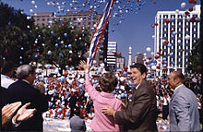
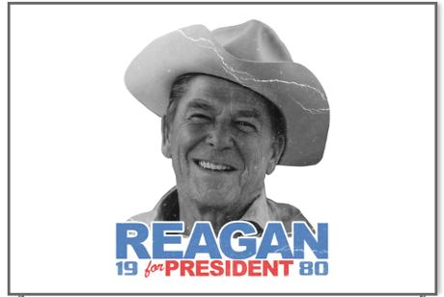
Reagan’s Appeal
Carter approval rating 26%
Blamed econ. woes on “crisis of confidence”
20% interest rate, 8% unemployment
Reagan promised tax cut & return to traditional values
Praised self-made Americans & private enterprise
Patriotic, likeable, & a good communicator

Slide 26
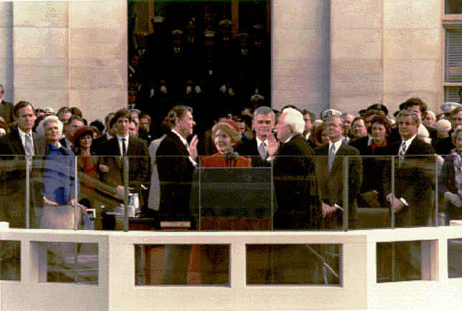
Reagan Victory in 1980
Won 44 of 50 states
489-49 electoral votes
51% of popular vote
U.S. hostages in Iran released on Reagan’s Inauguration Day

Slide 27
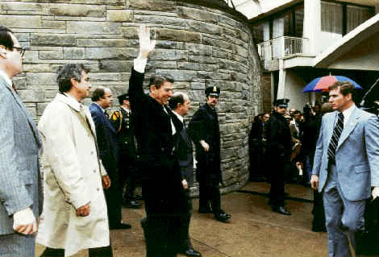
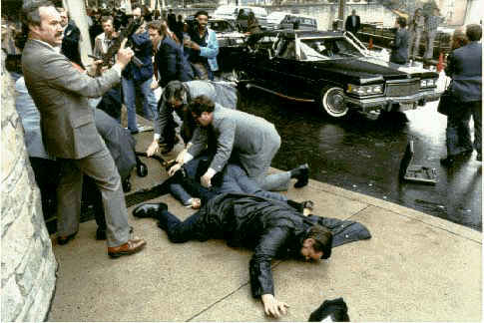
The Assassination Attempt
March 1981 - shortly after inauguration
John Hinkley Jr.
Reagan wounded in chest
Faced the incident w/ courage and humor
Commenting on doctors at hospital: “I hope they are all Republicans”

Slide 28
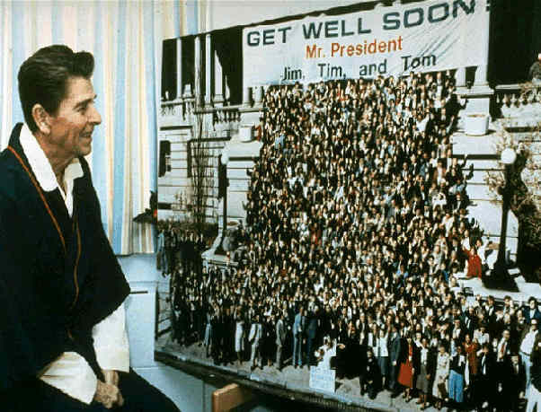
Assassination Attempt
Reagan quickly returned to work
Very healthy for 70-year-old
Hinkley found not guilty by reason of insanity
Public sympathy helps Reagan’s legislative agenda

Slide 29
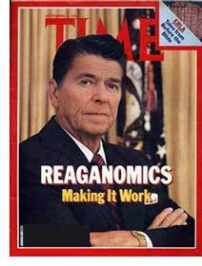
Reaganomics & Supply-Side Theory
Theory - the key to economic growth and prosperity is not over-taxing businesses and encouraging entrepreneurship
Government need not be concerned with stimulating the demand for goods and services
Businesses would do so

Slide 30
Reaganomics
Tax cuts meant to stimulate economy
Proposed 30% over 3 yrs. Cong. gave him 25%
Economic Recovery Tax Act (1981)
Spending cuts ($40 billion) meant to trim govt. “fat”
Military spending excluded
Social spending cuts made Reagan unpopular w/ liberals

Slide 31
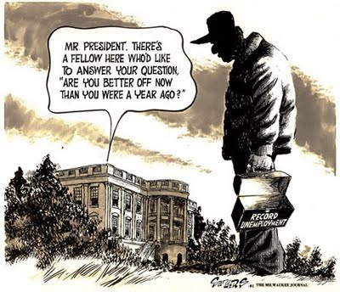
Reaganomics
Econ. plan included cuts in federal reg. of biz & increase in interest rate by the Fed.
A recession in 1981 was worse due to cuts in social programs
Lower exports, foreign competition, & tech. obsolescence led to massive layoffs
Trade deficit at $111 billion by 1984
Farm exports down = foreclosures

Slide 32
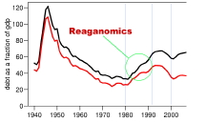
Reaganomics
Fed. tax cuts forced states to raise taxes to make up for lost federal $
At first, tax cuts did not result in greater consumer spending as predicted
Federal budget deficit increased - not enough $ coming in to pay debts
Helps Dems. in midterm elections
Rebound began in 1982

Slide 33
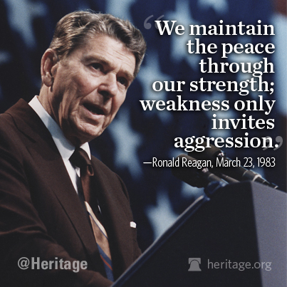
“Peace through Strength”
Military spending increased
Reagan a hard-line anti-communist
Strategy was to out-spend USSR in nuclear weapons
If US has more nukes - USSR less likely to attack us first

Slide 34
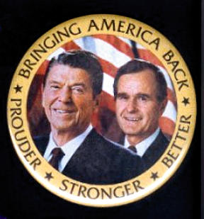
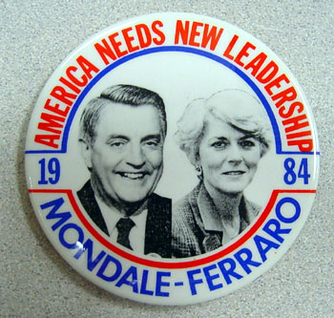
1984 Election
Reagan/Bush vs. Mondale/Ferraro
Mondale was Carter’s VP
Geraldine Ferraro the 1st woman VP candidate in U.S. history
Reagan too popular
Mondale portrayed as a “tax and spend liberal”

Slide 35
1984 Election
Many feared Mondale would damage the improving economy
He proposed tax increases to reduce budget deficit
Mondale attacked Reagan social policy & lack of progress in foreign policy
Reagan asks: “Are you better off today than you were four years ago?”

Slide 36
The Winner!
Reagan/Bush won greatest electoral victory in U.S. history - 49 states
525-13 & 58.8%
Mondale’s home state of Minnesota and D.C. his only wins

Slide 37
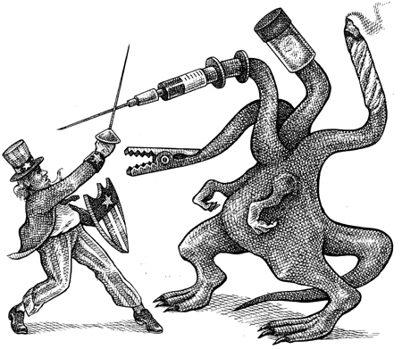
Reagan’s Social Policy
Greater emphasis on self-sufficiency
Stronger ties with Christian Right
Jerry Falwell’s Moral Majority
War on drugs - “Just Say No!”
Attn. Gen. Edwin Meese calls for regulation of obscene films & publications
Filled lower court judgeships w/ conservatives
Appointed O’Connor & Scalia to S.C.
also moderate Anthony Kennedy

Slide 38
Soviet - U.S. Relations
A lot of tension between them
Reagan moved away from détente - called the USSR the “Evil Empire”
U.S. dedicated to halting spread of communism
Soviets against U.S. involvement in Central America & elsewhere
Reagan didn’t meet w/ a Soviet leader during his 1st term

Slide 39
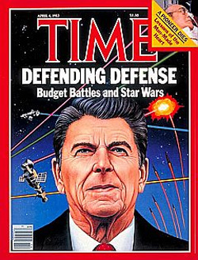
Reagan & Gorbachev
Met in Nov. 1985 - Geneva
To discuss nuclear proliferation
U.S. developing or deploying MX missiles, intermediate Pershing missiles, and Strategic Defense Initiative (Star Wars)
USSR making new systems too

Slide 40
Geneva Results
Improved US/USSR relations
Disagreement over verification prevented major changes
Gorbachev insisted that Reagan drop SDI (he refused)
Agreed to meet in future

Slide 41
Tax Reform Act of 1986
Dramatic change in income tax codes that adds to Reagan popularity
Exempted lowest incomes from taxation & dropped top rate by 13%
Eliminated many types of deductions by individuals & businesses
A fairer tax system but has loopholes for the rich

Slide 42
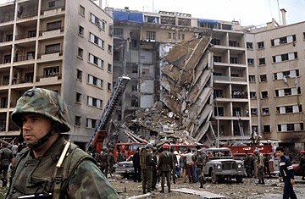
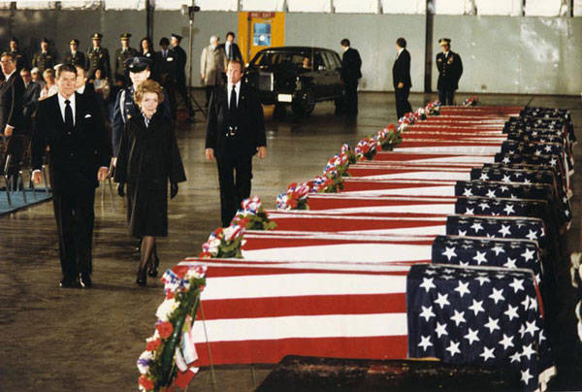
Reagan Foreign Policy
Cordial relations w/ China - détente
Middle East
U.S. part of multi-national peace-keeping force in Lebanon
Lebanon in chaos & civil war
U.S. embassy in Beirut bombed (63 dead) & Marine barracks bombed (241 dead).
Supported Israel & refused contact w/ PLO

Slide 43
Reagan’s Terrorism Policy
Widespread anti-U.S. terrorism during mid-1980s (bombings, hijackings, kidnapping, etc.)
Many hostages in captivity for a long time
Libya bombed after being linked to 1986 terrorist bombing at Berlin disco
U.S. policy generally excluded dealing w/ terrorists - didn’t want to encourage them

Slide 44
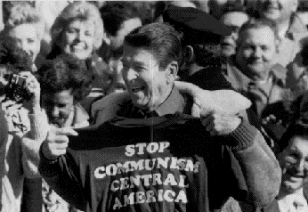
Reagan Foreign Policy cont.
Central America & Caribbean:
Reagan committed to stopping spread of communism in the region
Congress non-supportive of his efforts
Nicaragua - friendly to USSR & supporting leftist movt. in El Salvador
Despite congressional ban on efforts to overthrow Nicaraguan govt., Reagan admin. supported Contras through CIA
El Salvador
Reagan sent military advisors & financial aid to help the govt. against leftist revolutionaries

Slide 45
Iran - Contra Scandal - 1986
U.S. hostages held in Lebanon by pro-Iranian terrorists
To win their release - U.S. secretly sold arms to Iran in exchange for Iran’s help
Profits from sale sent to Nicaragua to support anti-communist rebels there
Against Reagan’s stated policy & law banning aid to Contras

Slide 46
Iran-Contra
Secret deal discovered by press
Reagan claimed to be unaware of the deal - a hands-off president
Tower Commission - appointed by Reagan to investigate NSC (12/86)
Found examples of deception & disregard for law by Reagan staff
Reagan failed to properly supervise staff
consequently ill-served by them

Slide 47
Iran-Contra
May to Aug 1987, televised Cong. hearings
Key figures testified that Reagan knew about aspects of the arms-for-hostages plan
He had urged NSC staff members to find a way around ban on helping Contras
Oliver North & others did not inform Reagan of specifics, but thought actions met approval
Final report - Reagan responsible but not tied to most serious violations

Slide 48
Iran - Contra
North, Poindexter, & McFarlane indicted for violating federal law
Reagan’s reputation bruised but not destroyed
Many start to refer to him as the “Teflon President”

Slide 49
Arms Control
Met w/ Gorbachev again in Oct. 1986 - Reykjavik, Iceland
Reykjavik summit failed but new talks held in Washington D.C. in Dec. 1987
Major Reagan foreign policy triumph
Intermediate-Range Nuclear Forces (INF) Treaty
U.S. to destroy 358 missiles
Soviets - 573 (some being multi-warhead missiles)
total # Soviet warheads to be destroyed is 4X that of U.S.

Slide 50
INF Treaty 12/87
First comprehensive nuclear arms control treaty
Agree to a system of short- notice verification inspections

Slide 51
Reagan Foreign Policy Impact
Middle East policy helped foster peace in the region
Anti-U.S. feeling still ran high
Helped provide allies for Gulf War
Central American policy created resentment in Latin America

Slide 52
Reagan Foreign Policy Impact
Highly visible military presence in Europe held off Communist Bloc but created tension among allies
Spending duel on nuclear programs weakened USSR & forced them to the negotiating table

Slide 53
Reagan Foreign Policy Impact
Hard-line policy toward USSR key to ending Cold War
Came w/ a high cost
U.S. budget deficit rose to record high figures
Diverted $ away from social programs

Slide 54
George H. W. Bush
1989 - 1993

Slide 55
1988 Election
1988 - Bush won the Republican nomination for President
Senator Dan Quayle of Indiana was his running mate
Criticized as too conserv., unintelligent, and a draft dodger
Defeated Mass. Governor Michael Dukakis in election
Bush ran negative campaign & also promised “no new taxes”
Won 54% of vote (426-112)
Democrats retained control of both houses of Congress

Slide 56
Domestic Issues
Creation of Americans with Disabilities Act [ADA] (1990)
Costly bail-out of Savings and Loan associations (1990)
Raising taxes to reduce budget deficit – despite pledge (11/90)

Slide 57
Milestones of Bush Presidency
Communism failed in Europe
Fall of Berlin Wall (1989) & reunification of Germany
Cold War ended after 40 years
USSR and U.S. agree to Strategic Arms Reduction Treaty (START I and START II) 1991 – ratified in 1992
U.S. & U.S.S.R plan to dismantle strategic nukes
Soviet Union collapsed
Gorbachev quit – Boris Yeltsin the new Russian President
New challenge – dealing with newly independent European countries – encouraging democracy there

Slide 58
Other Foreign Policy Matters…
North American Free Trade Agreement (NAFTA)
U.S., Mexico, Canada lower tariffs and restrictions

Slide 59
Persian Gulf War
Bush's greatest test came when Iraqi President Saddam Hussein invaded Kuwait (1990)
Threatened to move into Saudi Arabia
With Kuwaiti and Saudi oil fields – Iraq would have 50% of world’s oil

Slide 60
Persian Gulf War
Bush vowed to free Kuwait and protect Saudi Arabia
Rallied U.S. public and U.N. support for action against Iraq – Operation Desert Shield
Sent 425,000 American troops to Persian Gulf
Joined by 118,000 troops from 30 allied nations
Weeks of air and missile bombardment known as Operation Desert Storm began 1/17/91
Followed by 100-hour land battle (2/24/91)
Routed Iraq’s million-man army

Slide 61
Bush was very popular because of the war but…
Approval didn’t last long enough for him to win reelection
Discontent at home from …
Faltering economy impacting the middle class
Inner-city violence (Drugs, gangs, etc.)
Continued high deficit spending
Bush viewed positively on foreign affairs but negatively on domestic issues – the latter tend to decide elections

Slide 62
Bill Clinton
1993-2001

Slide 63
1992 Election
Arkansas Governor Bill Clinton won nomination in primaries, despite rumors of infidelity
Pledged activist government, addressing environment, health care, and economy. Strongly pro-choice.
President Bush won an easy reelection in primary.
Republican right dominated party convention, crusading for “family values”
Third Party Candidate: Texas million/billionaire H. Ross Perot
At one point, nearly 40% of voters supported him
Eccentric, poor response to critics turned off many potential supporters

Slide 64
1992 Election
The Campaign:
Bush attacked Clinton’s character
Clinton focused on stagnant economy, problems of the middle class.
Popular Vote: Clinton-43%, Bush-38%, Perot-19%
Perot gained largest third-party candidate share since Teddy Roosevelt in 1912.

Slide 65
Domestic Agenda
Clinton and Gore were leaders of the New Democratic Coalition
Moderates who sought to shed Democratic reputation for high taxes, heavy spending
Females
Named women heads of numerous departments, including the UN delegation.
Appointed wife Hillary to head the Task Force on National Health-Care Reform
Homosexuals
Tried to fulfill campaign pledge to end the exclusion of homosexuals from military service provoked controversy
Agreement: “Don’t ask, don’t tell”

Slide 66
The Economy
Feb. 1993- economic program offered > proposed spending cuts, tax increases to ease budget deficit.
Also proposed increase in spending to stimulate economic growth
August 1993- Congress enacted economic plan that incorporate Clinton’s plan except economic stimulus plan
Economy improved
By 1994, unemployment fell to lowest point in 4 years
Oil prices back to what they were before OPEC increases

Slide 67
Failure in Congress…
Health Care
Healthcare prices were increasing drastically.
Hilary’s task force proposed sweeping reform plan at expense of increased tobacco taxes.
Defeated by lobbyists for doctors, tobacco companies, insurance industry, retired persons
Fall of plan cost the Clinton presidency

Slide 68
Clinton’s Public Support
Mid-1994-approval ratings dropped to 42%.
Considered too ready to compromise, too inclined to flit from issue to issue.
More sexual harassment charges (Arkansas employee Paula Jones said Clinton had solicited sexual favors when he was governor)
Political climate turned nasty. Clinton experienced numerous attacks.
Christian Coalition, religious right

Slide 69
Clinton Loses Popularity
Voters saw Clinton as an old Democrat of the big-government, “tax-and-spend” variety.
Call for homosexuals being accepted in the army made him look bad (to conservatives)
Had a reputation as hopelessly indecisive.
New middle class movement to downsize
government, reform welfare, slash taxes, shift
power to states
Network of conservative organizations
orchestrated the rightward swing:
Christian Coalition, National Rifle Association
While prosperity was increasing, it did little to affect the average American family

Slide 70
1994 Mid-term Election
Republican landslide; GOP controlled both houses for first time since 1954.
Evangelical Christians flocked to the polls
“Contract with America:” pledged tax cuts, congressional term limits, tougher crime laws, balanced-budget amendment
Signed by 300 Republican candidates for office

Slide 71
Welfare Reform
Conservatives challenged the premises of welfare:
Cost too much
They believed it undermined the work ethic and trapped the poor in a cycle of dependence.
Politicians of both parties wanted welfare reform
Common consensus: the present system failed; welfare should be a short-term tool to gaining employment, not a lifelong entitlement.

Slide 72
Welfare Reform
August 1996- Clinton signed landmark welfare reform bill
Ended AFDC (Aid to Families with Dependent Children)
States to develop own welfare programs with federal grants, withdraw Medicaid coverage once welfare benefits terminated.
Effects: by December 1998, the welfare rolls dropped by 38% to 7.6 million
Critics warned of effects of bill on poor children, welfare mothers in inner cities
Clinton’s signing of the bill was proof of him starting to lean right in response to the election of 1994

Slide 73
1990s Social Trends
Culture of 1990s reflected general prosperity, with heavy emphasis on consumerism, leisure pursuits, mass-media diversions
Population increased by 33 million in 1990s, movement south and west continued.
Baby boomers caused average age to increase.
Traditional families became less common—from 74% in 1960 to 52% in 2000
Overall crime rate fell nearly 20% from 1992 to 2000

Slide 74
The “New Economy”
America in the late twentieth century experienced a decline in the industrial sector, rise of a service-based economy
58% of male workers were in service industry in 1998
Service economy was highly segmented—included everyone from fast-food workers to physicians.
Young people with education and skills entered high-tech industries
Older workers displaced from industrial jobs; devastating them both economically and emotionally.

Slide 75
Social Trends
diminished civic engagement, weakened interest in public issues.
Privatization of life, erosion of the public sphere.
The media
Showed desire for riches—Who Wants to be a Millionaire and Survivor.
Gays and Lesbians
Grew more vocal politically, increasingly visible in pop culture, on TV
Rash of state-level efforts sought to counter their demands for equality.
1998-gay student at University of Wyoming was tortured and murdered because of his sexual orientation - Matthew Shepard

Slide 76
Change in Society
April 19, 1995-bombing outside an Oklahoma City federal building, killing 168
A series of bombs were mailed between 1978 and 1995 to “anti-environmental” individuals. Killed 3, injured 28.
Theodor Kaczynski convicted for the crimes.
Many people feared the year 2000 as a possible apocalypse.
Y2K added to these fears

Slide 77
George W. Bush
2001-2009

Slide 78
2000 Election
Mixture of a strong economy and a scandal-ridden presidency = close presidential election
Democratic Candidate: Vice President Al Gore
Republican Candidate: Texas Governor George W. Bush.

Slide 79
2000 Election Results
Pre-election polls showed Gore and Bush virtually tied.
Votes in several states were too close to call on election night
Florida = enough electoral votes to win the presidency
Lawyers, politicians, and the media swarmed to Florida to monitor a recount of votes
Supreme Court decision: 5–4 to stop the Florida recounts
Awarded the state’s electoral votes to Bush.
Gore won the popular vote, but Bush won the election by 271 to 266.

Slide 80
Bush Administration
Dick Cheney – Vice President
Colin Powell – Secretary of State
Highest-ranking African American to serve in a presidential administration
Condoleezza Rice – national security advisor
Later Secretary of State during Bush’s 2nd term

Slide 81
Attack on America
September 11, 2001: terrorists hijacked four commercial airplanes. Two hit Twin Towers of World Trade Center NYC, 3rd plane hit Pentagon, 4th crashed in field near Pittsburgh, Pennsylvania.
1st time since 1812 = attack on U.S. mainland
Thousands died in the collapse of the 2 towers
Americans responded with an outpouring of support for the victims.

Slide 82
President Bush vowed to bring justice to those responsible for the attack (al Qaeda – headed by Osama bin Laden).
October 7: “Operation Enduring Freedom” against Afghanistan
Taliban was believed to be harboring Saudi dissident Osama bin Laden (suspected of masterminding the attack)
U.S. claimed victory in Dec. Captured al Qaeda fighters sent to Guantanamo Bay, Cuba

Slide 83
Tightening Security at Home
Transportation Security Administration (TSA): increased airport security
USA – Patriot Act: govt can monitor telephone and email communications and library internet searches
Dept of Homeland Security: included Coast Guard, Customs Service, Federal Emergency Management Agency (FEMA), Immigration and Naturalization service

Slide 84
Campaign in Iraq
Bush calls Iran, Iraq, and North Korea the “axis of evil”
Iraq’s Saddam Hussein accused of stockpiling/developing nuclear, chemical, and biological weapons
Neoconservatives: wanted aggressive foreign policy dedicated to spreading democracy to Arab world
Democratizing Iraq = 1st big step

Slide 85
A Controversial War
Critics asked administration of prove claims of weapons > thought preemptive war could last years and make more Arab countries angry at U.S.
October 2002: Congress passed resolution authorizing Bush to defend national security of U.S. against the continuing threat posed by Iraq
Used by Bush as legal basis for invading Iraq

Slide 86
A Controversial War
March 19, 2003 = U.S. cruise missiles rained down on Baghdad; land invasion March on 21
Conditions worsen (bombings, kidnappings, deadly highway blasts by IEDs) = War quickly becomes a quagmire

Slide 87
The Results
No weapons of mass destruction found in Iraq
Senate Intelligence Committee concluded that CIA had supplied faulty or incomplete information and administration officials had placed “significant pressure” on CIA to link Saddam to al Qaeda
Evidence suggests Cheney and officials “cherry-picked” intelligence data that strengthened case against Iraq and downplayed contradictory data

Slide 88
Economy
Trouble areas:
Stock market falls by more than 6%
Silicon Valley information-technology companies = hard hit
250 businesses collapsed within a few months
Industrial production dropped and service-sector employment fell fast > every state lost jobs
Longest economic boom in American history ended
Bush administration = inherited a budget surplus > now projected years of deficits
Business corruption/bankruptcies (Enron, WorldCom, Tyco) eroded investor confidence in market

Slide 89
Domestic Agenda
$1.35 trillion cut in income taxes
Bush argued it would stimulate investment and speed recovery > led to budget deficits
Energy bill
Gave $14.5 billion in tax breaks to oil, natural gas, coal, and nuclear power companies; exempted them from some environmental laws; offered 1 year tax credit for purchasing hybrid vehicles
“No Child Left Behind”
Standardized national tests in grades 4 & 8 to measure reading and math skills, with penalties for schools that fell short

Slide 90
2004 Election
George W. Bush/Dick Cheney vs. John Kerry/John Edwards
Major divisions over death penalty, abortion, gun control, same-sex marriage
Bush/Cheney win 51% of popular vote to Kerry’s 48%; Bush narrowly won Electoral College vote

Slide 91
Hurricane Katrina
August 2005: Hurricane Katrina slammed into the Gulf Coast
1400 people died; AL, MS, LA = massive damage
New Orleans = most damage due to levees breaking
Government response (FEMA) = ineffective and slow response

Slide 92
Supreme Court
Sandra Day O’Connor retired and Chief William Rehnquist died
Bush appointed John G. Roberts as Chief Justice and Samuel Alito, Jr.

