Slide 1
Adulthood
Are you ready for it?
Chapter 7

Slide 2
Adult Male Development
At the forefront of this research was Daniel Levinson.
Extensive, longitudinal study to identify these adult male developmental stages.
Selected men from a variety of different career fields.
Key areas of focus: education, work, leisure, politics, and relationships with family and friends.
Used their findings to determine life structure= combination of statuses, roles, activities, goals, values, beliefs, and circumstances of an individual.

Slide 3
Adult Male Development
Were able to distinguish patterns, or generalized characteristics for all adult males.
Three major eras:
Early adulthood (Age 17-39)
Middle adulthood (Age 40-59)
Late adulthood (Age 60-75+)
Alternating time periods of transition and stability.

Slide 4
Adult Male Development
Levinson stressed the importance of the first 5 stages in adult male development.
Early Adult Transition (17-22 years)
- Focus on leaving home, physically and psychologically
Entering the Adult World (23-27 years)
Explore relationships and career opportunities
Become a responsible member of society to form stable life structure.
Development of ‘adult accomplishment’ dream.

Slide 5
Adult Male Development
The Age 30 Transition (28-32 years)
Reflect on the choices you have made.
End of Levinson’s novice phase= time when men prepare to enter the adult world.
The Settling Down Period (33-39 years)
Establish oneself in society
Form true commitments– both personal and professional
Fulfill dreams
B.O.O.M. (Becoming One Own’s Man)– separate from a mentor (someone who fosters an individual’s development).

Slide 6
Adult Male Development
The Midlife Transition (40- 44 years)
Re-examine, sometimes realizing that previous dreams are unrealistic.
Adjust accordingly.
Period of moderate to severe crisis (80%).
Subjects went through the study at the same time.
Degree of difficulty in a period depends on mastery of previous stage.

Slide 7
Adult Female Development
Repeated life-structure study with women.
Conclusions:
Men and women go through same stages of adult development.
Men and women deal with developmental tasks in each stage differently.
However, not everyone agrees with Levinson. Irene Frieze and Esther Sales are two such individuals.
Suggested three phases of adult female development.

Slide 8
Adult Female Development
Phase 1: Leaving the Family
Leave home, break from parents and develop a plan.
Focus less on a career than on marriage.
Phase 2: Entering the Adult World
Dual roles between motherhood and a career.
Job advancement opportunities lessen when women stay home with children.
Break in employment is distinctly female.

Slide 9
Adult Female Development
Phase 3: Entering the Adult World Again
Women re-enter the workforce when children reach school age.
Coincides with the time that males are having doubts about own careers.
Prevalence of women in career positions is increasing.
Over the past few years, developmental patterns of men and women are merging, data shows.

Slide 10
The World of Work
Chapter 7, Section 2

Slide 11
The Labor Force
Labor force= all individuals age 16 and older who are employed in paid positions or seeking paid employment.
Who makes up the labor force is changing.
Growing presence of women in the workforce.
Rise in minority workers.
Higher education level of those in workforce.
Profession= a high-status occupation that requires formal skills, often through formal education.
What are some examples?

Slide 12
The Changing Nature of Work
Since 1900, we have seen a drastic shift in the fields where most people are employed.
1900: Farming→ 35%
Manufacturing/physical labor→ 45
Services→ 20%
2000: Farming and manufacturing→ 27%
Professional/service jobs→ 73%

Slide 13
Unemployment
Unemployment= when an individual does not have a job and is actively seeking employment.
Unemployment rate= percentage of civilian labor force that does not have a job, and is actively seeking one.
Factors influencing unemployment:
Age
Gender
Race
Cultural background
U.S. considers full employment around 95%

Slide 14
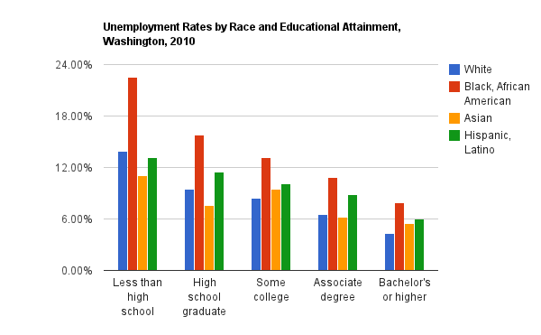
Analyze the Graph!

Slide 15
Job Satisfaction
The majority of people are satisfied with their job.
(some) Factors contributing to satisfaction: (choose 3 to write in your notes)
Control over work
Utilization of skills and talents
Recognition and appreciation
Positive relationships w/co-workers
Safe working conditions
Flexible hours
Job security

Slide 16
Job Satisfaction
(some) Factors contributing to dissatisfaction: (choose 2!)
Stress
Income
Promotion chances
Benefits
Because of this satisfaction, some people switch jobs.
Between the ages of 18 and 34, an individual holds roughly 9 jobs.
Average amount of time at current job: 3.5 years
Changing careers, as well… 5-6 careers in a lifetime.

Slide 17
Clarification
What’s the difference between a job and a career?
 | Career | Job
What is it?: | A career is the pursuit of a lifelong ambition or the general course of progression towards lifelong goals. | Job is an activity through which an individual can earn money. It is a regular activity in exchange of payment.
Requires: | Usually requires special training | Education or Special training may or may not be required
Risk taking: | A career may not mean stability of work as it encourages one to take risks | A job is “safe”, as stability of work and income is there.
Time: | Long term | Short term
Income: | High | Low

Slide 18
The Later Years

Slide 19
Changes in Older Adults
Gerontology= the scientific study of the processes and phenomenon of aging.
Social gerontology= study of the nonphysical aspects of the aging process.
Topics of study for social gerontologists differ based on the age of the individual.
Young-old= ages 65-74; focuses on adjustment to retirement.
Middle-old= 75-84
Old-old= 85+
Issues facing the last two groups include declining physical and mental functioning, dependency and death.

Slide 20
Adjustment to Retirement
The adjustment to retirement can be difficult for some seniors, but not as many as one would think.
Emphasis placed on occupation throughout life.
Factors affecting adjustment:
Income
Health
Social networks (ties to family, friends and the community)
Identity
Individuals who do not have strong social networks and self-identities can be more prone to suicide.
Higher rates in white males over 65– possibly due to their attachment to their careers.

Slide 21
Physical and Mental Decline
As the body declines, so does an individual’s ability to complete tasks quickly.
Contrary to popular belief, though, most elderly individuals retain their intellectual abilities.
Intelligence, learning and memory do decline.
Marked mental decline, or dementia, is most commonly seen in the form of Alzheimer’s disease.
An organic condition that results in the progressive deterioration of brain cells.
~15% of the population suffers from Alzheimer’s.

Slide 22
Dependency
Dependency= shift from being an independent adult to being dependent on others for physical or financial assistance.
Changes an individual’s status in society.
Changes in roles between parent and children.
Retirement can provide a sense of freedom for some, though.
New opportunities– classes, activities, hobbies.
Active role in politics: Gray Panthers; American Association of Retired Persons.
Those that are better prepared are more likely to thrive in their elderly years.

