Slide 1
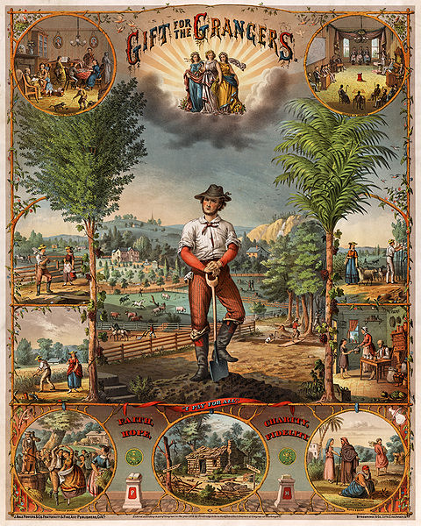

The Last Stand of the
Agrarians
Agrarian Politics, Populism,
and the 1896 Presidential Election

Slide 2
USHC 4.4
Explain the impact of industrial growth and business cycles on farmers, workers, immigrants, labor unions, and the Populist movement and the ways that these groups and the government responded to the economic problems caused by industry and business.

Slide 3
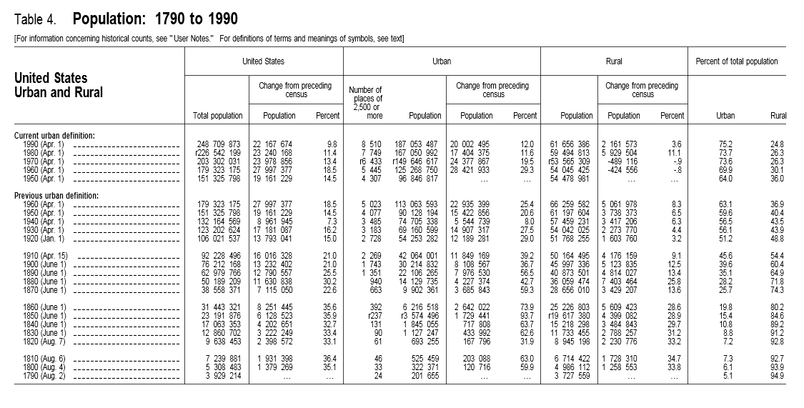
Urban / Rural Shifts
Source: http://www.census.gov/population/censusdata/table-4.pdf

Slide 4
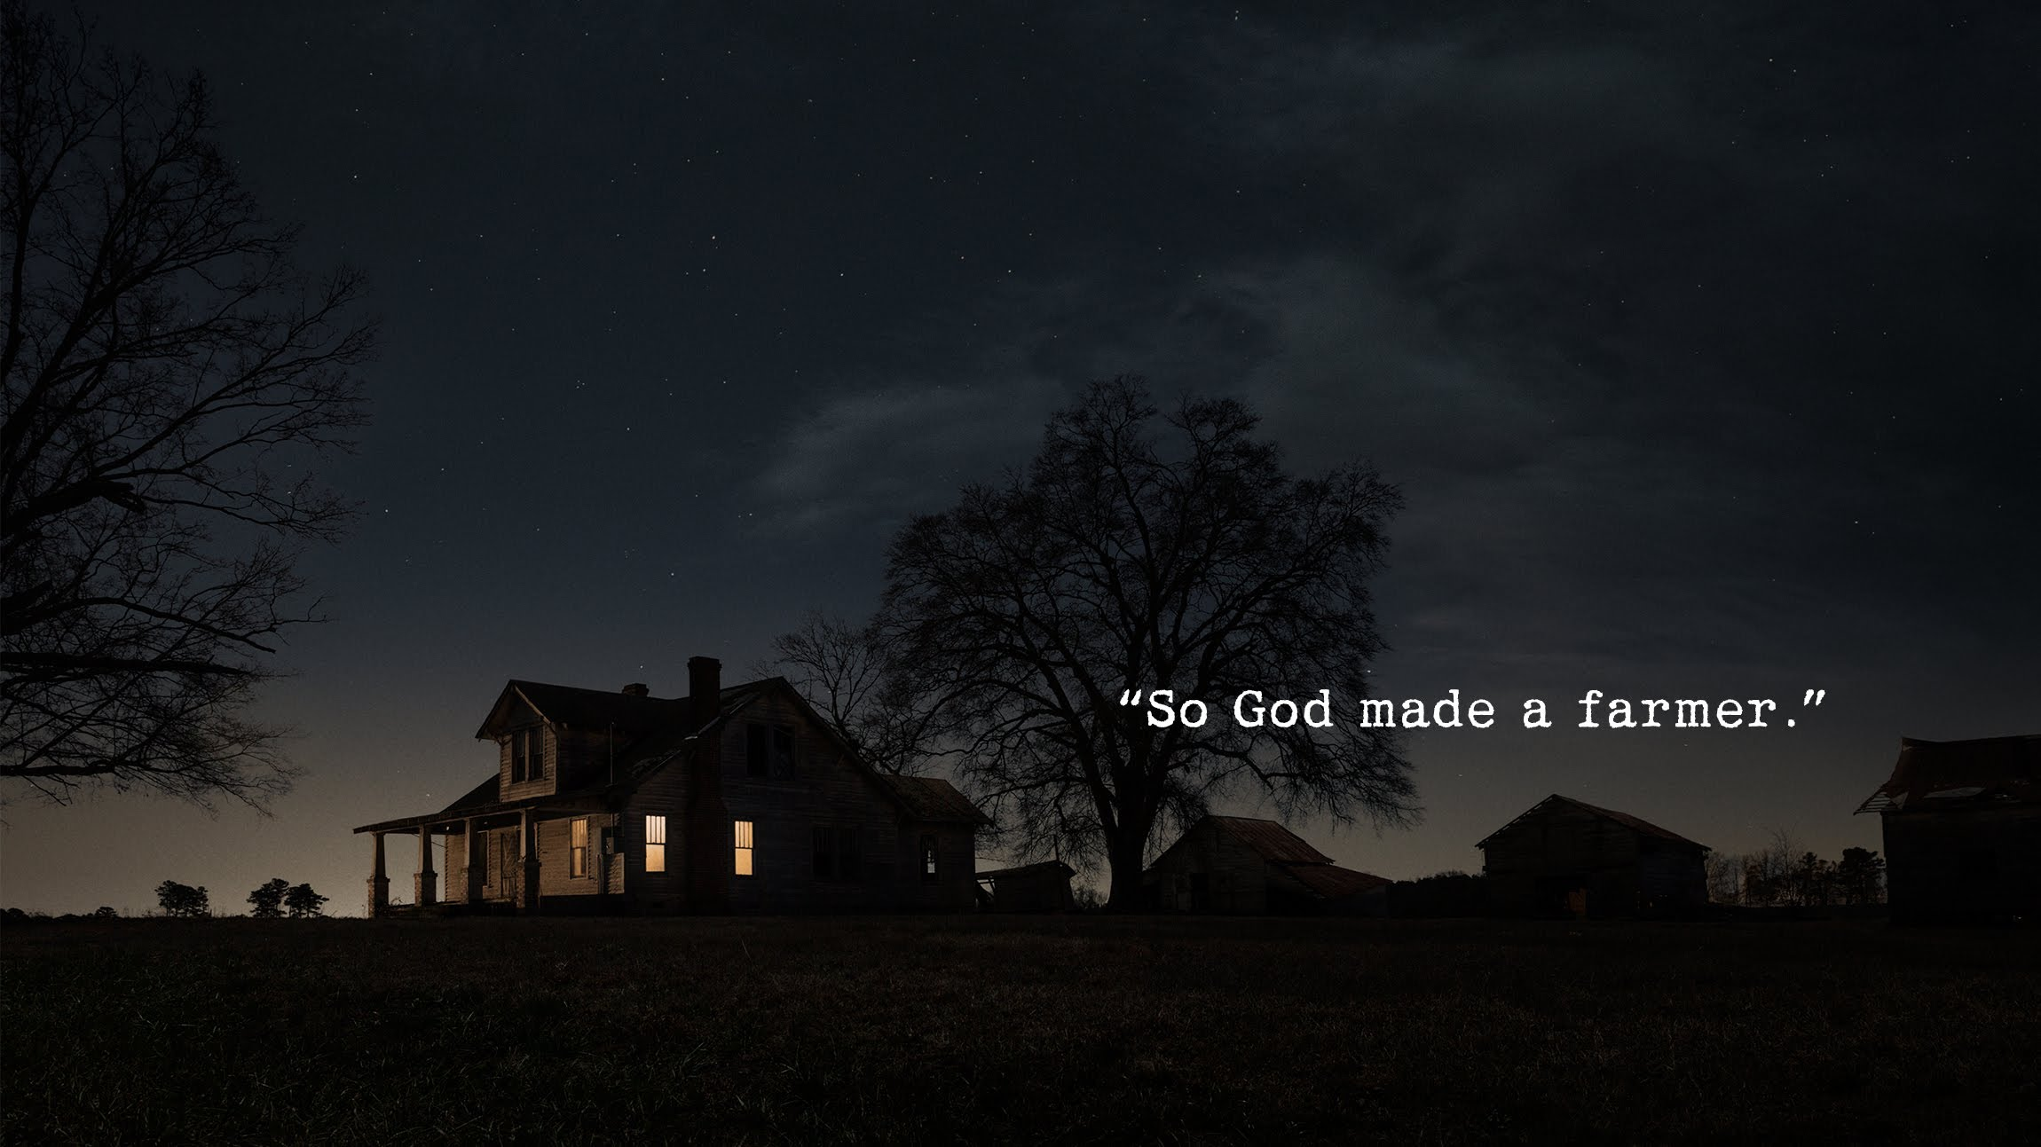
http://www.youtube.com/watch?v=AMpZ0TGjbWE

Slide 5
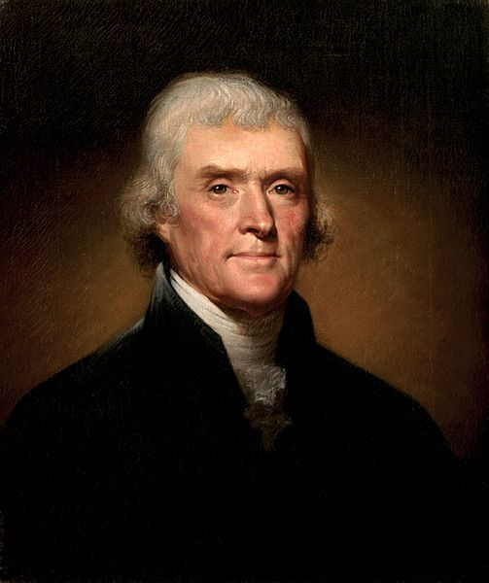

Slide 6
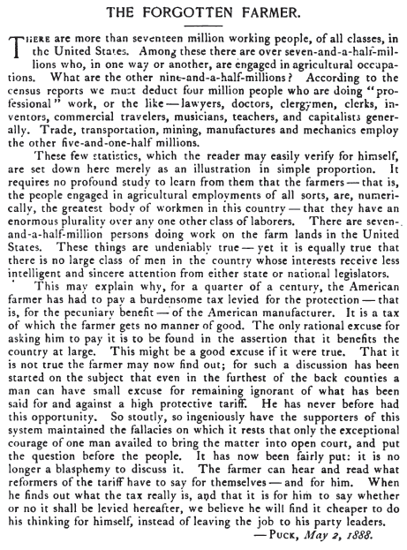

Slide 7

The American Labor Force
Puck Magazine, 1888

Slide 8
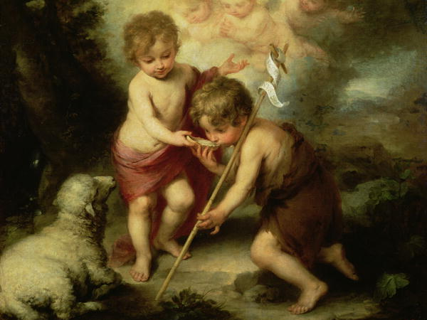
The Bible was directed to an audience of farmers.
“After me comes one who is more powerful than I, whose sandals I am not worthy to carry. He will baptize you with the Holy Spirit and fire. His winnowing fork is in his hand, and he will clear his threshing floor, gathering his wheat into the barn and burning up the chaff with unquenchable fire.”
-- John the Baptist (Matthew 3)

Slide 9
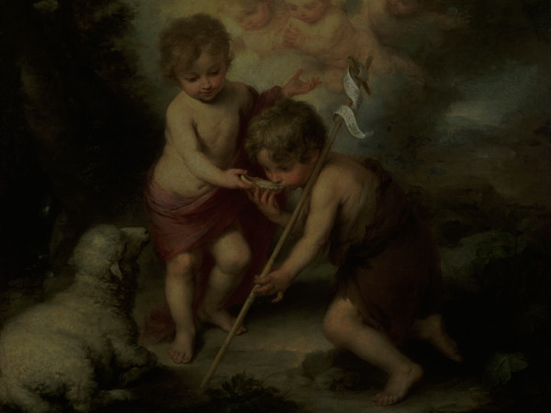
“After me comes one who is more powerful than I, whose sandals I am not worthy to carry. He will baptize you with the Holy Spirit and fire. His winnowing fork is in his hand, and he will clear his threshing floor, gathering his wheat into the barn and burning up the chaff with unquenchable fire.”
-- John the Baptist (Matthew 3)

Slide 10

Say WHAT?
Some rights reserved by DoodleDeMoon

Slide 11
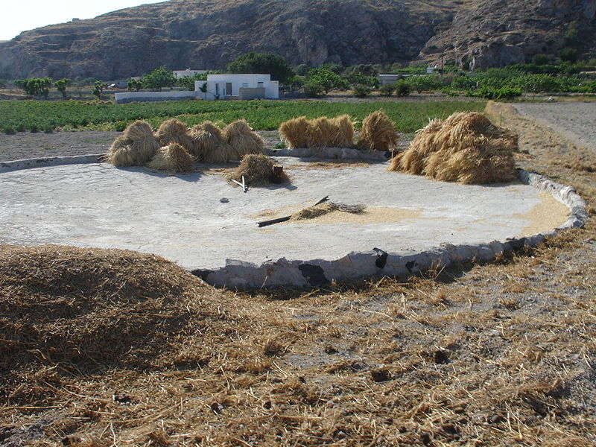
This is...
A Threshing Floor
Some Rights Reserved by Stan Zurek

Slide 12
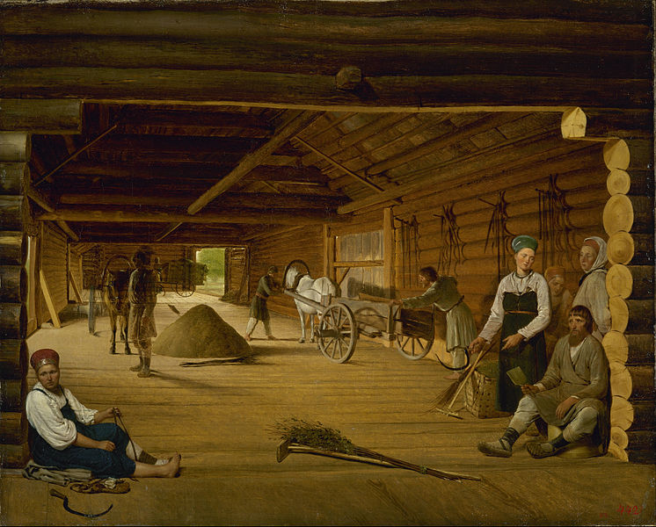
Eighteen centuries changed
very little about farming...

Slide 13
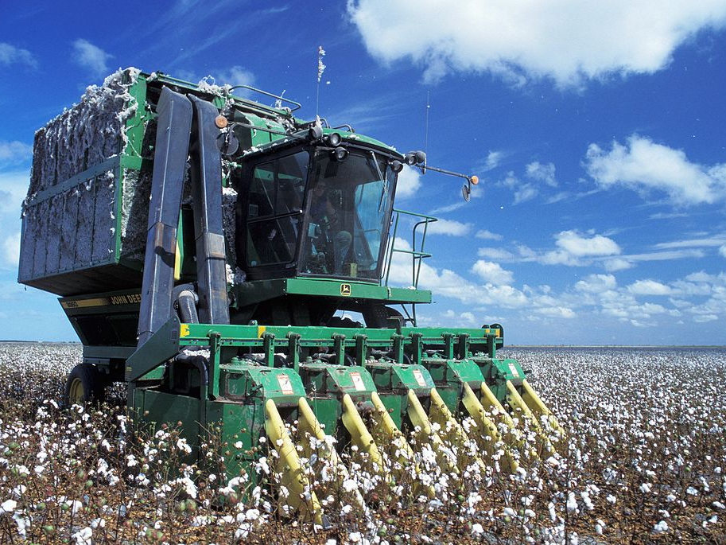
Mechanized Farming

Slide 14
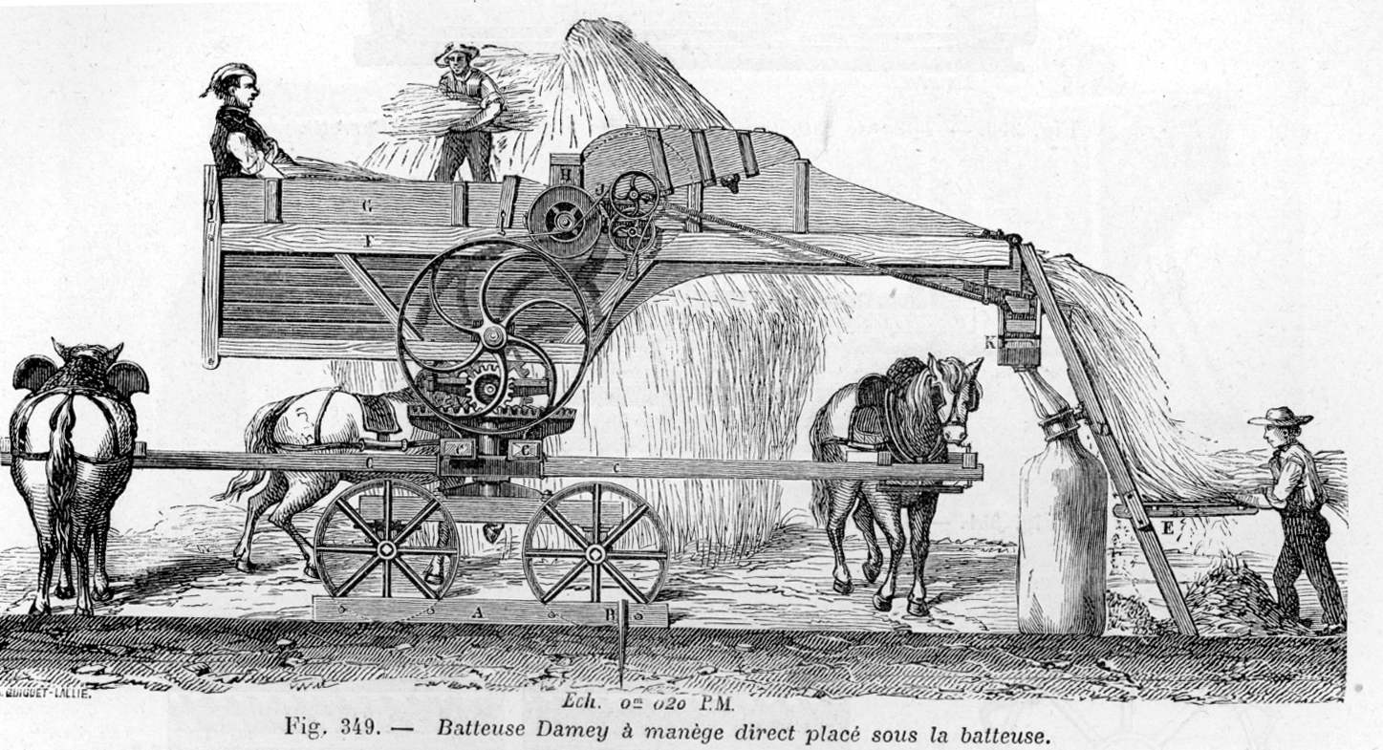
Mechanical Threshing Machine

Slide 15
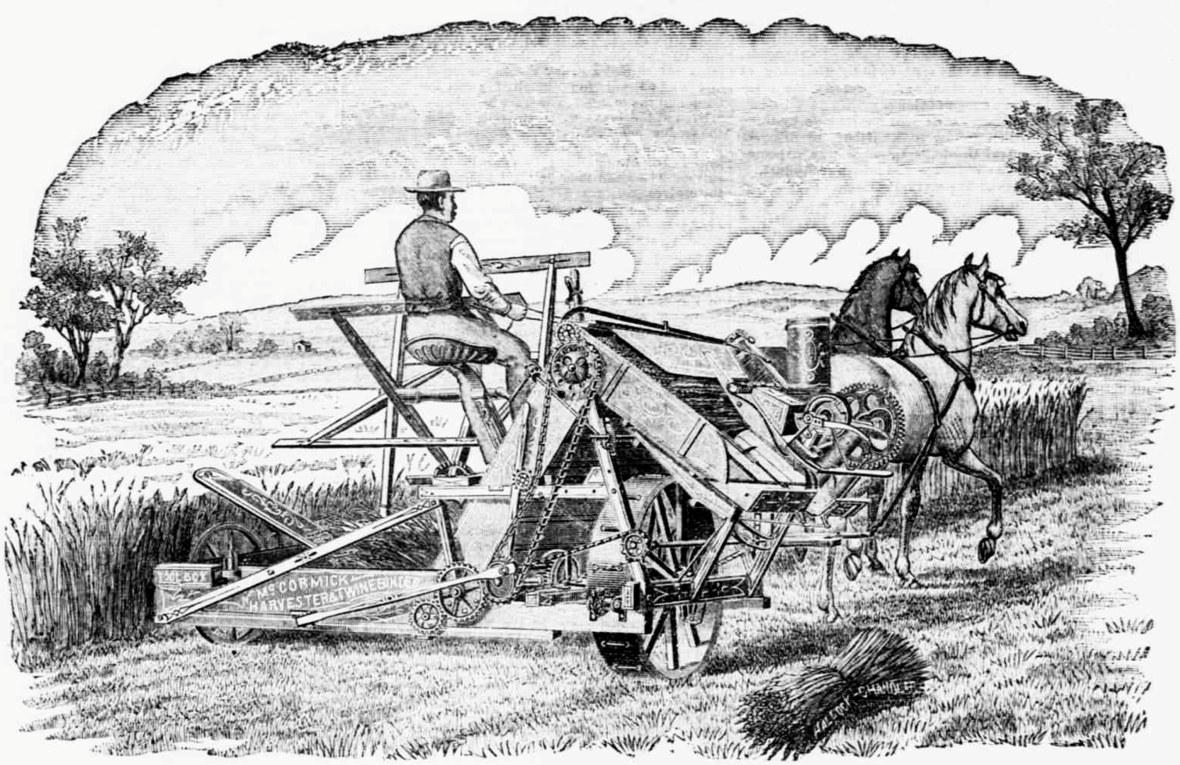
The McCormick Reaper

Slide 16
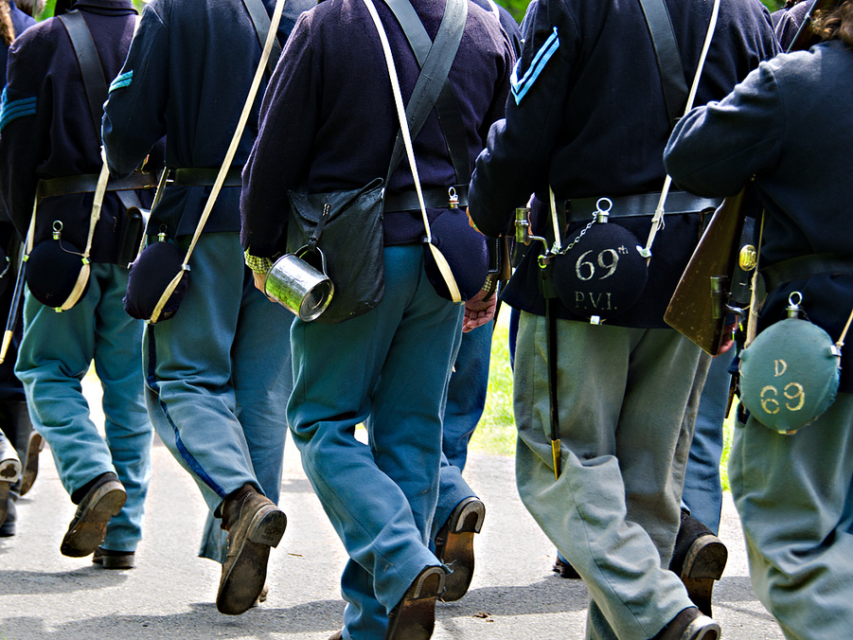
Every McCormick Reaper freed five men to fight for the Union.
Some rights reserved by dfbphotos

Slide 17
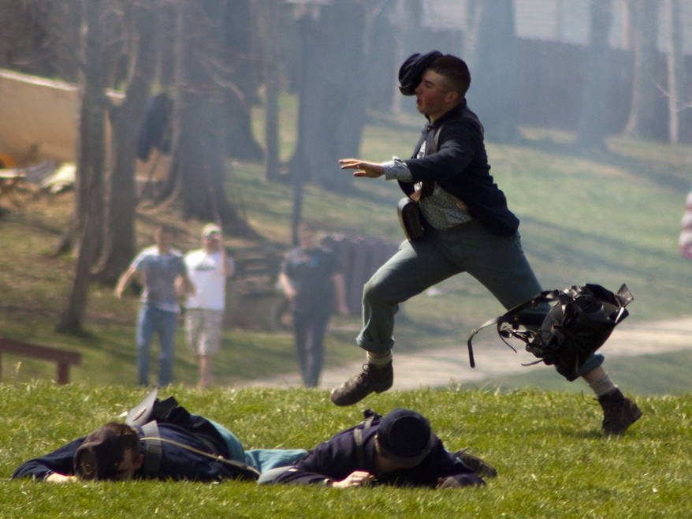
Not that they all wanted to
Some rights reserved by frankpierson

Slide 18
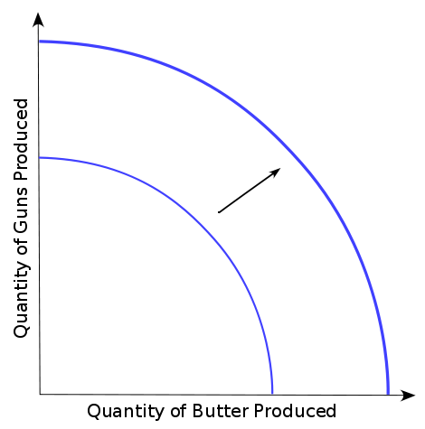
Technology & Economic Growth
Better Technology = Increased Production
Agricultural Production

Slide 19
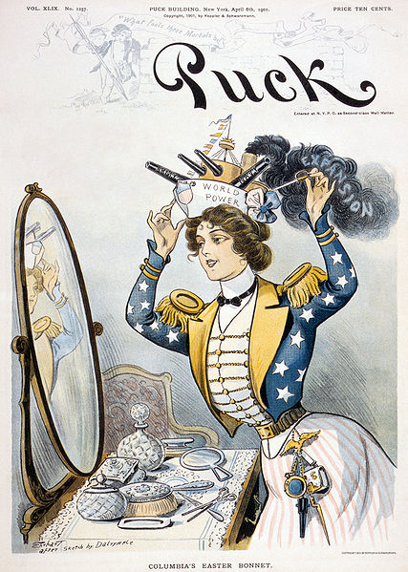
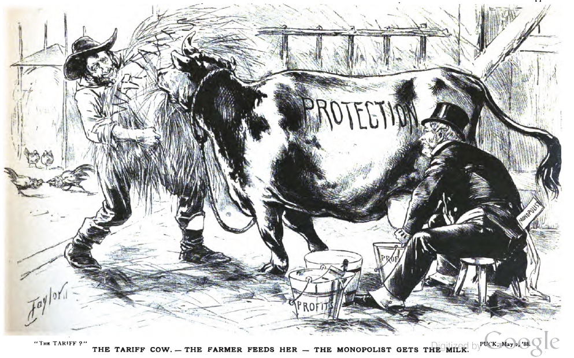
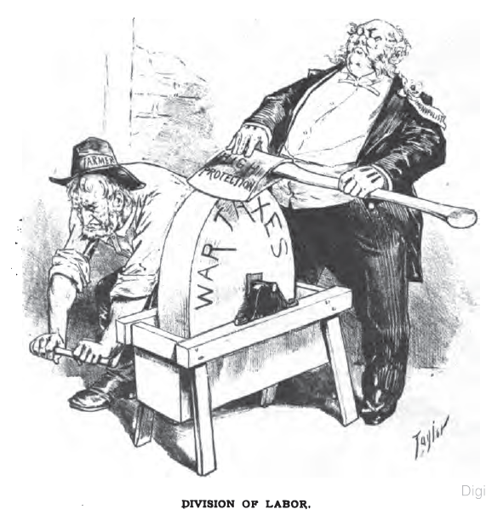
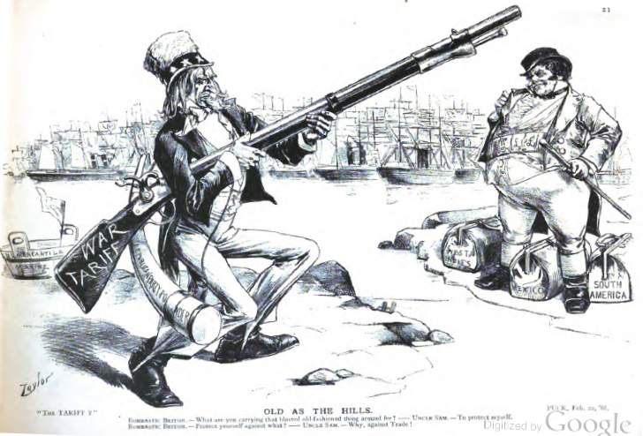
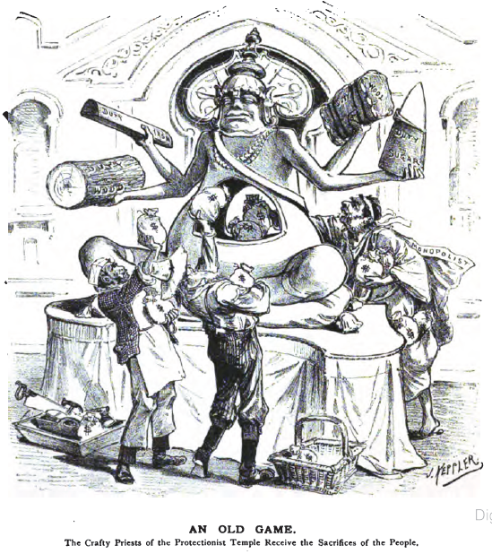
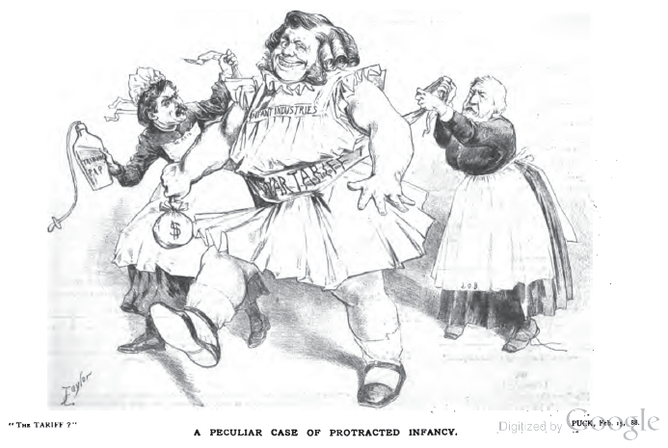
Political Cartoons
From Puck Magazine (Democratic Publication)

Slide 20
AN OLD GAME.
The Crafty Priests of the Protectionist Temple Receive the Sacrifices of the People.

Slide 21
The Tariff Cow. – The Farmer Feeds Her – The Monopolist Gets the Milk.

Slide 22
Division of Labor.

Slide 23
What are you carrying that bloated old-fashioned thing around for?
To protect myself.
Protect yourself against what?
Against TRADE!

Slide 24
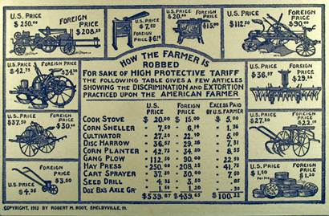

Slide 25
A Peculiar Case of Protracted Infancy.

Slide 26
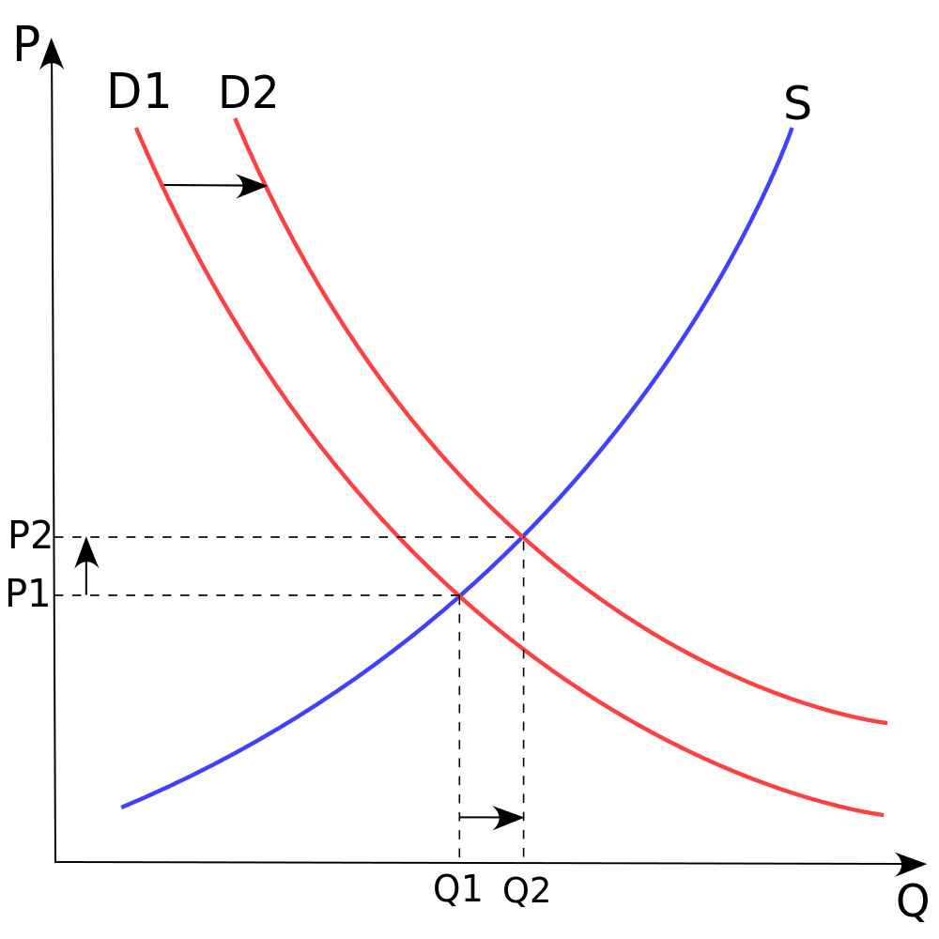
Chart by:
Paweł Zdziarski

Slide 27
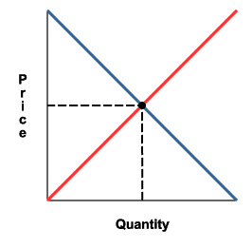
Overproduction and its Consequences
Agricultural Production
Trade
(Distribution)
Domestic Consumption

Slide 28
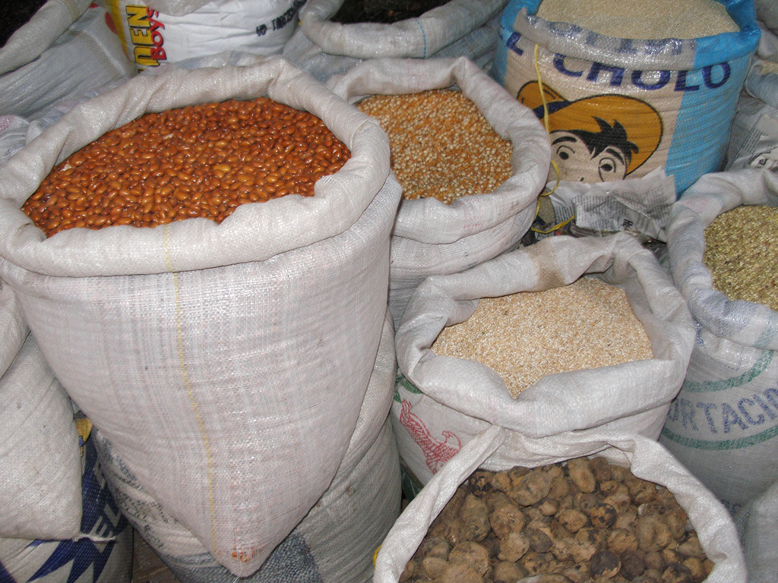
SURPLUS
Some rights reserved by quinet

Slide 29
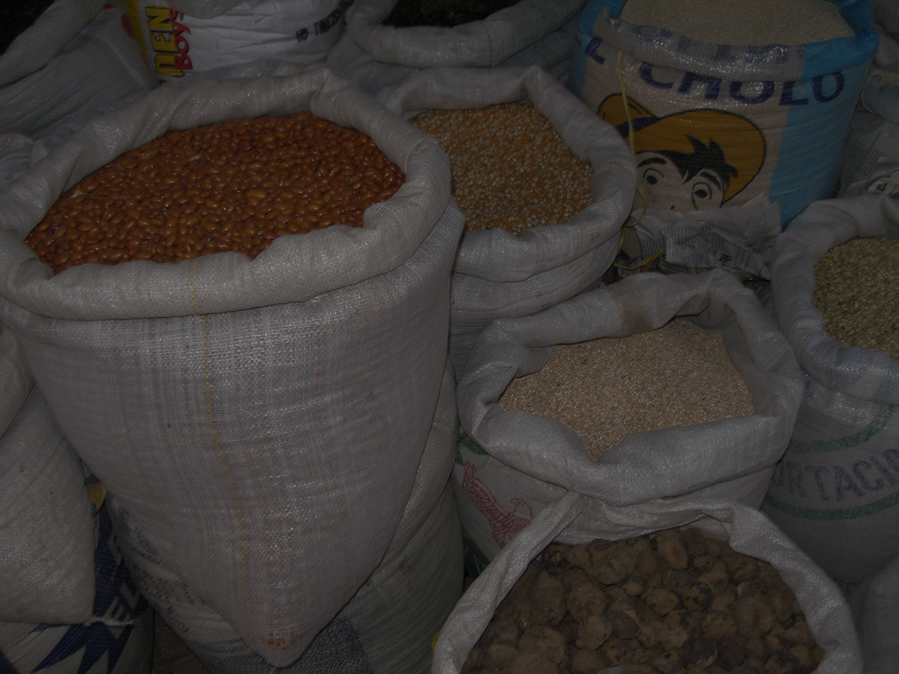
LOW PRICES
Some rights reserved by quinet

Slide 30
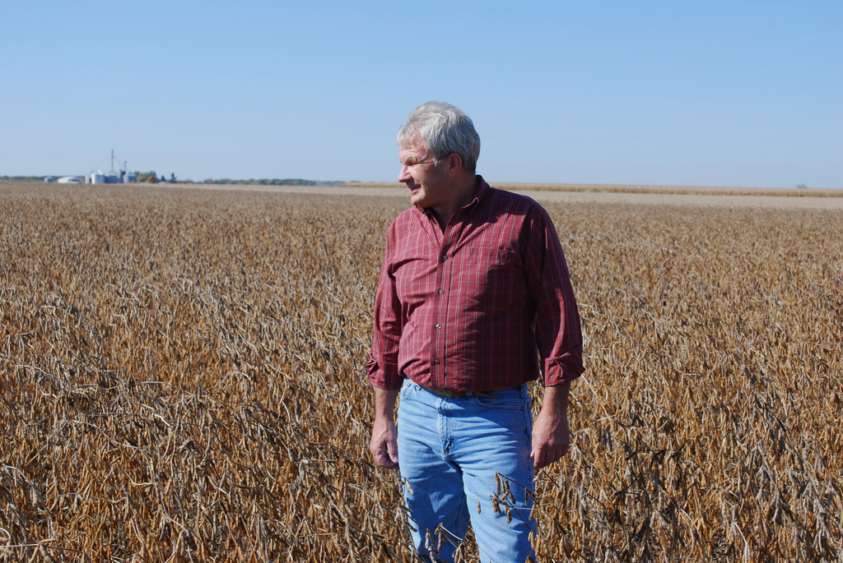
SUCKS TO BE
YOU
Some rights reserved by UnitedSoybeanBoard

Slide 31
The American Labor Force
Puck Magazine, 1888

Slide 32
COMBINATIONS
MONOPOLISTS
[Trusts]
Government Policy
FARMERS?
Although the farmers still made up the plurality of the work force in the late 19th century, they were the last to organize as an interest group.
LABORERS
[UNIONS]

Slide 33
Farmers Unite!
Social
Economic
Political
The Grange
Farmers’ Alliances
Populist Party

Slide 34
Patrons of Husbandry
AKA The
“Grangers”

Slide 35
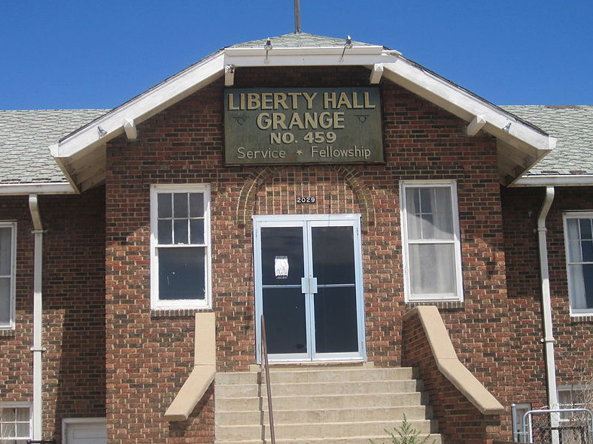
Photo Credit: Billy Hathorn

Slide 36
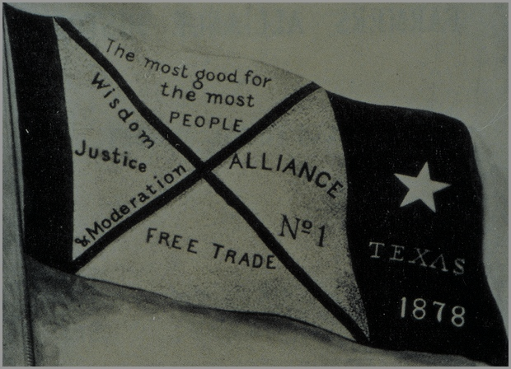
Farmers’
Alliances
Economic Cooperatives

Slide 37
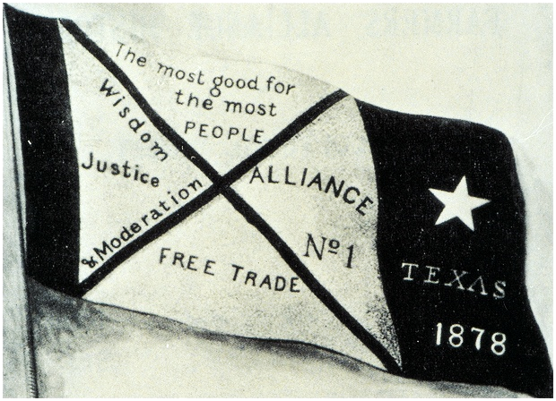
Farmers’
Alliances

Slide 38
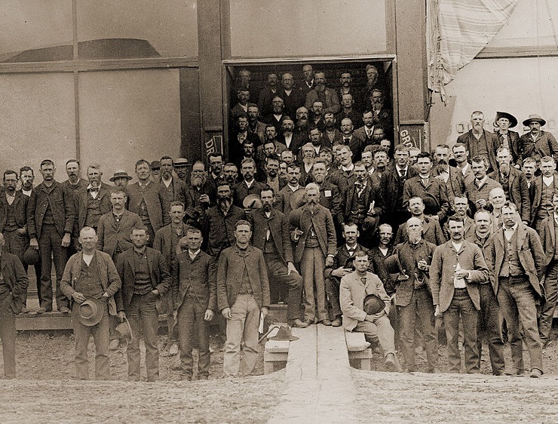
The People’s Party
AKA “POPULISTS”
Photo of People's Party convention at Columbus, Nebraska, 1890

Slide 39
WHO?
Southern and Western Farmers
Photo of People's Party convention at Columbus, Nebraska, 1890

Slide 40
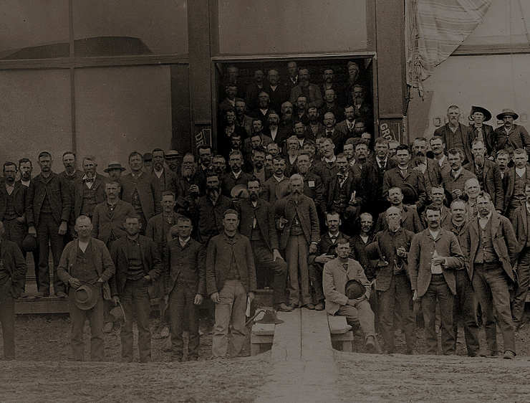
“THIRD” Party
Photo of People's Party convention at Columbus, Nebraska, 1890

Slide 41
The Populist Platform
Political Reform Proposals | Economic Reform Proposals
Graduated [Progressive]
Income Tax
Unlimited Coinage
of Silver
Nationalization
of Railroads
Direct Election
of Senators
Ballot Initiatives
Secret Ballot

Slide 42
A Jeffersonian Movement?

Slide 43
The Populist Platform
Political Reform Proposals | Economic Reform Proposals
Graduated
Income Tax
Unlimited Coinage
of Silver
Nationalization
of Railroads
Direct Election
of Senators
Ballot Initiatives
Secret Ballot

Slide 44
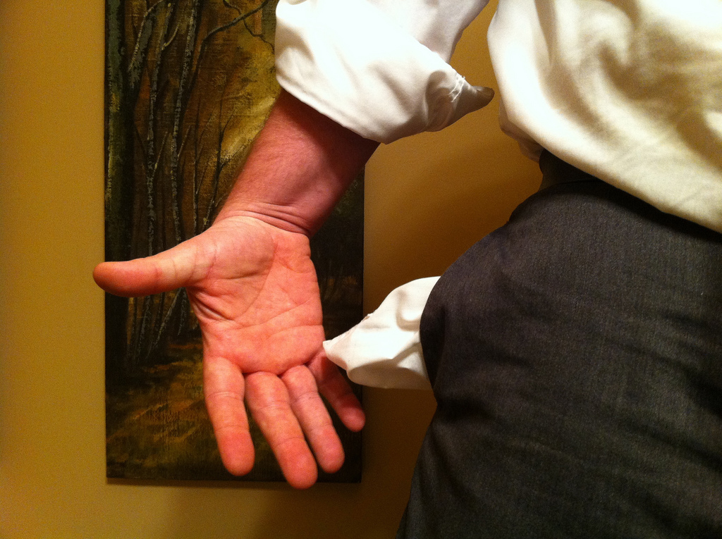
THE MONEY SUPPLY
Some rights reserved by danielmoyle

Slide 45
Chart by:
Paweł Zdziarski

Slide 46
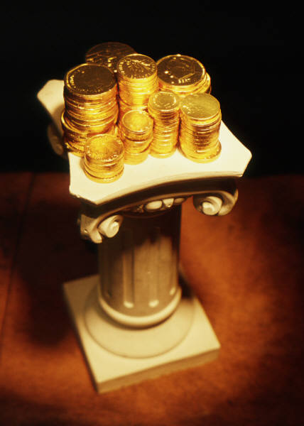
The Gold Standard
SOUND MONEY
Store of Value
Inflation

Slide 47
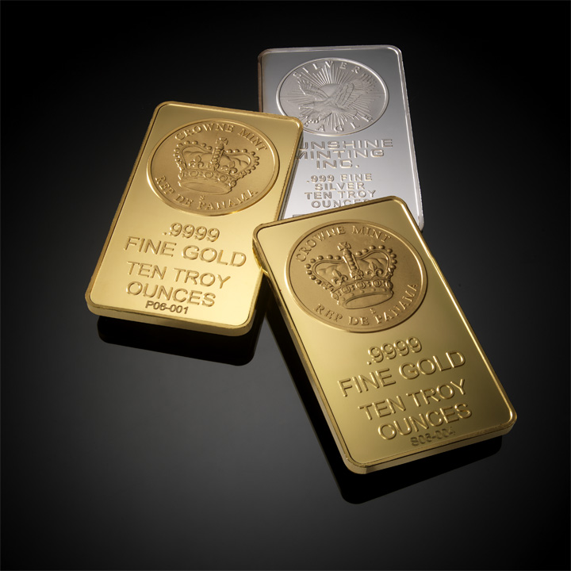
Bimetallism
Some rights reserved by digitalmoneyworld

Slide 48
Forms of Currency
2
Some rights reserved by digitalmoneyworld

Slide 49
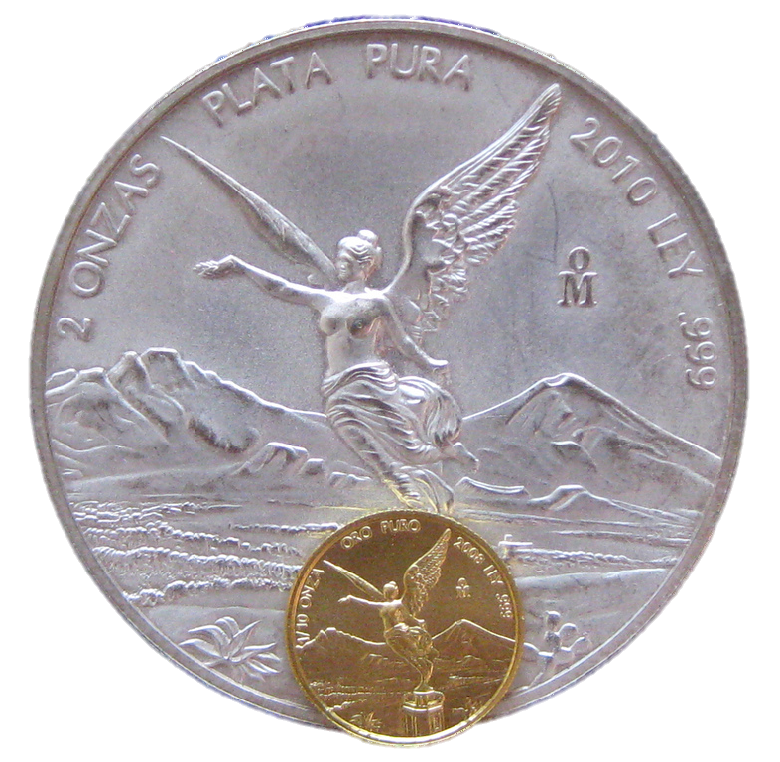
16:1
Some rights reserved by sirqitous

Slide 50
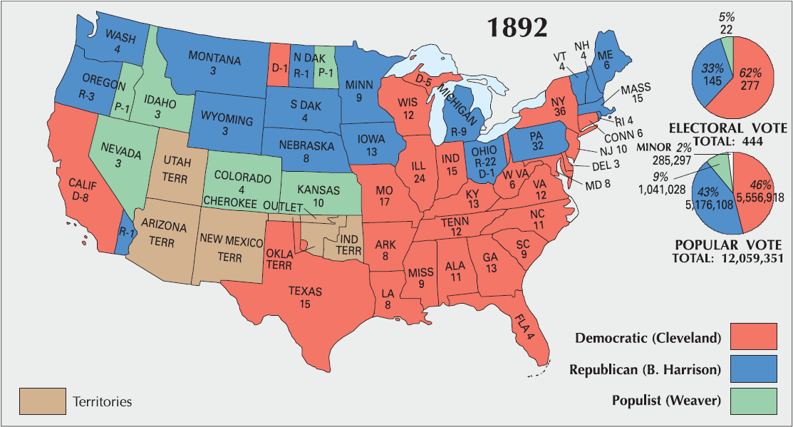
Election of 1892
1892
1896
1900

Slide 51
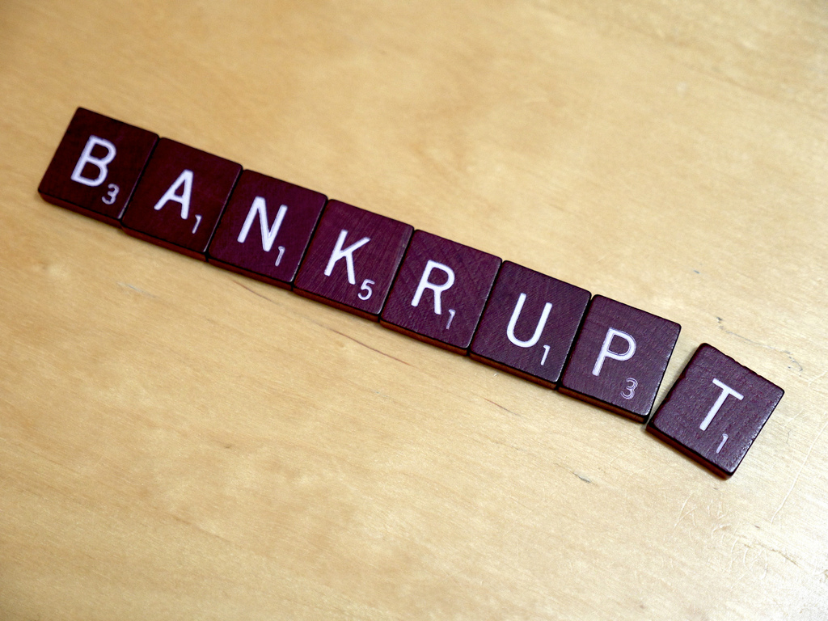
Panic of
1893
Economy = BAD
Some rights reserved by LendingMemo

Slide 52
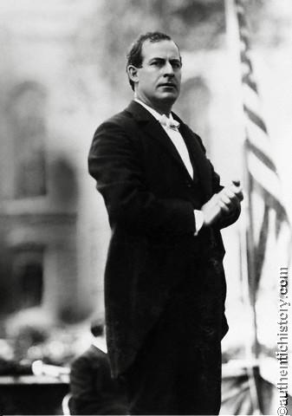
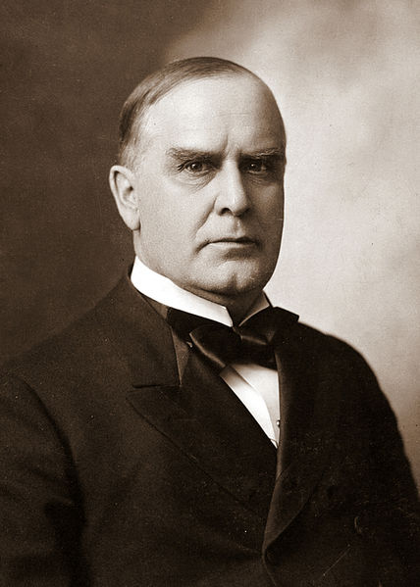
Election of 1896
vs.
William Jennings Bryan
(D-NE)
William McKinley
(R-OH)

Slide 53
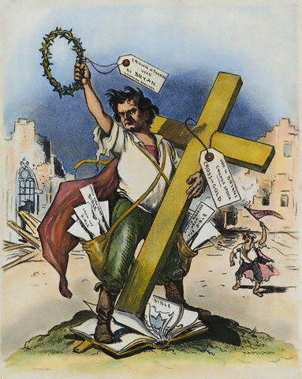
“Cross of Gold Speech”
1896 Democratic National Convention
“If protection has slain its thousands the gold standard has slain its tens of thousands.”
-- W.J. Bryan
Cartoon from Judge Magazine, 1896

Slide 54
“Cross of Gold Speech”
1896 Democratic National Convention
“You shall not press down upon the brow of labor this crown of thorns! You shall not crucify mankind upon a cross of gold!”
-- W.J. Bryan
Cartoon from Judge Magazine, 1896

Slide 56

Populists Endorse
Bryan
Bryan

Slide 57
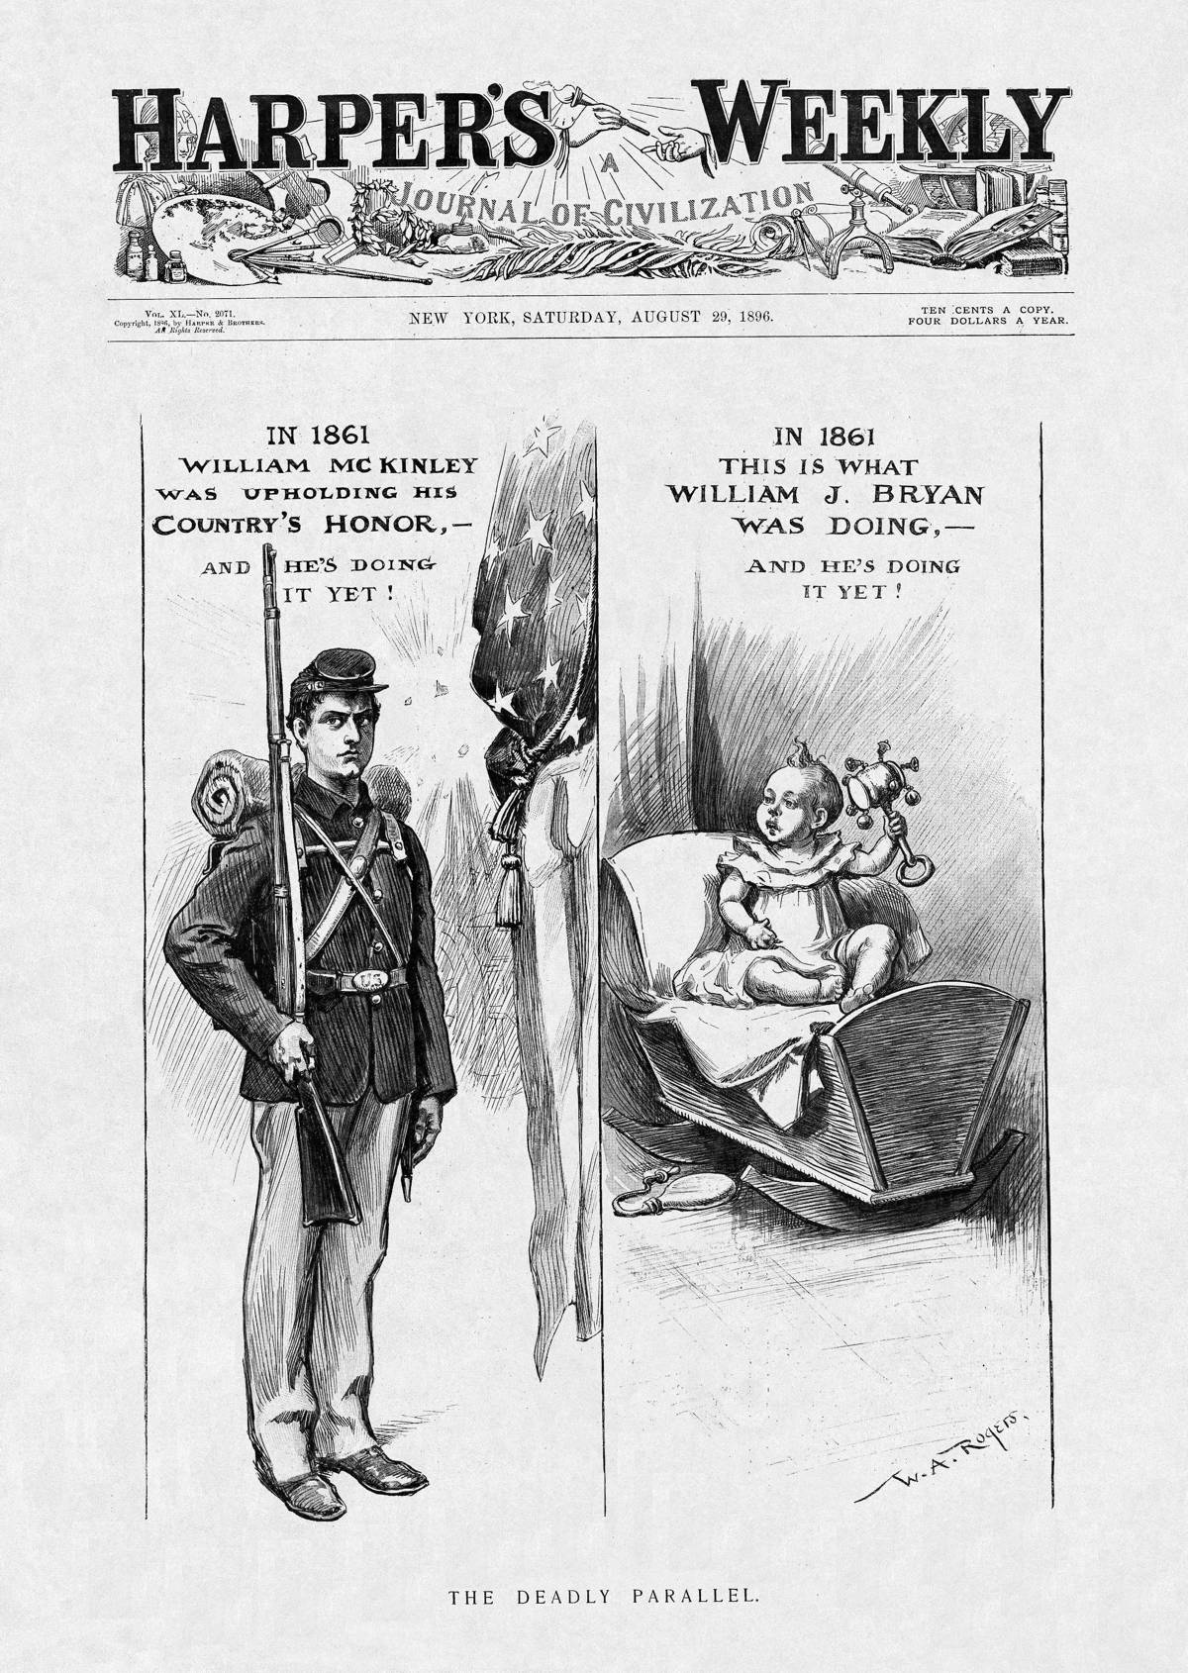
A
Republican Political Cartoon

Slide 58
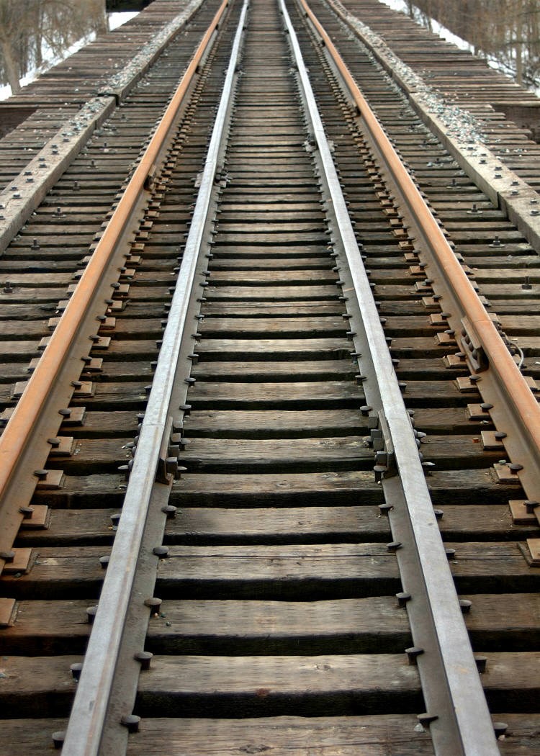
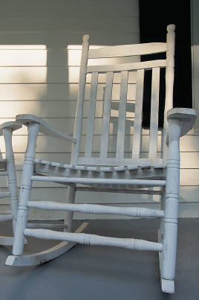
The Train vs. the Porch

Slide 59
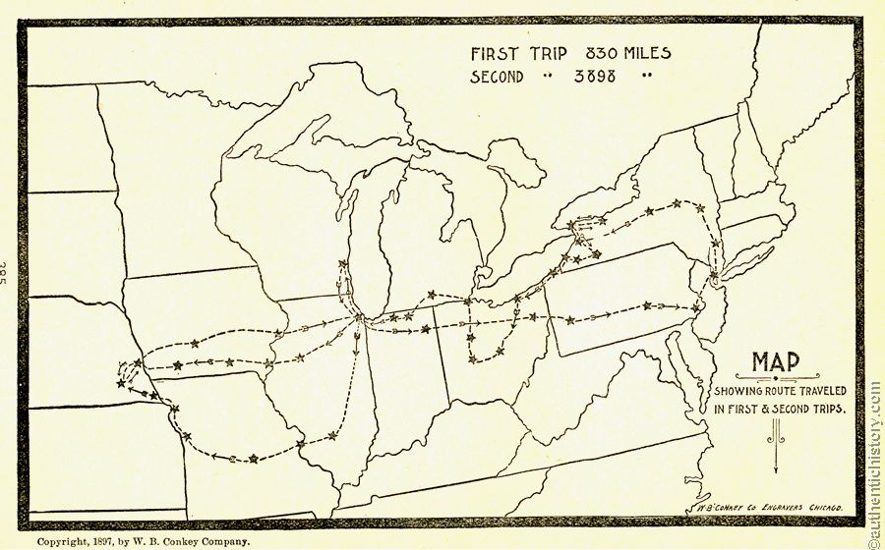

Bryan’s Campaign Tour
http://www.authentichistory.com/1865-1897/progressive/mckinley/WJB_Campaign_Maps_From_The_First_Battle.html

Slide 60
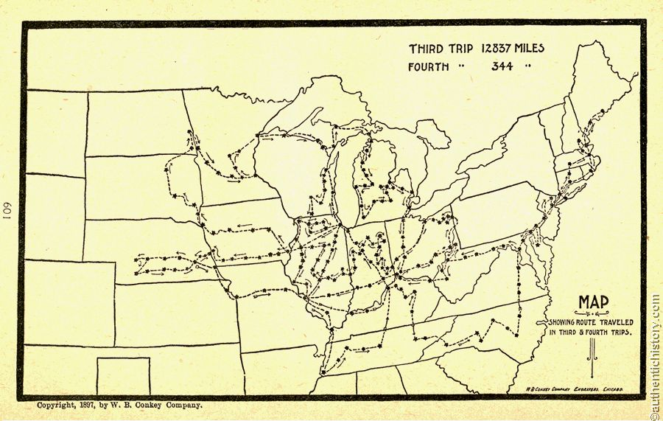
Bryan’s Campaign Tour
http://www.authentichistory.com/1865-1897/progressive/mckinley/WJB_Campaign_Maps_From_The_First_Battle.html

Slide 61
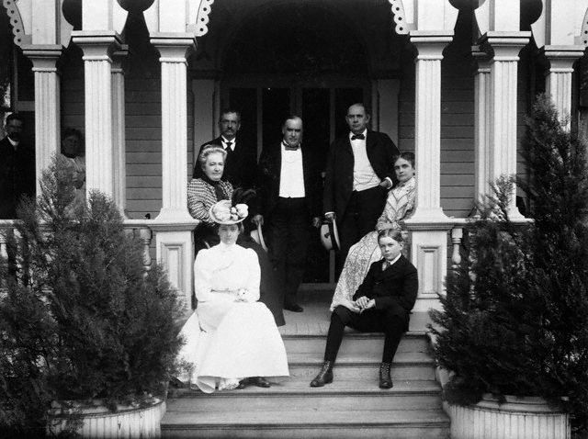
McKinley’s “Front Porch” Campaign
Mark Hanna
Monopolist turned campaign manager

Slide 62

The Keys
to Political Victory

Slide 63
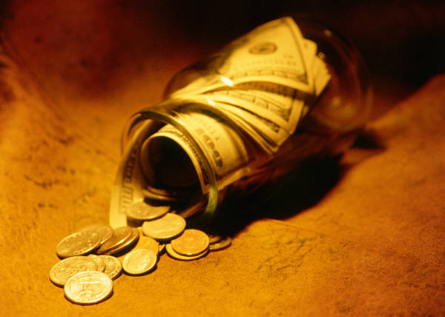
Money

Slide 64

Fear

Slide 65
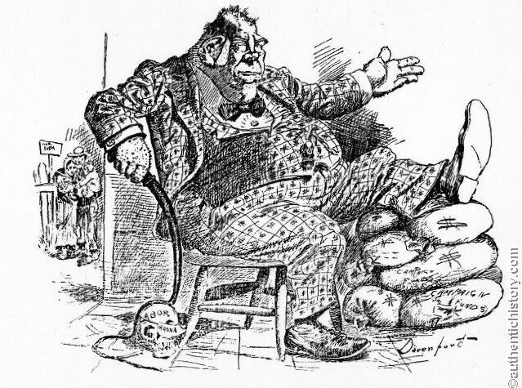
“I am confident the workingmen are with us.” -- Mark Hanna

Slide 66
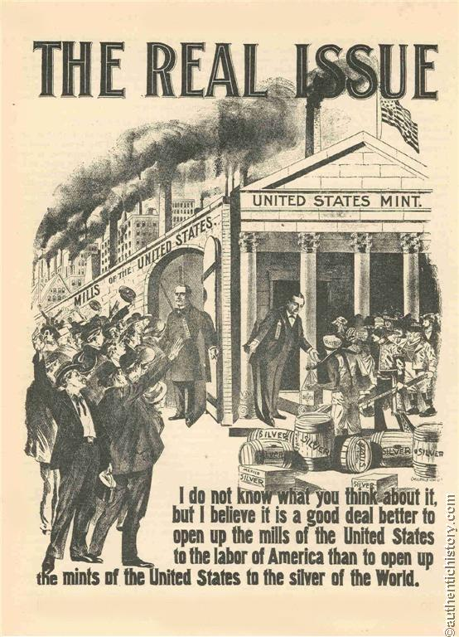

Slide 67


Slide 68

An Easy Choice…

Slide 69


Slide 70

Election of 1896
1892
1896
1900

Slide 71


Slide 72

The Sound Money Scare
BOTTOM LINE:
We all want more money, but we also want our money to be worth something.

Slide 73



Sound Money WINS!
but so do the monopolists.

Slide 74

The Rematch
1892
1896
1900

Slide 75







