Slide 1
1968
“The Year Everything Went Wrong”

Slide 2
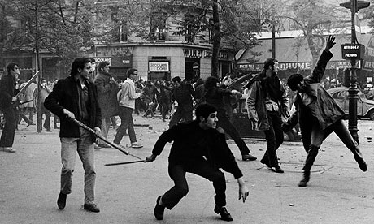
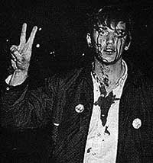
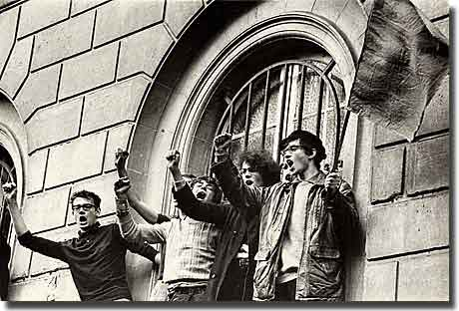
Uprising at Columbia University
April - NYC
Students protesting apparent racial bias & war-related research
Students seize campus buildings & officials
After 6 days, police use force to end uprising - hundreds arrested
Investigation shows police brutality & University neglect of student concerns

Slide 3
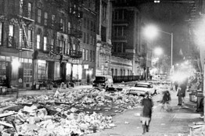
Civil Servant Strikes
New York City sanitation workers walk out for more $
Stench = Raise in wages
NYPD “Blue Flu”
NYFD stopped fire safety inspections
NYC teachers walk out 3 times over $

Slide 4
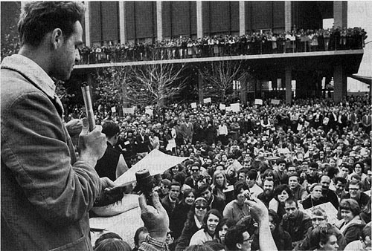
Protest Movement
Students for a Democratic Society (1962)
Port Huron Statement - a call for more activism among students
Jack Weinberg- “Don’t trust anyone over 30!”
arrested at Cal for refusing to take down a CORE information table … leads us to...
Mario Savio- “Berkley Free Speech Movement.”
“I’m tired of reading about history. I want to make it.”
Let’s “put our bodies against the gears, against the wheels… and make the machine stop until we’re free.”
Anti-War “Teach Ins”
Notes:
3

Slide 5
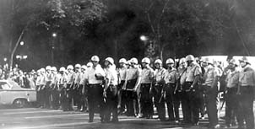
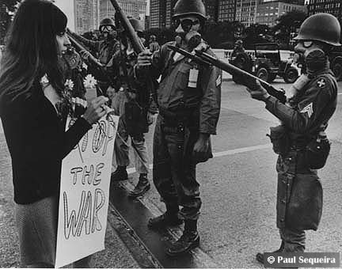
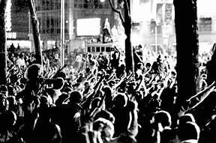
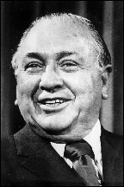
Democratic National Convention
Held in Chicago - August 1968
10K come to protest U.S. policy on Vietnam
Chicago Mayor Richard Daley surrounds convention hall w/ fences
Police, troops, FBI agents, etc. on full alert for trouble

Slide 6
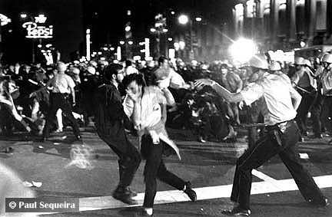
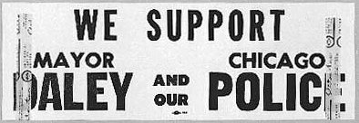
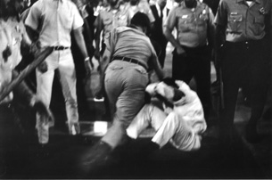
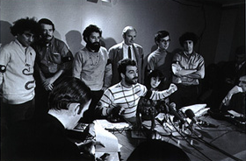
DNC continued
Protestors forbidden to march
Police beat them when they tried
100’s injured

Slide 7
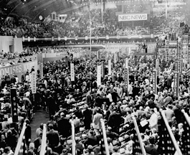
Trouble inside DNC as well
Pro- and anti-war delegates argued over Vietnam policy
Attempts made to silence anti-war delegates
Anti-war delegates ultimately removed from the convention

Slide 8
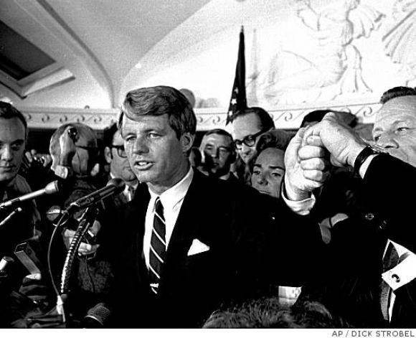
Democratic Party is Split
Eugene McCarthy (MN) the anti-war candidate - a serious contender
Robert Kennedy enters the race.
Assassinated before election (6/5/68)
LBJ withdraws - had little chance
Hubert Humphrey- “The Politics of Joy”
“The Happy Warrior”
Notes:
4

Slide 9
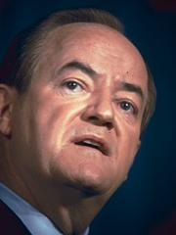
Hubert Humphrey
Humphrey won the Democratic nomination
Party platform supported current administration policy on Vietnam
Significant dissention over platform

Slide 10
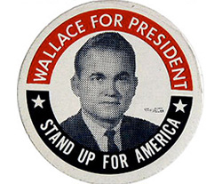
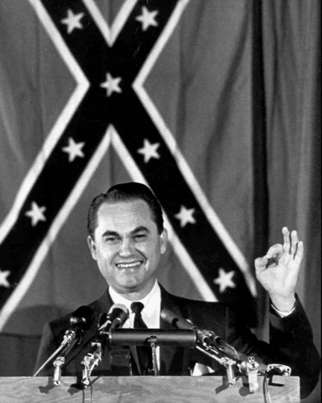
George Wallace
the American Independent Party
Segregationist & a “Hawk”
“There’s not a dime’s worth of difference between Democrats and Republicans.”
“America love it or leave it.”
Notes:
5

Slide 11
Republicans rally behind the “New” Nixon
Comes back from 1962 loss in California governor’s race.
Seen as a “center-right” candidate
Promises “peace with honor” in Vietnam, law & order at home
Portrays himself as the voice of the silent majority
Notes:
6

Slide 12
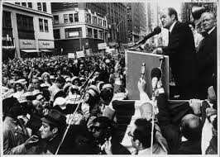
Humphrey vs. Nixon
Humphrey had trouble from the start
LBJ did not convincingly endorse him
Party divided over the war

Slide 13
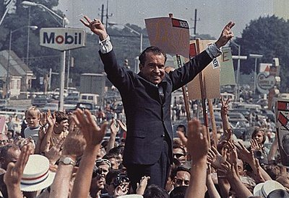
H vs. N cont.
Republicans ran strong campaign
“Peace with honor”
Nixon running mate was Spiro Agnew - the “shrill partisan” of the ticket
Nixon confident of victory

Slide 14
Results of the Election
One month before election, Humphrey changes stand on Vietnam (now supports LBJ)
Nixon wins with 43.4% of votes
about 1% difference from Humphrey
Electoral vote Nixon 301, Humphrey 191, Wallace 46
Wallace & other minor parties drew votes from both major tickets
Notes:
7

Slide 15
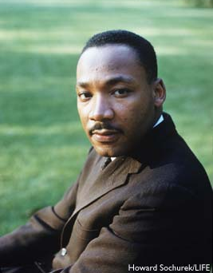
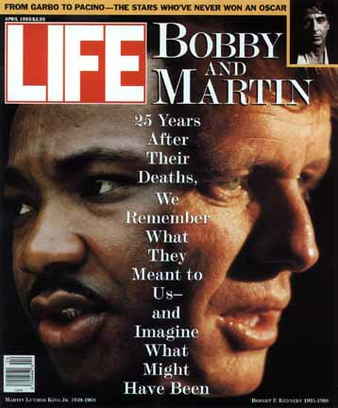
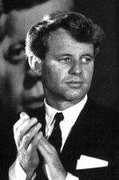
A year of assassinations
Martin Luther King Jr.
Robert Kennedy

Slide 16
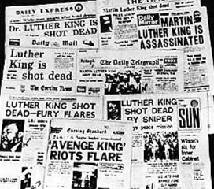
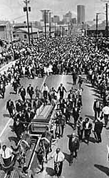
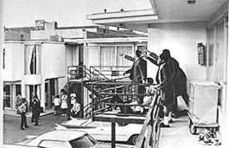
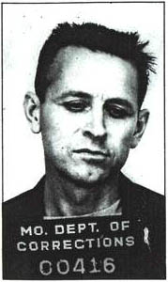
Martin Luther King Jr.
Shot April 4, 1968
Memphis, TN
Riots broke out in 40 cities
Funeral in Atlanta - Televised
Assassin - James Earl Ray

Slide 17
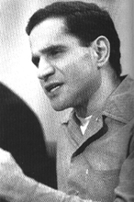
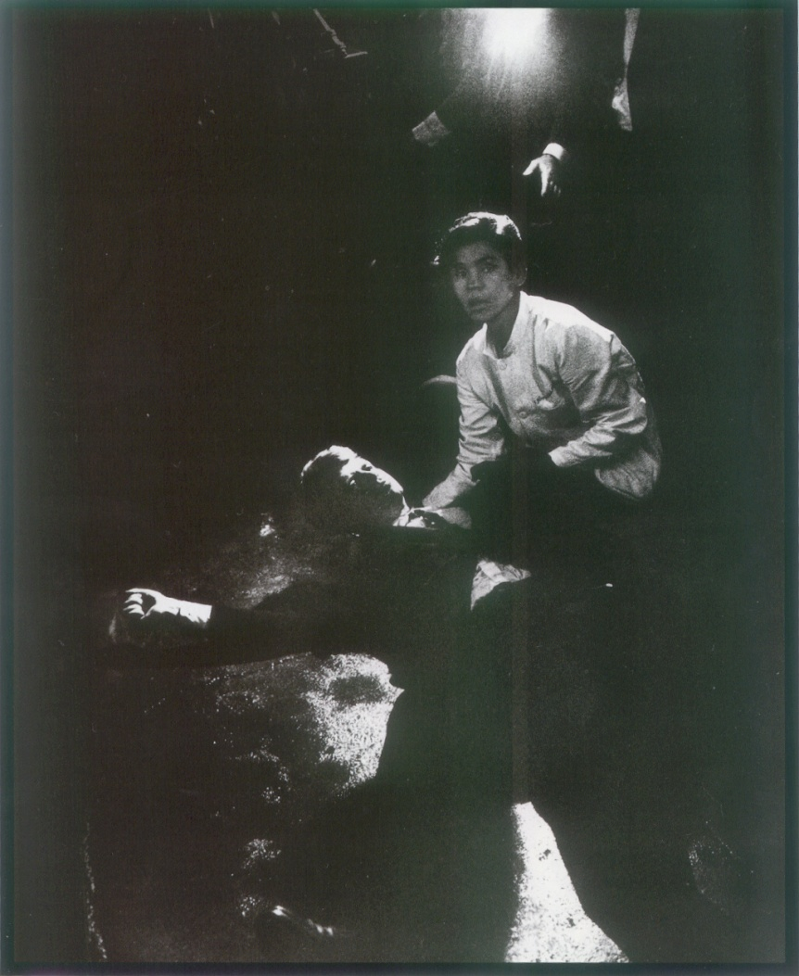
Robert Kennedy
Killed June 4, 1968
Sirhan Sirhan - Jordanian Arab
Angry over Kennedy support of Israel
Same day as big Kennedy victory in California Democratic Primary
Had locked Demo Nomination

